Slide 1
Conservation Coaches Network Workshop Presentation
The Open Standards for the Practice of Conservation Planning, Managing, Monitoring, and Learning from Projects (and Programs) at All Scales

Slide 2
Attribution
Product of the Conservation Coaches Network, 2012
These presentations were developed based on materials from Foundations of Success (FOS), The Nature Conservancy (TNC), and World Wildlife Fund (WWF).
CCNet strongly recommends that this presentation is given by experts familiar with the adaptive management process presented by the Conservation Measures Partnership’s Open Standards for the Practice of Conservation.
You are free to share this presentation and adapt it for your use. Please attribute the work to CCNet or FOS, TNC and WWF. If you significantly alter, transform, or build upon this work, it may be appropriate to remove the CCNet logo.

Slide 3
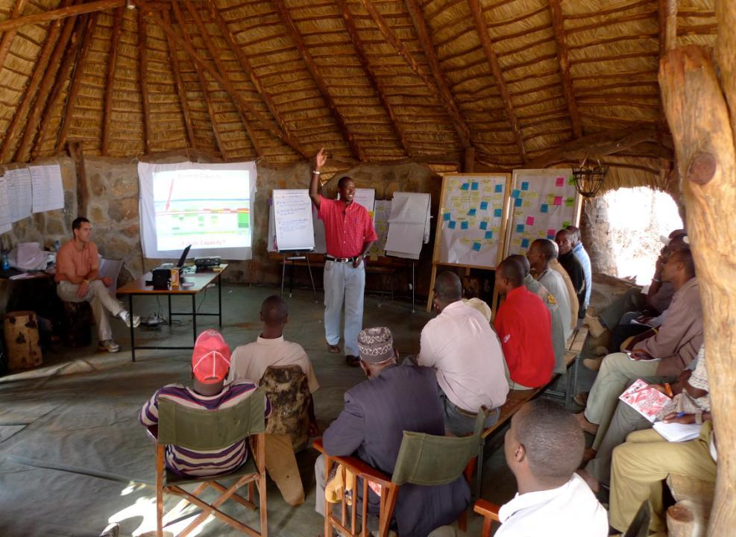
CAP Stories from around the World
Why we like CAP
Northern Kenya Rangelands
Notes:
Tribal leaders and local people across adjacent 2 million acres of communal lands are coming together to develop a shared approach to managing the precious forage, wildlife resources and water that they all depend on using this method. And as one tribal leader said “The CAP [Open Standards] workshop has shown us how to move forward. By setting priorities with our neighboring conservancies, there is real hope that we can make progress.” (they call their collectives “land conservancies”.)

Slide 4
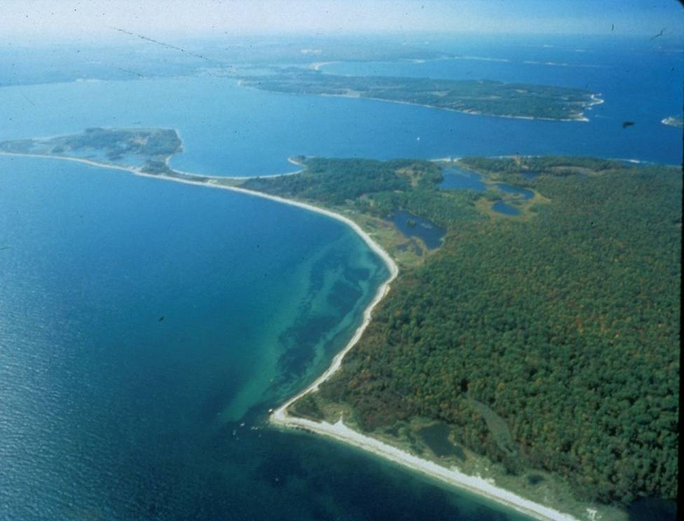
Peconic Estuary, New York
Notes:
In the Peconic Estuary,
Oystermen, fishermen, Town councilors, NGOs got together using CAP [Open Standards] to forge a plan for their estuary and now …..new scallop spawning sanctuaries have been created and scallop harvest regulations have been modified.
Baymen and Long Island towns have banded together to fund the purchase of clams to release into the new sanctuaries
And the Scallop and hard clam populations are increasing in the Estuary.

Slide 5
Mesoamerican Reef
Notes:
At the Cayos Cochinos National Monument, Fisherman, tourism operators, government and NGO representatives hadn’t even finished their Protected Area plan which used the CAP [Open Standards] framework and the group had all agreed to and pushed for expansion of the sanctuary boundaries to include four critical spawning areas.
The process revealed clearly for all to see that it was in all of their best interest to protect his additional area in the sanctuary.

Slide 6
Whooping Crane Range-wide Conservation Plan
Notes:
When you now think about developing a shared conservation plan for this magnificent species --- what are some of the things you would want to have in your plan of action?
Let participants brain storm some components of a good action plan…..

Slide 7
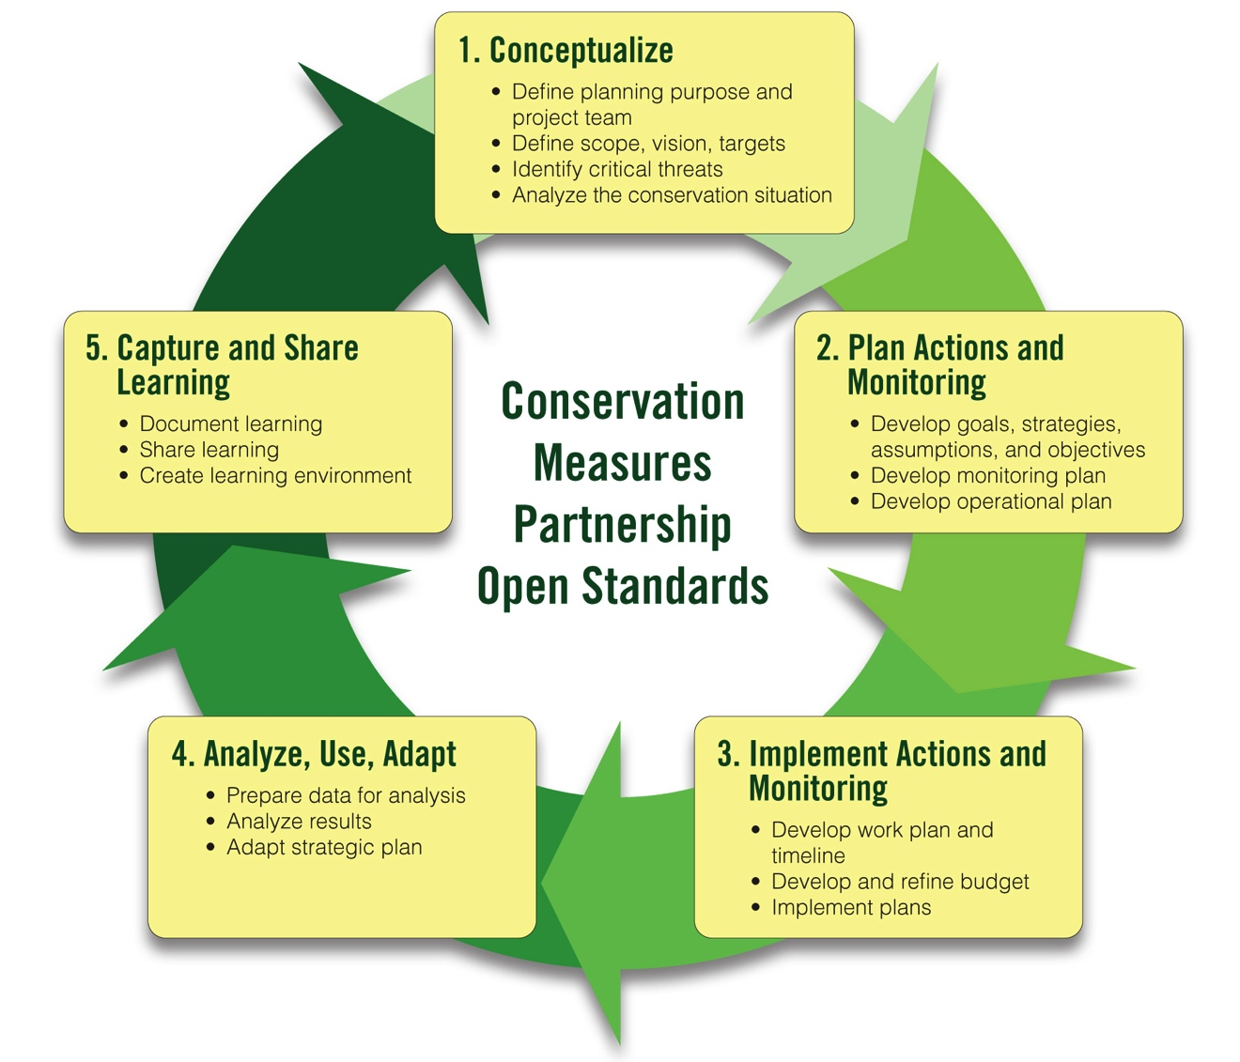
CMP Open Standards for the Practice of Conservation
www.conservationmeasures.org
Notes:
What all of these projects – and many more – have in common is the use of the Conservation Measures Partnership’s Open Standards for the Practice of Conservation.

Slide 8
This Presentation
What is adaptive management?
Brief summary of the Open Standards for the Practice of Conservation
Resources available to support implementation of the Open Standards

Slide 9
Why Do Adaptive Management?
Are we achieving an impact?
Are we doing the right things?
Are we doing them well?
Notes:
Many conservation professionals are asking these questions. Adaptive management is designed to help answer these questions.

Slide 10
What is Adaptive Management?
The integration of project or program planning, management, and monitoring to provide a framework for:
Testing assumptions
Learning
Adapting
Notes:
Adaptive management is designed to answer the questions on the previous slide. Adaptive management allows teams to change quickly when no going in the right direction rather than waiting until the end of a project to determine it did not work.
There are different definitions of adaptive management out there. This is the Conservation Measures Partnership’s definition.

Slide 11
Adaptive Management Combines Action and Research
Notes:
Ready, Fire, Aim

Slide 12
Adaptive Management Combines Action and Research
Notes:
Ready, Ready, Ready

Slide 13
Adaptive Management Combines Action and Research

Slide 14
The Basic Project Management Cycle
Notes:
The basic project management/adaptive management cycle includes these 4 steps (some groups add a “share” step after adapt).

Slide 15
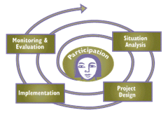
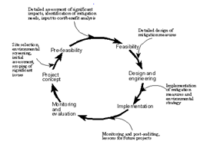
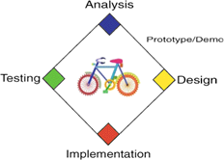
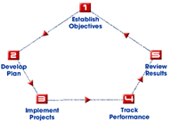
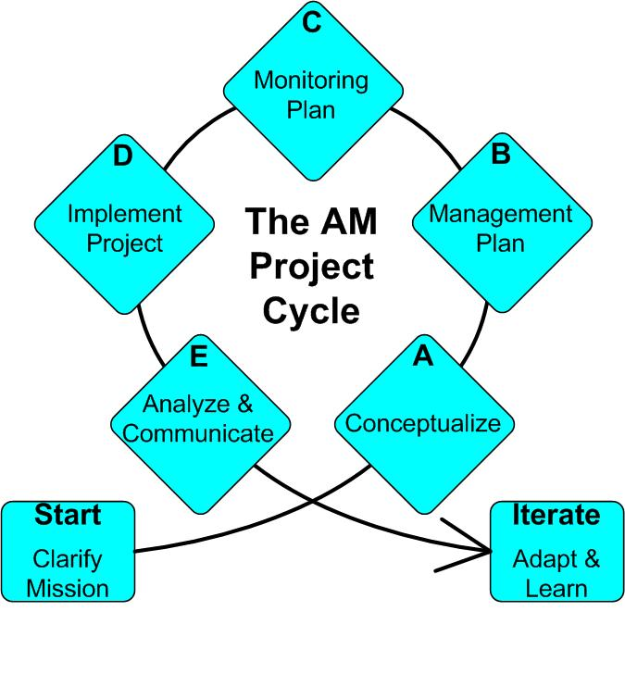
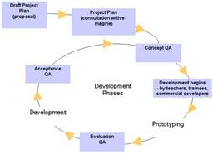
Many Versions of Adaptive Management in Practice
Notes:
Point is – there are a lot of different cycles out there, but if you really look closely at them, they are conceptually very similar. Once you learn one cycle, you probably know 90% of what you would see in any other cycle.
It doesn’t matter which cycle you use – what’s important is that you follow a systematic process

Slide 16
The Conservation Measures Partnership (CMP)
Notes:
The Conservation Measures Partnership (CMP) was formed in 2002 by representatives of the organizations on the top line of this slide: Foundations of Success (FOS), The Nature Conservancy (TNC), World Wildlife Fund (WWF), African Wildlife Foundation (AWF), Wildlife Conservation Society (WCS) and Conservation International (CI). CMP has grown since then and each year there are new organizational members – which makes it hard to keep this slide up to date! (This is the 2013 version.) Several private foundations – some of whom used to provide financial support for CMP – are now members of the partnership.

Slide 17
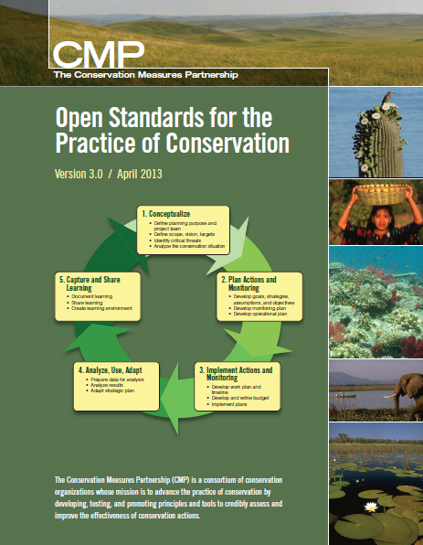
Open Standards for the Practice of Conservation
Developed by leading orgs & agencies
Draws on many fields
Open source & common language
Used around the world
State Wildlife Agencies
National Park Systems
Donor Funding Programs
Academic Training
Notes:
Version 3.0 was published in April 2013 and was a joint effort between many individuals and organizations.

Slide 18
What is Our Approach to Adaptive Management?
www.conservationmeasures.org

Slide 19
This Presentation
What is adaptive management?
Brief summary of the Conservation Measures Partnership’s Open Standards for the Practice of Conservation
Resources available to support implementation of the Open Standards

Slide 20
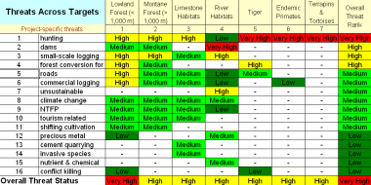
Brief Summary of the Open Standards
Summarize what you want to conserve
Understand current & desired condition
Identify and rank threats
Develop a general model of socioeconomic-ecological system
Identify strategies based on the general model
Define theories of change to show how strategies will work
Implement the strategies, checking as you go
Adjust
Notes:
Diagram icons are there to refer to the steps in Miradi (you could remove if you are not using the software but they might also be helpful).

Slide 21
Brief Summary of the Open Standards
Summarize what you want to conserve
Notes:
Any conservation site, no matter how small, contains thousands of species when we consider invertebrates. But that is too much complexity to plan for – so we try to summarize the biodiversity of a site but identifying “conservation targets.”

Slide 22
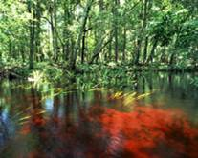
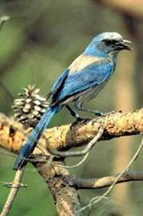
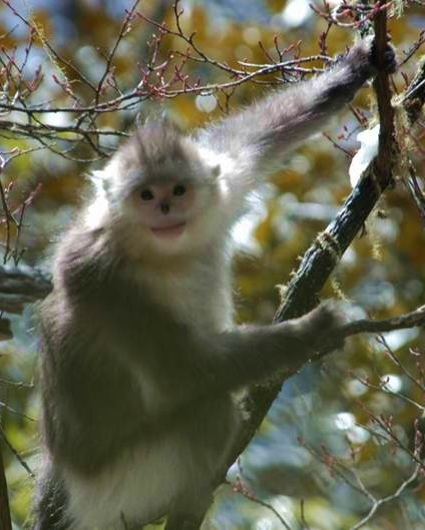
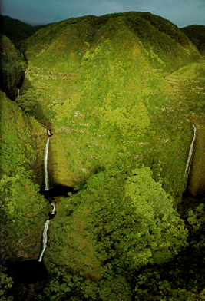
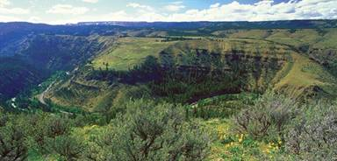
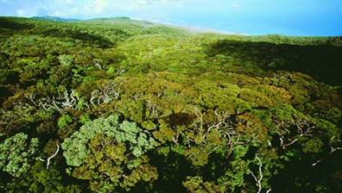
1. Summarize what you want to conserve
Notes:
Conservation targets can include
Species
communities,
and ecological systems.
Conservation targets are selected to encompass and represent the needs of the broader set of biodiversity occurring within the project.

Slide 23
1. Summarize what you want to conserve
1. Seabirds
2. Pinnipeds
3. Pelagic Fish
4. Sea-Ice
Ecosystem
5. Sea otter
6. Whales
7. Bottom Dwelling
Fish & Crabs
8. Coastal Lagoons
9. Maritime
Island Tundra
Kittiwakes
Murres
Cormorants
Northern fur seal
Stellar sea lion
Harbor seal
Pacific salmon
Pollock
Spectacled eider
Walrus
Polar bear
Sea otter
Kelp forests
Orca
Gray whale
Beluga whale
Rockfish
Crab
Coral & sponge gardens
Juvenile fish & shellfish
Herring
Pribilof rock sandpiper
Pribilof shrew
Pribilof arctic fox
Aleutian whitlow grass
Black-footed brown lemming
Passerines
Notes:
This is an example of how you can simplify and summarize your targets.
Biodiversity targets can be focal species, or habitats/ ecological systems. From an initial list of possible targets, you should identify the eight or fewer targets that best meet the following criteria:
• Represent the biodiversity at the site. The focal targets should represent or capture the array of ecological systems, communities and species at the project area and the multiple spatial scales at which they occur. A target that complements other focal targets in this respect is more desirable.
• Reflect ecoregion or other existing conservation goals. Focal targets should reflect efforts at the regional, national or state level where they exist such as Ecoregional Assessments, State Conservation Plans, or a national biodiversity action plan. Focal targets that are grounded in the reasons for the project area’s inclusion in existing plans are desirable.
• Are viable or at least feasibly restorable. Viability indicates the ability of a conservation target to persist for many generations. If a target is on the threshold of collapse, or conserving a proposed target requires extraordinary human intervention, it may not represent the best use of limited conservation resources.
• Represent the critical threats at the site. All else being equal, focusing on highly threatened targets will help ensure that critical threats are identified and addressed through conservation actions.
TERRESTRIAL PROJECTS (from Ecoregions to Individual Protected Areas)
1 (or 2) major ecosystems (the matrix, whether forest or grassland or...)
2-3 minor ecosystems
1 (or 2) freshwater systems (usually at least river ecosystems, but sometimes lakes and/or wetlands as well)
the rest are species
FRESHWATER PROJECTS (from Ecoregions to basins)
River ecosystems (might be one habitat with below nested, or the below may be targets themselves)
main river channel
overbank wetland habitats (flooded seasonally)
riparian habitats (when forest present, typically)
Lake ecosystems
Wetlands
the rest are species
MARINE PROJECTS (from Ecoregions to Individual Protected Areas)
Tropical
Coral Reefs
Seagrasses
Mangroves
Northern/Polar
Sea Ice Communities
Polar-Temperate Convergence System
Plus (Can be common to any marine system)
Island habitats (when small islands are present, the terrestrial habitats are often included as a target)
Coastal wetlands/lagoons
Seamounts
Pelagic habitats
Soft bottom communities

Slide 24
Brief Summary of the Open Standards
Summarize what you want to conserve
Understand current & desired condition
Notes:
How are the conservation targets doing? It is important to know which conservation targets are faring well and which are not doing as well. In order to determine this, need to break the targets down into “key ecological attributes” and associated indicators. For each of the indicators, we should strive to understand the current status as well as the desired future status.

Slide 25
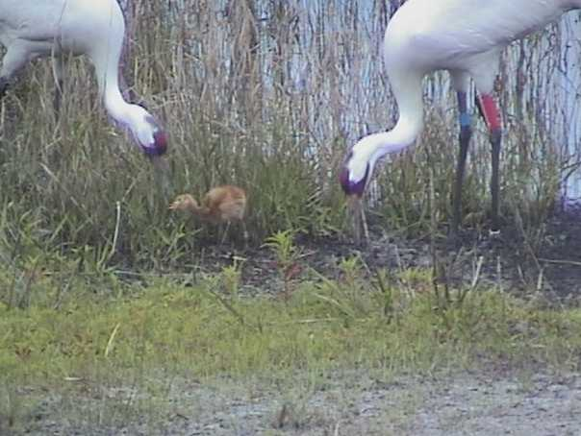
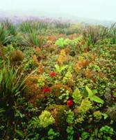
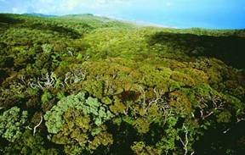
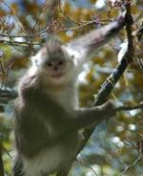
2. Understand Current & Desired State of What You Want to Conserve
What do you want to conserve?
What is your best estimate of how it’s doing?
Viability Summary
East Molokai
Targets |  | Landscape Context | Condition | Size | Viability Rank
1 | North Shore Forests & Cliffs | Fair | Good | Fair | Fair
2 | Montane Wet Forest | Fair | Very Good | Fair | Good
3 | South Slope Mesic Forest & Shrubland | Poor | Good | Poor | Fair
Overall Biodiversity Health Rank |  |  |  |  | Fair
Notes:
The Open Standards approach asks us to consider:
What is it we want to conserve (the conservation targets)?
What is our current best understanding of what these things need to be “healthy”?
What condition is our system in right now?

Slide 26
2. Understand Current & Desired State of What You Want to Conserve
POOR
FAIR
GOOD
VERY GOOD
Current
Status
5-yr Interim
Objective
10-yr Interim
Objective
Long-term
Desired
Status
Historical*
Level
Notes:
The Open Standards characterizes the size, condition, or landscape context of an ecosystem or species on a four point scale of Poor, Fair, Good, Very Good – each with its own objective criteria. The most important distinction is between Fair (not viable in the long-term and requiring significant human intervention for maintenance) and Good (viable for the long-term and requiring only modest human intervention for maintenance).
In this degraded site example, the historical condition of an ecosystem or species may have been on the far right of this diagram, but is currently on the far left. The idea is to move the state of the indicators for the ecosystem or species towards the right. Over 5 years you might be able to move the “needle” into the Fair range, and after 10 years you might be able to get it into the Good, or viable range. Your ultimate conservation goal may be somewhere in the middle of the Good range, and it may simply be impractical or even impossible to regain the Very Good range.

Slide 27
Brief Summary of the Open Standards
Summarize what you want to conserve
Understand current & desired condition
Identify and rank threats
Notes:
Remember that threats are projected into the future. You have assessed the impact of past threats when you ranked the condition

Slide 28
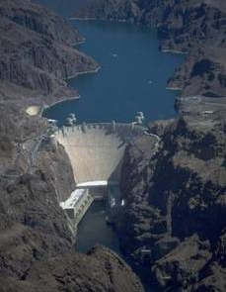
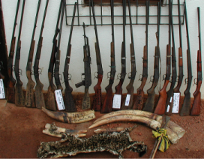
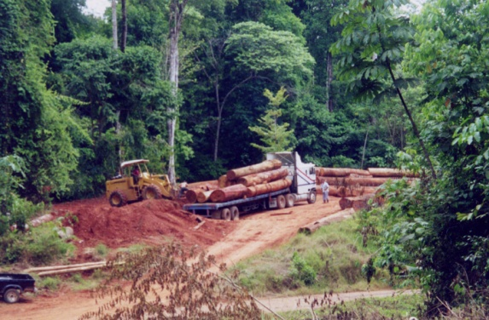
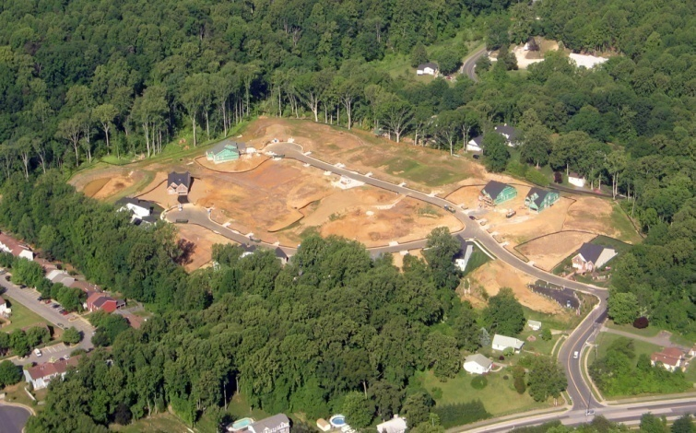
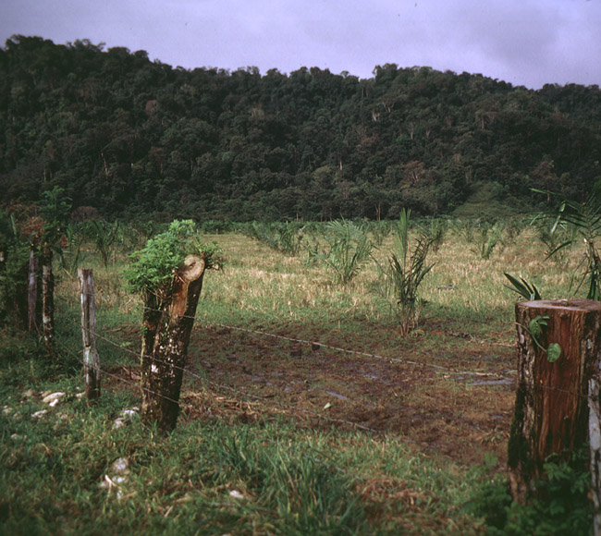
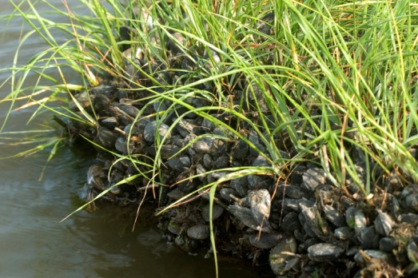
Identify and Rank Threats
Unsustainable Logging
Unsustainable harvest
Operation of Dams
Exotic/Invasive Species
Residential Development
Incompatible Livestock Grazing
Photo: Adrian Jones,
IAN Image Library
Notes:
threat ranking methodology
3-5-7 Rule
3 H = 1 VH
5 M = 1 H
7 L = 1 M
Plus 2-prime rule
Criteria for Direct Threat Rankings
Scope – Most commonly defined spatially as the geographic scope of impact on the conservation target at the site that can reasonably be expected within 10 years under current circumstances (i.e., given the continuation of the existing situation).
Very High: The direct threat is likely to be very widespread or pervasive in its scope, and affect the conservation target throughout the target’s occurrences at the site.
High: The direct threat is likely to be widespread in its scope, and affect the conservation target at many of its locations at the site.
Medium: The direct threat is likely to be localized in its scope, and affect the conservation target at some of the target’s locations at the site.
Low: The direct threat is likely to be very localized in its scope, and affect the conservation target at a limited portion of the target’s location at the site.
Severity – The level of damage to the conservation target that can reasonably be expected within 10 years under current circumstances (i.e., given the continuation of the existing situation).
Very High: The direct threat is likely to destroy or eliminate the conservation target over some portion of the target’s occurrence at the site.
High: The direct threat is likely to seriously degrade the conservation target over some portion of the target’s occurrence at the site.
Medium: The direct threat is likely to moderately degrade the conservation target over some portion of the target’s occurrence at the site.
Low: The direct threat is likely to only slightly impair the conservation target over some portion of the target’s occurrence at the site.
Irreversibility – The degree to which the effects of a direct threat can be restored. Note that irreversibility refers to the "effects of the direct threat on the target" not the direct threat itself – you can think of it as the "recoverability" of the target from the effects of the threat.
Very High: The effects of the direct threat are not reversible (e.g., wetlands converted to a shopping center).
High: The effects of the direct threat are reversible, but not practically affordable (e.g., wetland converted to agriculture).
Medium: The effects of the direct threat are reversible with a reasonable commitment of resources (e.g., ditching and draining of wetland).
Low: The effects of the direct threat are easily reversible at relatively low cost (e.g., off-road vehicles trespassing in wetland).

Slide 29
Identify and Rank Threats
Notes:
threat ranking methodology
3-5-7 Rule
3 H = 1 VH
5 M = 1 H
7 L = 1 M
Plus 2-prime rule
Criteria for Direct Threat Rankings
Scope – Most commonly defined spatially as the geographic scope of impact on the conservation target at the site that can reasonably be expected within 10 years under current circumstances (i.e., given the continuation of the existing situation).
Very High: The direct threat is likely to be very widespread or pervasive in its scope, and affect the conservation target throughout the target’s occurrences at the site.
High: The direct threat is likely to be widespread in its scope, and affect the conservation target at many of its locations at the site.
Medium: The direct threat is likely to be localized in its scope, and affect the conservation target at some of the target’s locations at the site.
Low: The direct threat is likely to be very localized in its scope, and affect the conservation target at a limited portion of the target’s location at the site.
Severity – The level of damage to the conservation target that can reasonably be expected within 10 years under current circumstances (i.e., given the continuation of the existing situation).
Very High: The direct threat is likely to destroy or eliminate the conservation target over some portion of the target’s occurrence at the site.
High: The direct threat is likely to seriously degrade the conservation target over some portion of the target’s occurrence at the site.
Medium: The direct threat is likely to moderately degrade the conservation target over some portion of the target’s occurrence at the site.
Low: The direct threat is likely to only slightly impair the conservation target over some portion of the target’s occurrence at the site.
Irreversibility – The degree to which the effects of a direct threat can be restored. Note that irreversibility refers to the "effects of the direct threat on the target" not the direct threat itself – you can think of it as the "recoverability" of the target from the effects of the threat.
Very High: The effects of the direct threat are not reversible (e.g., wetlands converted to a shopping center).
High: The effects of the direct threat are reversible, but not practically affordable (e.g., wetland converted to agriculture).
Medium: The effects of the direct threat are reversible with a reasonable commitment of resources (e.g., ditching and draining of wetland).
Low: The effects of the direct threat are easily reversible at relatively low cost (e.g., off-road vehicles trespassing in wetland).

Slide 30
Brief Summary of the Open Standards
Summarize what you want to conserve
Understand current & desired state of conservation
Identify and rank threats
Develop a general model of socioeconomic-ecological system

Slide 31
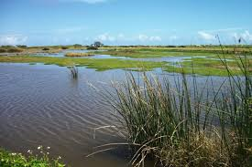
General model of socioeconomic-ecological system

Slide 32
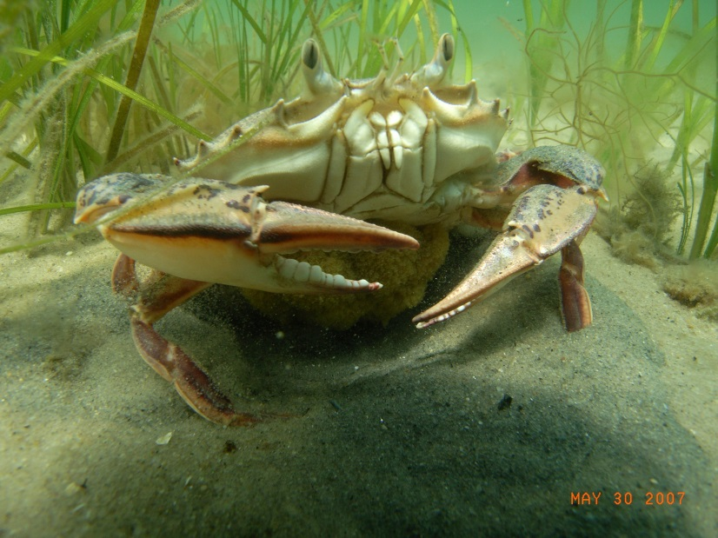
General model of socioeconomic-ecological system

Slide 33
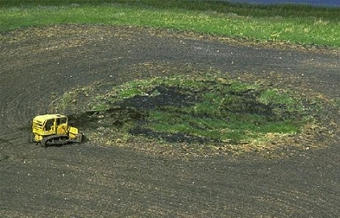
General model of socioeconomic-ecological system

Slide 34
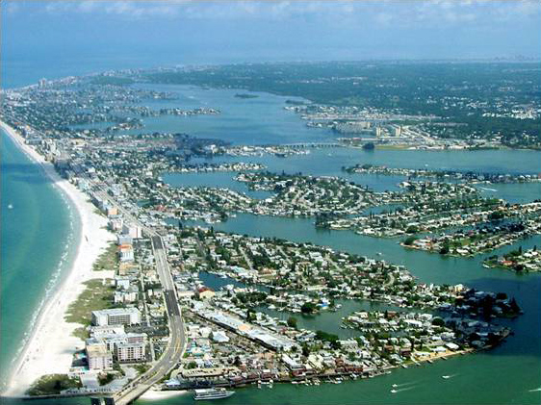
General model of socioeconomic-ecological system

Slide 35
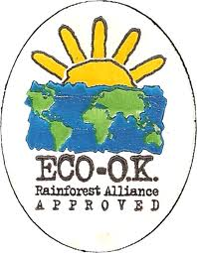
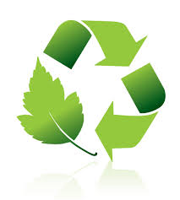
Develop a General Model of Socioeconomic-Ecological System
Notes:
Don’t forget about opportunities – factors that can contribute to reducing your direct threat. These are examples of certification programs that are responding to the opportunity.

Slide 36
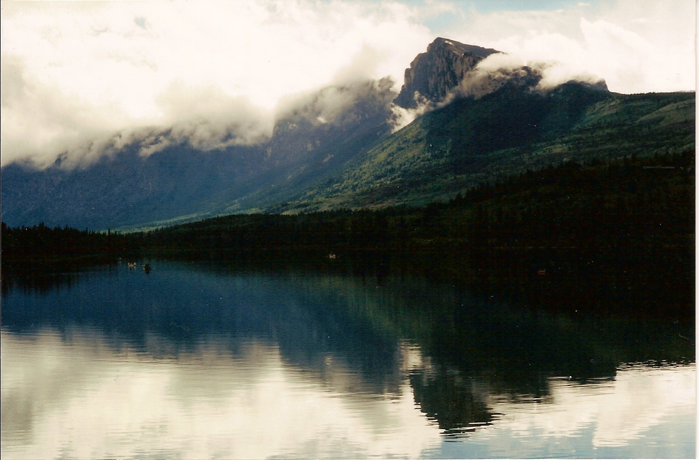
Develop a General Model of Socioeconomic-Ecological System
Notes:
An example of a full conceptual model

Slide 37
Brief Summary of the Open Standards
Summarize what you want to conserve
Understand current & desired condition
Identify and rank threats
Develop a general model of socioeconomic-ecological system
Identify strategies based on the general model

Slide 38
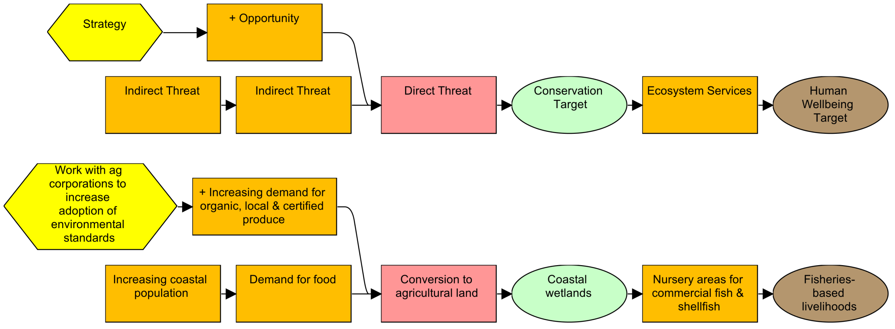
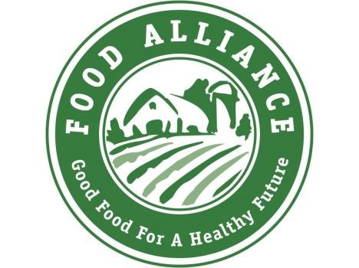
5. Identify Strategies Based on the General Model

Slide 39
5. Identify Strategies Based on the General Model
Create market incentives for best practices

Slide 40
Brief Summary of the Open Standards
Summarize what you want to conserve
Understand current & desired condition
Identify and rank threats
Develop a general model of socioeconomic-ecological system
Identify strategies based on the general model
Define theories of change to show how strategies will work

Slide 41
6. Theories of Change to Show How Strategies Will Work
Human
Wellbeing
Necessary
Material
Health
Security
Good Social
Relations
Freedom &
Choice

Slide 42
6. Theories of Change to Show How Strategies Will Work

Slide 43
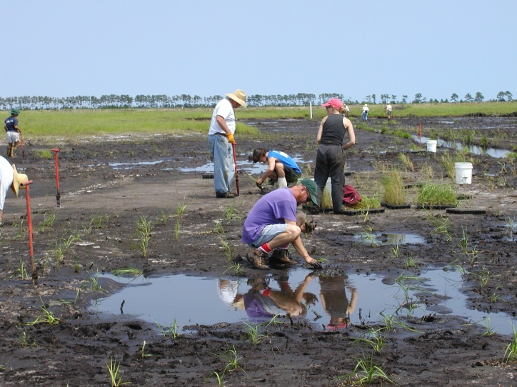
6. Theories of Change to Show How Strategies Will Work

Slide 44
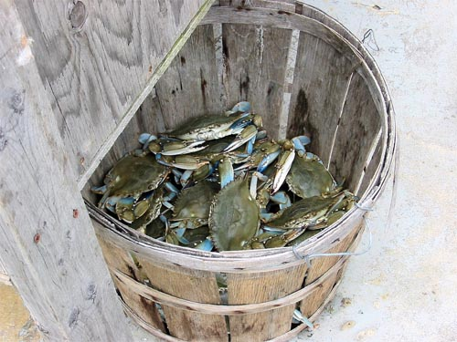
6. Theories of Change to Show How Strategies Will Work

Slide 45
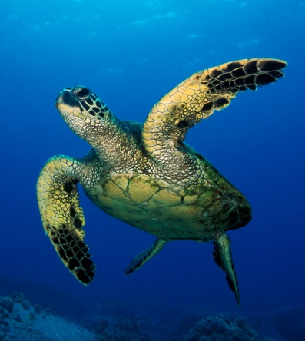
Example of a Real Theory of Change

Slide 46
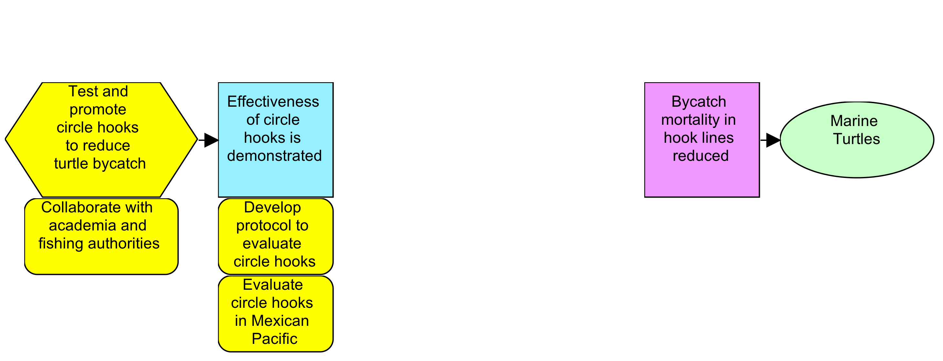
Example of a Real Theory of Change

Slide 47
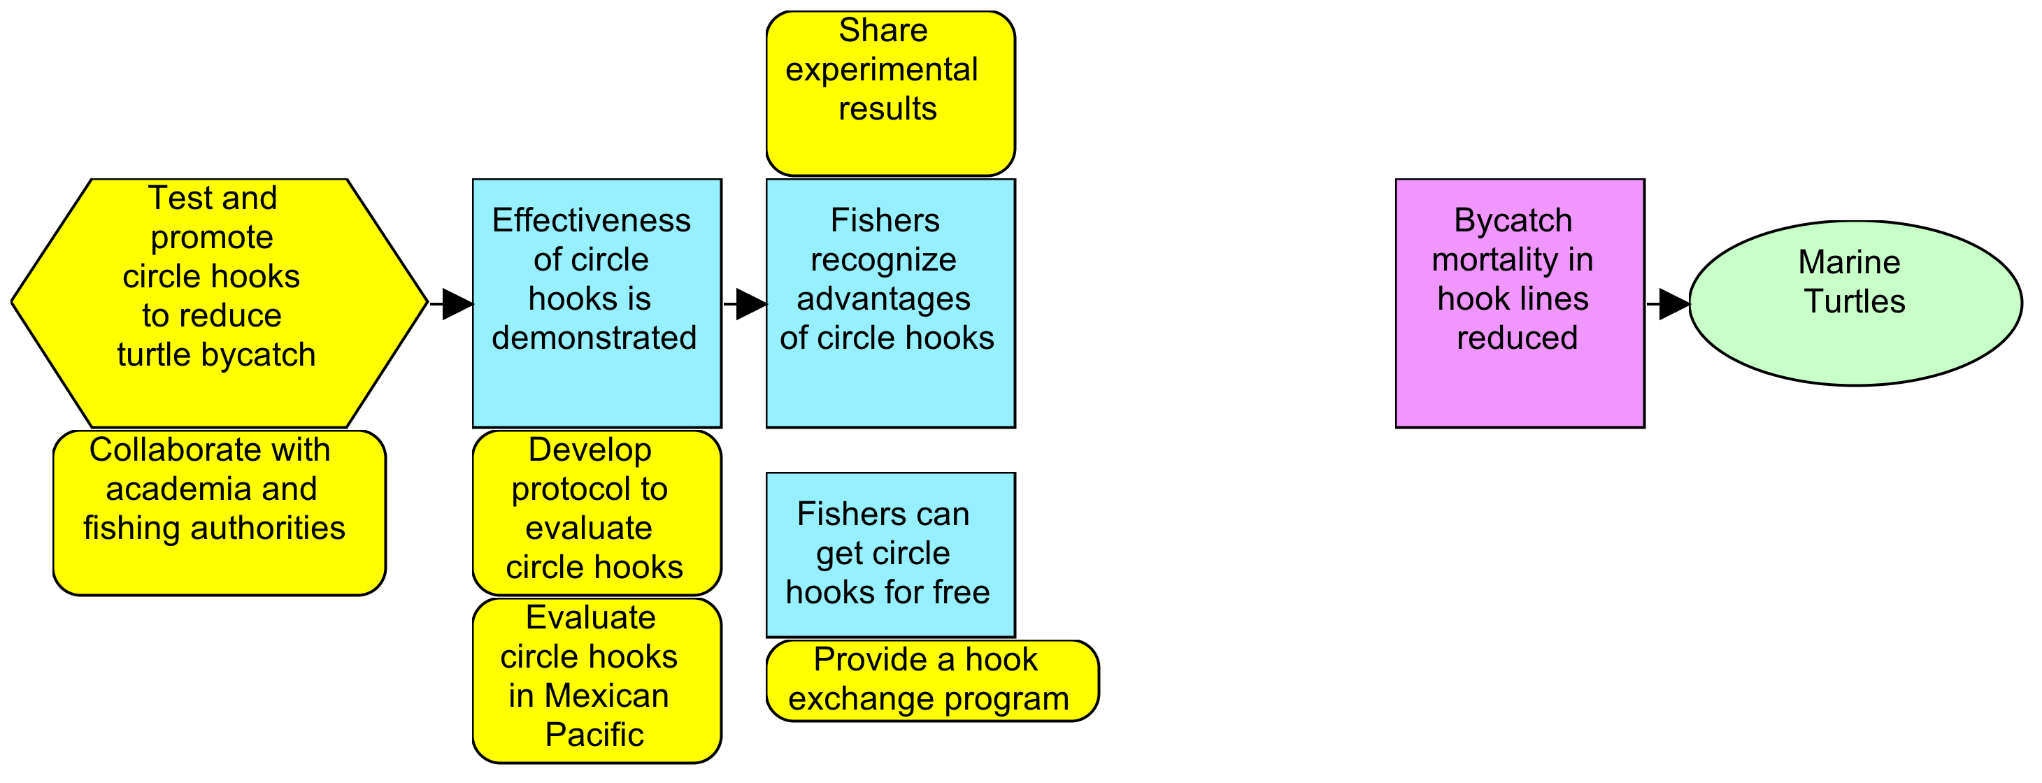
Example of a Real Theory of Change

Slide 48
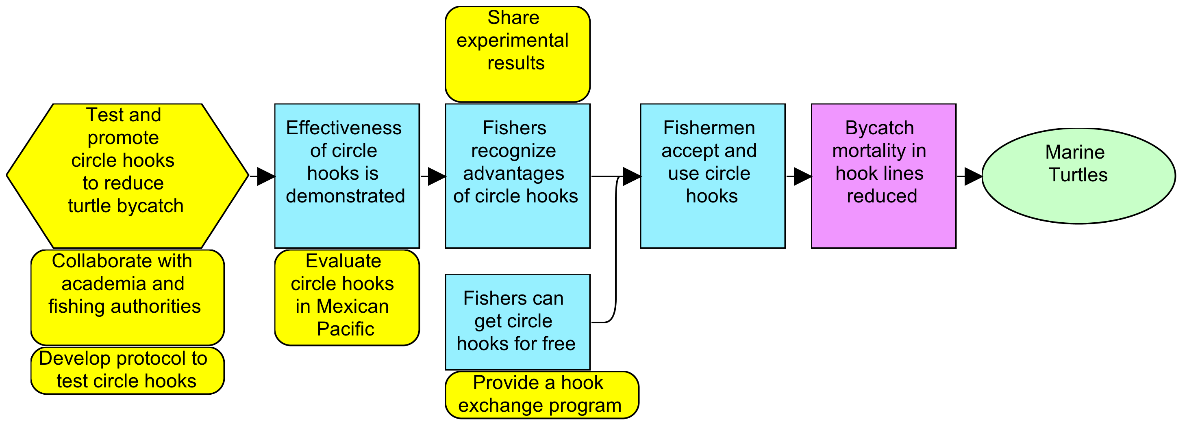
Example of a Real Theory of Change
Measurable Goal:
By 2025, there will be a 10% increase in the survival of leatherback and green turtles into the GoC compared to 2005 levels.
Indicator: Abundance Index
Method: Counting of nesting turtles
Date: Every three years, starting in 2007
Responsible Entity: Turtle camps personnel
Place: Baja California Sur and Michoacán turtle camps

Slide 49
Example of a Real Theory of Change
Measurable Objective:
By 2012, 90% of the Gulf’s artisanal longliner fleet will operate with circle hooks.
Indicator: Percentage of boats using circle hooks
Measurable Objective:
By 2009, we will have a proven method (circular hooks) to significantly reduce marine turtle bycatch from the artisanal longline fleets from 12 locations on the Mexican Pacific.
Indicator: Circular hooks bycatch rate for marine turtle
Measurable Objective:
By 2010, at least 220,000 circular hooks will have been exchanged for the same number of type “J” hooks in the artisanal longliner fleet in the GoC.
Indicator: Number of “J” hooks exchanged for circular hooks

Slide 50
Example of a Real Theory of Change
Activity Planning:
By July 2008, carry out 10 three-day fishing trials in three different locations using circular hooks. Publish full report by November 2008.
Activity Planning:
By January 2009, develop, staff, publicize and initiate major hooks exchange campaign initiative in three regions.

Slide 51
Brief Summary of the Open Standards
Summarize what you want to conserve
Understand current & desired condition
Identify and rank threats
Develop a general model of socioeconomic-ecological system
Identify strategies based on the general model
Define theories of change to show how strategies will work
Implement the strategies, checking as you go
Adjust

Slide 52
Brief Summary of the Open Standards
Summarize what you want to conserve
Understand current & desired condition
Identify and rank threats
Develop a general model of socioeconomic-ecological system
Identify strategies based on the general model
Define theories of change to show how strategies will work
Implement the strategies, checking as you go
Adjust

Slide 53
This Presentation
What is adaptive management?
Brief summary of the Conservation Measures Partnership’s Open Standards for the Practice of Conservation
Resources available to support implementation of the Open Standards

Slide 54
Resources Available to Support Implementation of Open Standards
Guidance and training materials
CMP-IUCN Standard Classifications
Miradi software
Conservation Coaches Network
Teaching Adaptive Management Network
Notes:
This is an introductory slide, to introduce the next few slides.

Slide 55
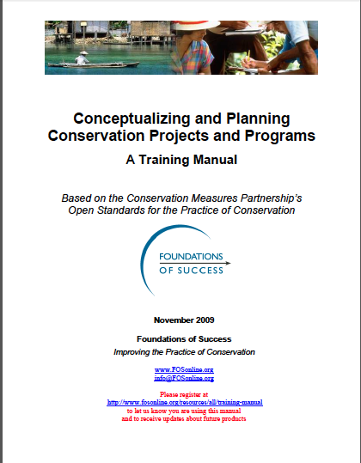
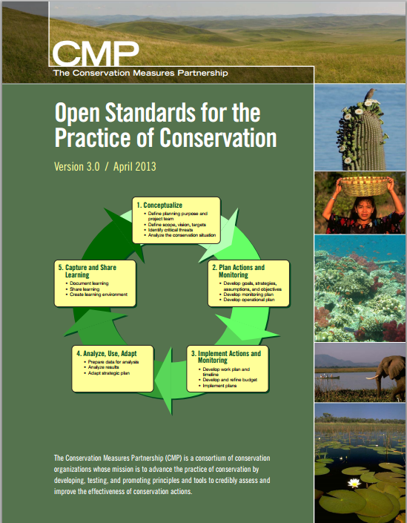
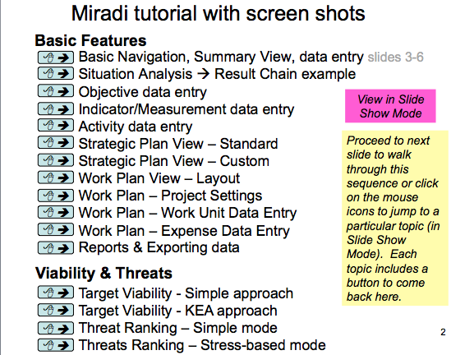
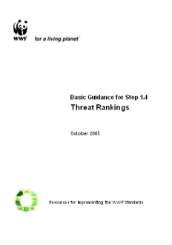
Examples of Guidance & Training Materials

Slide 56
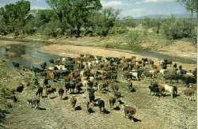
We Need Standard Terms to Describe Conservation
Cows?
Cattle?
Livestock?
Grazing?
Ranching?
Notes:
Just as doctors have standard terms to describe illnesses, conservation practitioners need standard terms to describe threats to biodiversity and conservation strategies.
If we use different terms to describe the threats we are addressing and the strategies we are implementing, then it will be harder for people who are working on the same threats / implementing the same strategies to find one another and learn from one another. For example, if I call the threat cattle ranching and you call it grazing, then it will be harder for us to find another

Slide 57
CMP-IUCN Standard Classifications
CMP-IUCN Taxonomy of Conservation Actions
Notes:
To meet this need, CMP and IUCN have worked together to develop a Taxonomy of Conservation Actions and a Taxonomy of Direct Threats to Biodiversity. In using this taxonomy of conservation actions, conservation teams use their own name for a strategy (e.g., translocation of endangered species) but then use the taxonomy to CLASSIFY their strategy as an example of Species Management.

Slide 58
Miradi Software
TM
Adaptive Management Software
for Conservation Projects
www.Miradi.org or info@Miradi.org
CMP
The Conservation Measures Partnership
Notes:
The Miradi software was developed as a tool for implementing the Open Standards. It was developed by CMP in partnership with Benetech, a software non-profit.

Slide 59
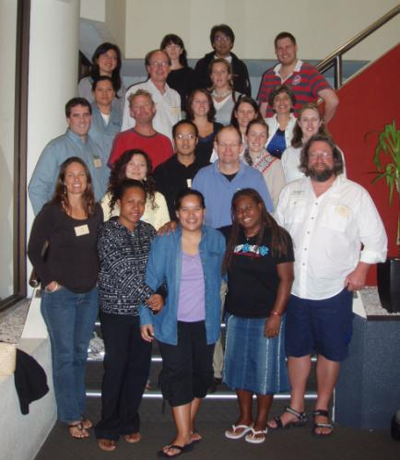
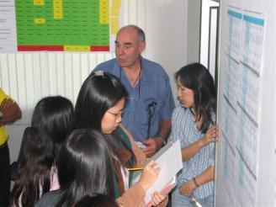
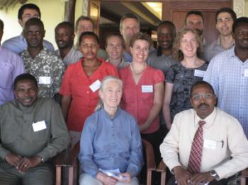
Conservation Coaches Network
Notes:
The Conservation Coaches Network (CCNet) is a very important resource. It is a network of conservation practitioners who help conservation teams to apply the Open Standards.

Slide 60
Conservation Coaches Network
Mission - catalyze effective conservation worldwide through action planning, coaching, knowledge sharing, and innovation

Slide 61
Coaches Around the World
290 Coaches 82 Organizations
57 Countries
(As of May 2013)
Notes:
Conservation Coaches Network – engaged board
Active list serve
Materials accessed and downloaded - 8000 hits/month

Slide 62
Find a Coach Map
http://maps.tnc.org/ccnet/

Slide 63
Graduate Courses in Adaptive Management
Building capacity to do good Adaptive Management from the beginning of conservation careers
Notes:
Academic courses based on the Open Standards have been developed at all of these universities, to give graduate students (and in some cases undergraduates) the opportunity to learn how to design, plan and monitor conservation projects, as they are just beginning their careers in conservation.

Slide 64
Teaching Adaptive Management Learning Network http://teachadaptivemanagement.pbworks.com
Notes:
The Teaching Adaptive Management (TAM) network is a resource for people who are working to develop academic courses based on the Open Standards. TAM has a website with curricula from past and existing courses.

Slide 65
All aiming for one thing… Great conservation of Great Places!
Notes:
This process has one aim and one aim only – to get conservation work done in real places on this earth.

