Slide 1
Conservation Coaches Network Workshop Presentation
1C. Identify and Rate
Critical Threats

Slide 2
Attribution
Product of the Conservation Coaches Network, 2012
These presentations were developed based on materials from Foundations of Success (FOS), The Nature Conservancy (TNC), and World Wildlife Fund (WWF).
CCNet strongly recommends that this presentation is given by experts familiar with the adaptive management process presented by the Conservation Measures Partnership’s Open Standards for the Practice of Conservation.
You are free to share this presentation and adapt it for your use. Please attribute the work to CCNet or FOS, TNC and WWF. If you significantly alter, transform, or build upon this work, it may be appropriate to remove the CCNet logo.

Slide 3
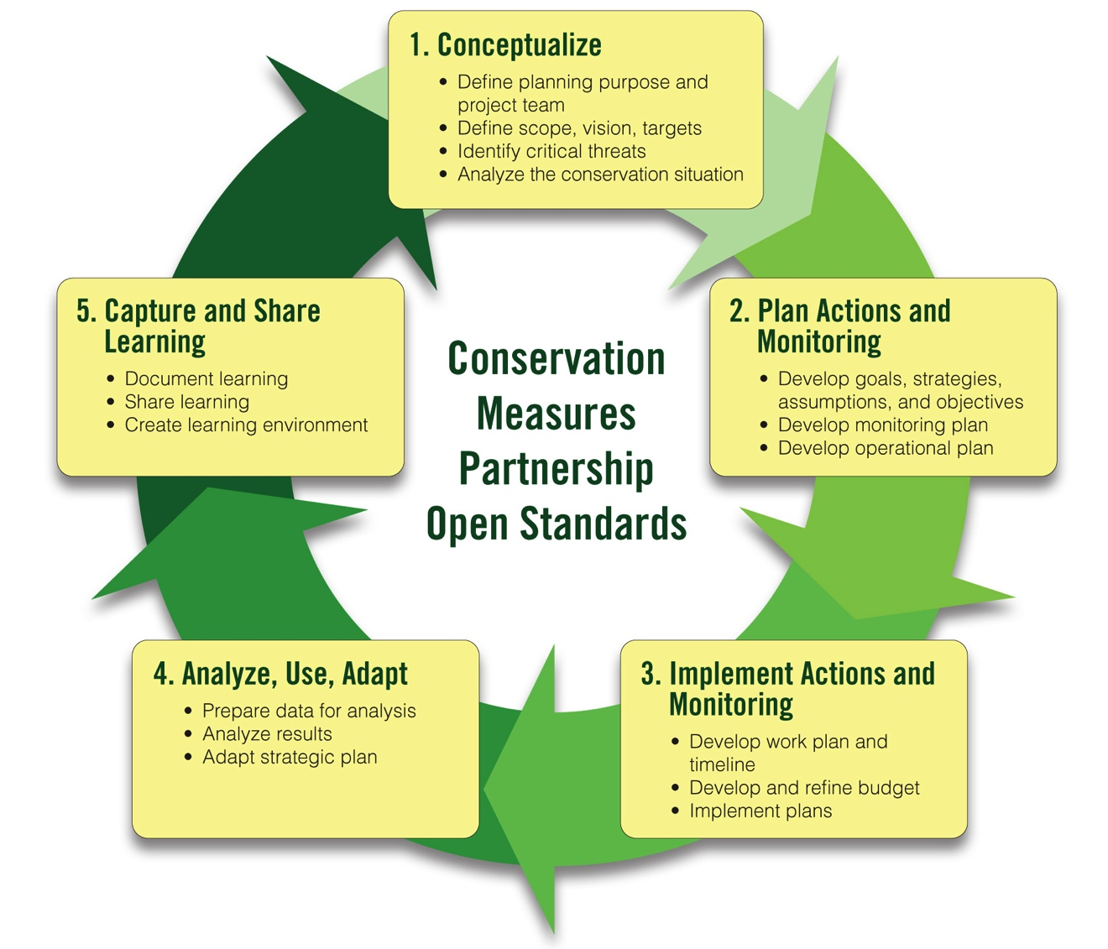
Adaptive Management Workshop Presentations
1A-1B. Team, Scope, Vision
1B. Conservation Targets
1B. Viability Assessment
2A-1. Strategy Selection
2A-2. Results Chains
2A-3. Goals and Objectives
1C. Threat Rating
1D. Conceptual Models
2B. Monitoring Plan

Slide 4
Conceptualize
Threats

Slide 5
This Presentation
Threats
What is a Direct Threat
How to Identify and Rank Direct Threats

Slide 6
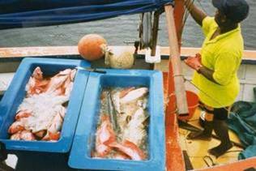
What is a Direct Threat?
Threats
Direct Threats: Human-induced actions or events that will
directly degrade one
or more conservation
targets
Direct threats are:
usually human activities, but they can be
natural phenomena altered by human activities or whose impact is increased by human activities
(e.g., global climate change causing increased frequency of drought threatening wetlands)
Notes:
6

Slide 7
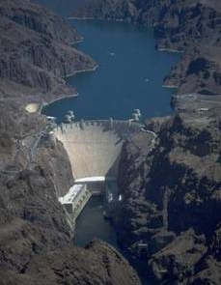
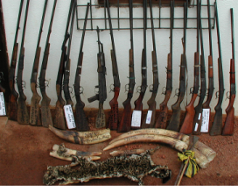
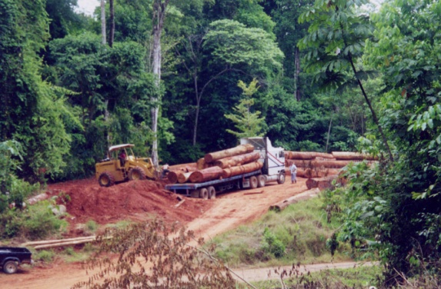
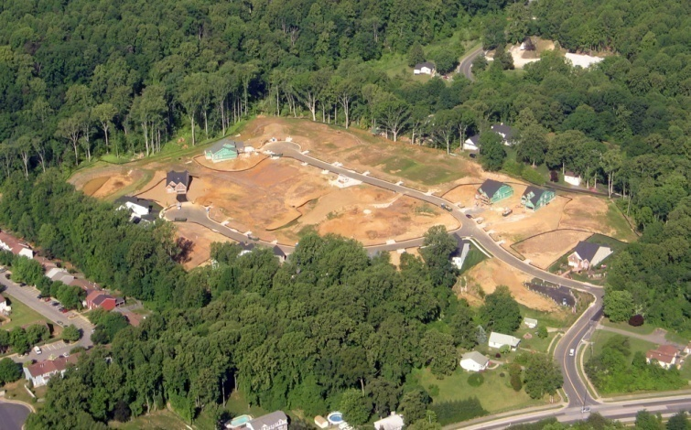
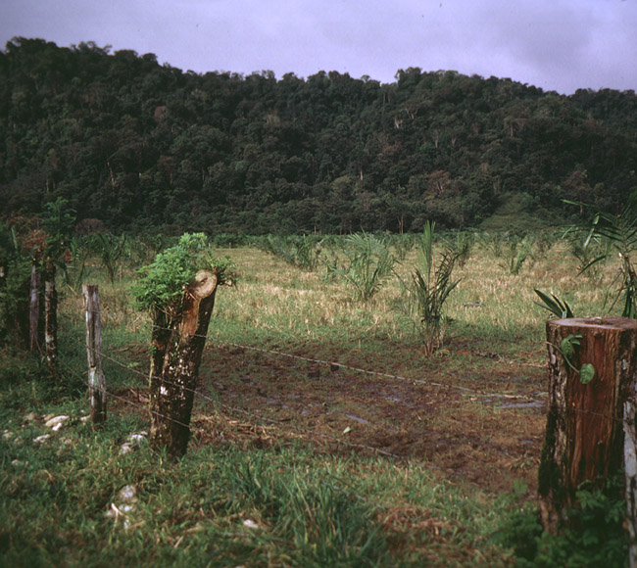
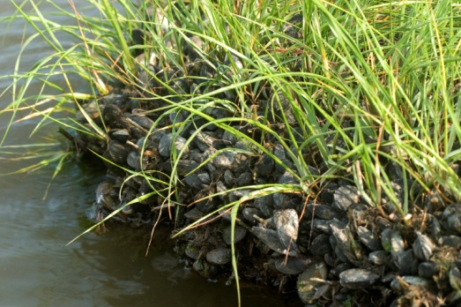
Examples of Direct Threats
Threats
Unsustainable Logging
Unsustainable harvest
Operation of Dams
Exotic/Invasive Species
Residential Development
Incompatible Livestock Grazing
Photo: Adrian Jones,
IAN Image Library

Slide 8
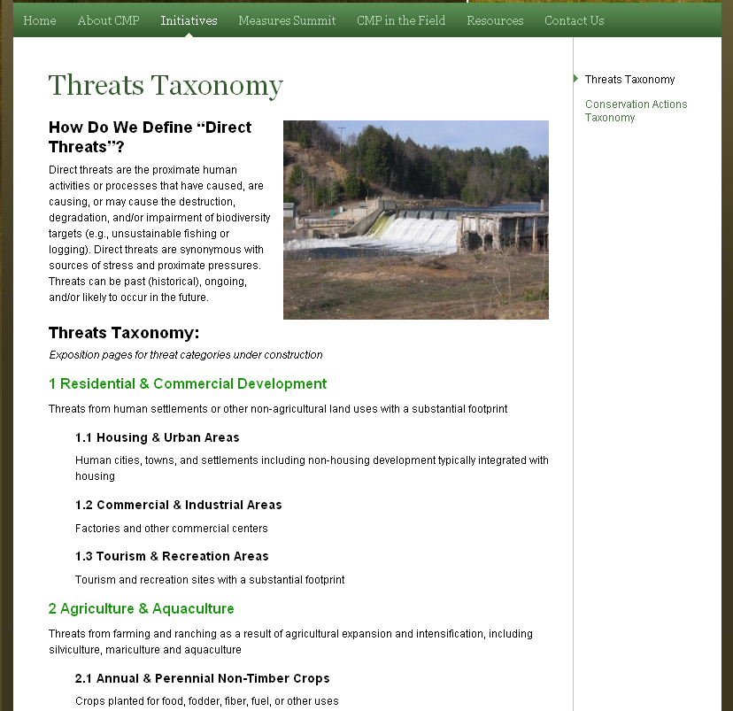
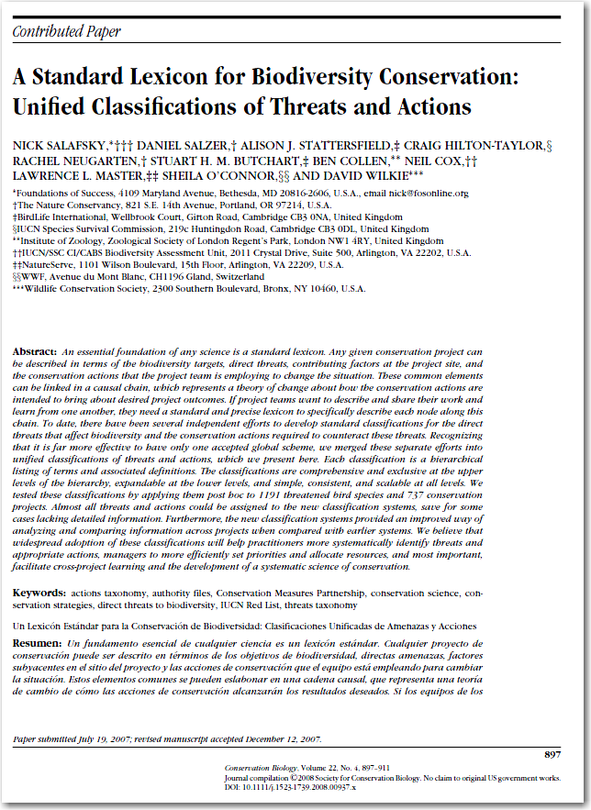
IUCN-CMP Classification of Direct Threats
Threats
Available at
www.conservationmeasures.org
Salafsky et al. (2008). Conservation Biology

Slide 9
Difference Between Direct Threat & Stress?
Threats
Direct Threat: Human-induced actions or events that will directly degrade one or more conservation targets. A direct threat has at least one actor associated with it.
Example: residential development
Stress: biophysical impact of that action on the target – an impaired key ecological attribute of a target. A single stress can be caused by multiple direct threats.
Examples: habitat fragmentation, high mortality

Slide 10
Difference Between Direct Threat & Stress?
Threats
Direct Threat | Example Stress(es) | Example Target Affected
Dams | Altered stream flows Reduced reproductive success of fish | Rivers and streams Migratory fish
Unsustainable Logging | Erosion (Rivers and streams) Sedimentation Habitat destruction Habitat fragmentation | Rivers and streams Rivers and streams, Estuaries Forests Forests
Illegal Hunting | Altered population structure | Monkeys, Rhinos
Unsustainable Agriculture | Sedimentation Habitat destruction Habitat fragmentation | Rivers and streams, Estuaries Forests, Grasslands, Wetlands Forests, Grasslands, Wetlands
Climate change | Coral bleaching Rising sea levels Reduced rainfall | Coral reefs Shoreline habitat Forests, Grasslands, Deserts
Notes:
Point out how same stresses can be caused by 2 different threats – logging and agriculture; Dams and climate change could also both affect river levels

Slide 11
Difference Between Direct & Indirect Threats
Threats
Direct threat: Human-induced actions or events that will directly degrade one or more conservation targets. A direct threat has at least one actor associated with it.
Example: residential development
Indirect threat/contributing factor (short definition): an economic, cultural, societal, or institutional factor which allows or encourages direct threats to occur
Examples: need for income, lack of knowledge, low capacity

Slide 12
This Presentation
Threats
What is a Direct Threat
How to Assess Direct Threats

Slide 13
How Do You Assess Direct Threats?
Threats
Identify your direct threats & link them to your targets
If necessary, add stresses
Rate each threat-target combination
Review and discuss the summary ratings

Slide 14
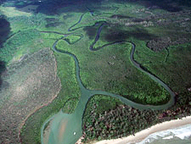
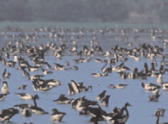
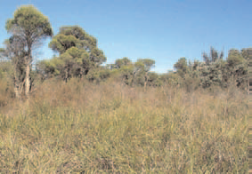
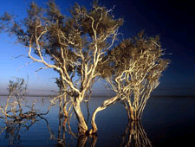
Our Example: Swan Coastal Plain Wetlands
Threats
Adapted from WWF Australia’s Wetlands Watch Project

Slide 15
1. Identify Direct Threats & Link Them
Threats
Notes:
15

Slide 16
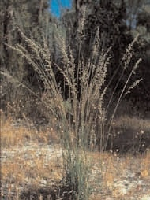
1. Identify Direct Threats & Link Them
Threats
Invasive weeds
Notes:
16
Veld grass (Ehrharta calycina) is a tufted perennial invasive grass

Slide 17
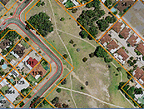
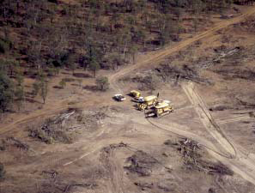
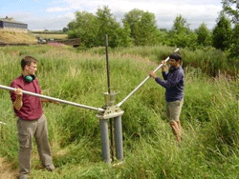
1. Identify Direct Threats & Link Them
Threats
Clearing for residential & infrastructure
Illegal clearing by landowners
Increased groundwater extraction
Notes:
17

Slide 18
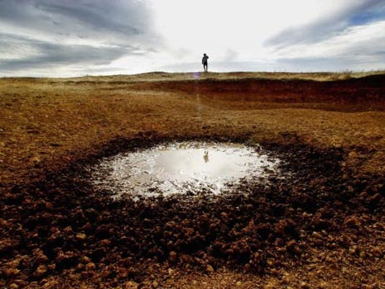
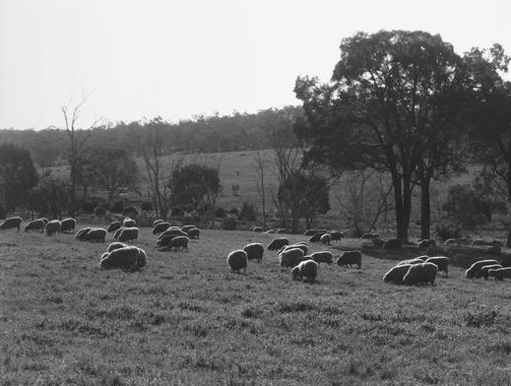
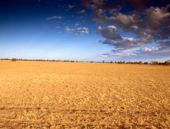
1. Identify Direct Threats & Link Them
Threats
Climate change
Overgrazing
Pesticides from agriculture
Notes:
18

Slide 19
When to Lump or Split Direct Threats
Threats
Lump direct threats if:
they are similar and are caused by the same actors
they will require similar strategies
you have a lot of direct threats
Example: all unsustainable fishing practices used by local fishers
Split if direct threats:
are different and are caused by different actors
will require different strategies
Example: unsustainable fishing practices used by local, small-scale fishers vs. illegal practices used by industrial fishing boats

Slide 20
How Do You Assess Direct Threats?
Threats
Identify your direct threats & link them to your targets
If necessary, add stresses
Rate each threat-target combination
Review and discuss the summary ratings

Slide 21
2. If Necessary, Add Stresses
Threats
For clarity, it may be necessary in some cases to include stresses that describe the biophysical impact of the threat on the target
Notes:
21

Slide 22
How Do You Assess Direct Threats?
Threats
Identify your direct threats & link them to your targets
If necessary, add stresses
Rate each threat-target combination for 3 criteria
Review and discuss the summary ratings

Slide 23
Comparison of Different Threat Rating Criteria
Threats
THREAT RATING SYSTEM | THREAT RATING CRITERIA
CMP e-AM / TNC Rapid CAP | Scope | Severity |  | Irreversibility
TNC 5-S | Scope (Spatial) | Severity | Contribution | Irreversibility
BSP TRA | Area | Intensity |  |  |  |  | Urgency
Birdlife | Scope | Severity |  |  |  |  | Timing
WWF RAPPAM | Extent | Impact |  | Permanence | Probability | Trend
TNC’s SE Division | Extent – % Targets | Severity
WWF Root Causes | Scope | Impact |  | Permanence
WCS Living Landscapes | Proportion of Area | Severity |  | Recovery Time | Probability |  | Urgency
Notes:
Why do we assess threats according to scope, severity, and irreversibility? These criteria were selected based on a review of existing methods. As this table shows, an examination of several threat rating methods shows that all methods have used scope and severity, and many have used irreversibility or permanence.

Slide 24
3. Rate Each Threat-Target Combination
Threats
For each Threat-Target combination, score the threat by 3 criteria:
Scope or Extent
Severity
Irreversibility
Overgrazing
Fringing shrublands
Notes:
24
For each combination, there are 3 criteria to score: scope of the threat, severity, and irreversibility.

Slide 25
Scope or Extent
Threats
Spatial proportion of the target affected within ten years given continuation of current circumstances and trends.
For ecosystems: proportion of the target's occurrence
For species: proportion of the target’s population
Notes:
Scope - Most commonly defined spatially as the geographic scope of impact on the conservation target at the site that can reasonably be expected within ten years under current circumstances (i.e., given the continuation of the existing situation). Very High: The threat is likely to be very widespread or pervasive in its scope, and affect the conservation target throughout the target's occurrences at the site. High: The threat is likely to be widespread in its scope, and affect the conservation target at many of its locations at the site. Medium: The threat is likely to be localized in its scope, and affect the conservation target at some of the target's locations at the site. Low: The threat is likely to be very localized in its scope, and affect the conservation target at a limited portion of the target's location at the site.
Severity - The level of damage to the conservation target that can reasonably be expected within ten years under current circumstances (i.e., given the continuation of the existing situation). Very High: The threat is likely to destroy or eliminate the conservation target over some portion of the target's occurrence at the site. High: The threat is likely to seriously degrade the conservation target over some portion of the target's occurrence at the site. Medium: The threat is likely to moderately degrade the conservation target over some portion of the target's occurrence at the site. Low: The threat is likely to only slightly impair the conservation target over some portion of the target's occurrence at the site.
Irreversibility - The degree to which the effects of a threat can be undone. Very High: The effects of the threat are not reversible (e.g., wetlands converted to a shopping center). High: The effects of the threat are technically reversible, but not practically affordable (e.g., wetland converted to agriculture). Medium: The effects of the threat are reversible with a reasonable commitment of resources (e.g., ditching and draining of wetland). Low: The effects of the threat are easily reversible at relatively low cost (e.g., off-road vehicles trespassing in wetland).

Slide 26
Scope
Threats
Scope – proportion of the target expected to be affected by the threat within 10 years
4 = Very High: The threat is likely to be pervasive in its scope, affecting the target across all or most (71-100%) of its occurrence/population.
3 = High: The threat is likely to be widespread in its scope, affecting the target across much (31-70%) of its occurrence/population.
2 = Medium: The threat is likely to be restricted in its scope, affecting the target across some (11-30%) of its occurrence/population.
1 = Low: The threat is likely to be very narrow in its scope, affecting the target across a small proportion (1-10%) of its occurrence/population.

Slide 27
Severity
Threats
Within the scope or where the threat is occurring, the level of damage given continuation of current circumstances and trends.
For ecosystems: degree of destruction or degradation of the target within the scope.
For species: degree of reduction of the target population within the scope.
Notes:
Scope - Most commonly defined spatially as the geographic scope of impact on the conservation target at the site that can reasonably be expected within ten years under current circumstances (i.e., given the continuation of the existing situation). Very High: The threat is likely to be very widespread or pervasive in its scope, and affect the conservation target throughout the target's occurrences at the site. High: The threat is likely to be widespread in its scope, and affect the conservation target at many of its locations at the site. Medium: The threat is likely to be localized in its scope, and affect the conservation target at some of the target's locations at the site. Low: The threat is likely to be very localized in its scope, and affect the conservation target at a limited portion of the target's location at the site.
Severity - The level of damage to the conservation target that can reasonably be expected within ten years under current circumstances (i.e., given the continuation of the existing situation). Very High: The threat is likely to destroy or eliminate the conservation target over some portion of the target's occurrence at the site. High: The threat is likely to seriously degrade the conservation target over some portion of the target's occurrence at the site. Medium: The threat is likely to moderately degrade the conservation target over some portion of the target's occurrence at the site. Low: The threat is likely to only slightly impair the conservation target over some portion of the target's occurrence at the site.
Irreversibility - The degree to which the effects of a threat can be undone. Very High: The effects of the threat are not reversible (e.g., wetlands converted to a shopping center). High: The effects of the threat are technically reversible, but not practically affordable (e.g., wetland converted to agriculture). Medium: The effects of the threat are reversible with a reasonable commitment of resources (e.g., ditching and draining of wetland). Low: The effects of the threat are easily reversible at relatively low cost (e.g., off-road vehicles trespassing in wetland).

Slide 28
Severity
Threats
Severity – level of damage to the target expected if current trends continue
4 = Very High: Within the scope, the threat is likely to destroy or eliminate the target, or reduce its population by 71-100% within ten years or three generations.
3 = High: Within the scope, the threat is likely to seriously degrade/reduce the target or reduce its population by 31-70% within ten years or three generations.
2 = Medium: Within the scope, the threat is likely to moderately degrade/reduce the target or reduce its population by 11-30% within ten years or three generations.
1 = Low: Within the scope, the threat is likely to only slightly degrade/reduce the target or reduce its population by 1-10% within ten years or three generations.

Slide 29
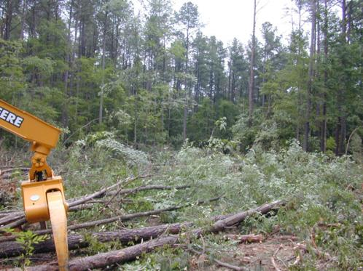
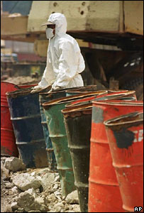
Irreversibility
Threats
Degree to which the effects of a threat can be reversed and the target restored, if the threat no longer existed.
vs.
Notes:
Scope - Most commonly defined spatially as the geographic scope of impact on the conservation target at the site that can reasonably be expected within ten years under current circumstances (i.e., given the continuation of the existing situation). Very High: The threat is likely to be very widespread or pervasive in its scope, and affect the conservation target throughout the target's occurrences at the site. High: The threat is likely to be widespread in its scope, and affect the conservation target at many of its locations at the site. Medium: The threat is likely to be localized in its scope, and affect the conservation target at some of the target's locations at the site. Low: The threat is likely to be very localized in its scope, and affect the conservation target at a limited portion of the target's location at the site.
Severity - The level of damage to the conservation target that can reasonably be expected within ten years under current circumstances (i.e., given the continuation of the existing situation). Very High: The threat is likely to destroy or eliminate the conservation target over some portion of the target's occurrence at the site. High: The threat is likely to seriously degrade the conservation target over some portion of the target's occurrence at the site. Medium: The threat is likely to moderately degrade the conservation target over some portion of the target's occurrence at the site. Low: The threat is likely to only slightly impair the conservation target over some portion of the target's occurrence at the site.
Irreversibility - The degree to which the effects of a threat can be undone. Very High: The effects of the threat are not reversible (e.g., wetlands converted to a shopping center). High: The effects of the threat are technically reversible, but not practically affordable (e.g., wetland converted to agriculture). Medium: The effects of the threat are reversible with a reasonable commitment of resources (e.g., ditching and draining of wetland). Low: The effects of the threat are easily reversible at relatively low cost (e.g., off-road vehicles trespassing in wetland).

Slide 30
Irreversibility
Threats
Irreversibility – degree to which target can be restored if threat removed
4 = Very High: Effects of the threat cannot be reversed and it is very unlikely the target can be restored, and/or would take >100 years to achieve.
3 = High: Effects of the threat can technically be reversed and the target restored, but it is not practically affordable and/or it would take 21-100 years to achieve.
2 = Medium: The effects of the threat can be reversed and the target restored with a reasonable commitment of resources and/or within 6-20 years.
1 = Low: The effects of the threat are easily reversible and the target can be easily restored at a relatively low cost and/or within 0-5 years.
Notes:
Examples for Very High: wetlands converted to a shopping center
High: wetland converted to agriculture
Medium: ditching and draining of wetland
Low: off-road vehicles trespassing in wetland
Overall Rating rolls up to MEDIUM for this threat-target combination

Slide 31
Threat Ratings in Miradi
Threats
Miradi indicates the summary values for threats in the diagram view
Notes:
Note direct threat ratings on diagram (top left corner of box)

Slide 32
Threat Rating in Miradi
Threats
Scope + Severity = Threat Magnitude
 |  | Scope
 |  | Very High | High | Medium | Low
Severity | Very High | Very High | High | Medium | Low
 | High | High | High | Medium | Low
 | Medium | Medium | Medium | Medium | Low
 | Low | Low | Low | Low | Low
Threat Magnitude + Irreversibility = Threat Rating
 |  | Irreversibility
 |  | Very High | High | Medium | Low
Magnitude | Very High | Very High | Very High | Very High | High
 | High | Very High | High | High | Medium
 | Medium | High | Medium | Medium | Low
 | Low | Medium | Low | Low | Low
Notes:
Miradi combines scope and severity ratings to get the overall threat magnitude rating for each threat on each target, using the following rule-based system:
Miradi then combines the threat magnitude rating with the irreversibility rating using the following rule-based system:

Slide 33
How Do You Assess Direct Threats?
Threats
Identify your direct threats & link them to your targets
If necessary, add stresses
Rate each threat-target combination for 3 criteria
Review and discuss the summary ratings

Slide 34
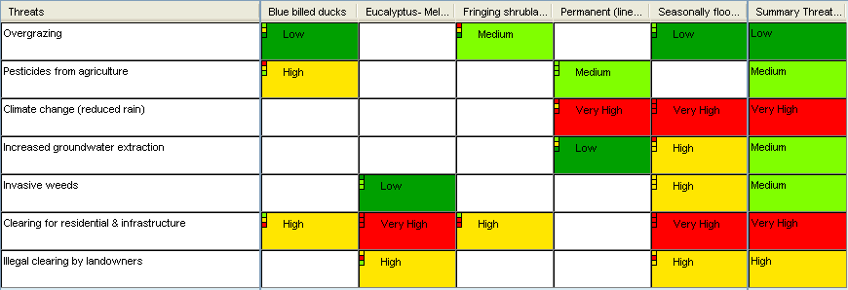
4. Review & discuss the summary ratings
Threats
2 Prime Rule:
Need at least 2 of a level
3-5-7 Rule:
3 highs = 1 Very High
5 Mediums = 1 High
7 Lows = Medium
Notes:
To calculate these summaries, Miradi the 2-prime rule:
Which says, that you need at least 2 of a particular value within a row or column to receive that level as the row or column total.
This is best understood by example..
So, the threat clearing for residential developed, received a Very High summary score, because two or more targets received a very high rating for this threat.
Overgrazing, on the other hand, received a low summary score, because only one target received a score of medium. If a second target, like blue-billed ducks, had received a medium score, then the summary would also be medium. -
Within the 2-prime rule, Miradi uses a second rule called the 3-5-7 rule:
Here, 3 highs within a column or row equivalent to receiving 1 Very High value
5 mediums are equal 1 high
And 7 lows equal a medium
If these rules aren’t crystal clear to you, you read them in detail within Miradi and explore what happens when you change values.

Slide 35
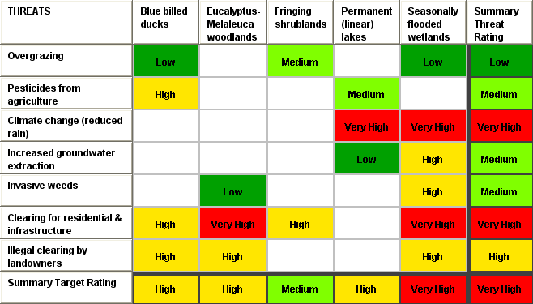
4. Review & discuss the summary ratings
Threats

Slide 36
Threats
Key Points to Introduce this Step
There are two common types of threat ratings:
Stress-based threat rating:
Rates the scope and severity of stress to target and the contribution and irreversibility of each direct threat to stress
Simple threat rating:
Rates the scope, severity, irreversibility of direct threat only

Slide 37
Threats
Key Points to Introduce this Step
A common threat taxonomy exists, and helps to bring clarity to the discussion
Miradi uses a rule-based system to develop ratings

Slide 38
Breakout Instructions
Threats
Identify and Rate Your Critical Threats
Identify the direct threats predicted to affect each of your conservation targets over the next 10 years and link them to the targets in the Diagram view of Miradi.
Use the Threat Rating view of Miradi to do your rating.
Rank each threat by target for scope, severity, and irreversibility. Where you lack information, make your best guess at the rating, but be sure to note any questions or concerns you have.
Review Miradi’s summary ratings for each threat, for each target and for the overall site.
Prepare to present your results (briefly).

