Slide 1
Conservation Coaches Network Workshop Presentation
2A. Develop a Formal Action Plan: Results Chains

Slide 2
Attribution
Product of the Conservation Coaches Network, 2012
These presentations were developed based on materials from Foundations of Success (FOS), The Nature Conservancy (TNC), and World Wildlife Fund (WWF).
CCNet strongly recommends that this presentation is given by experts familiar with the adaptive management process presented by the Conservation Measures Partnership’s Open Standards for the Practice of Conservation.
You are free to share this presentation and adapt it for your use. Please attribute the work to CCNet or FOS, TNC and WWF. If you significantly alter, transform, or build upon this work, it may be appropriate to remove the CCNet logo.

Slide 3
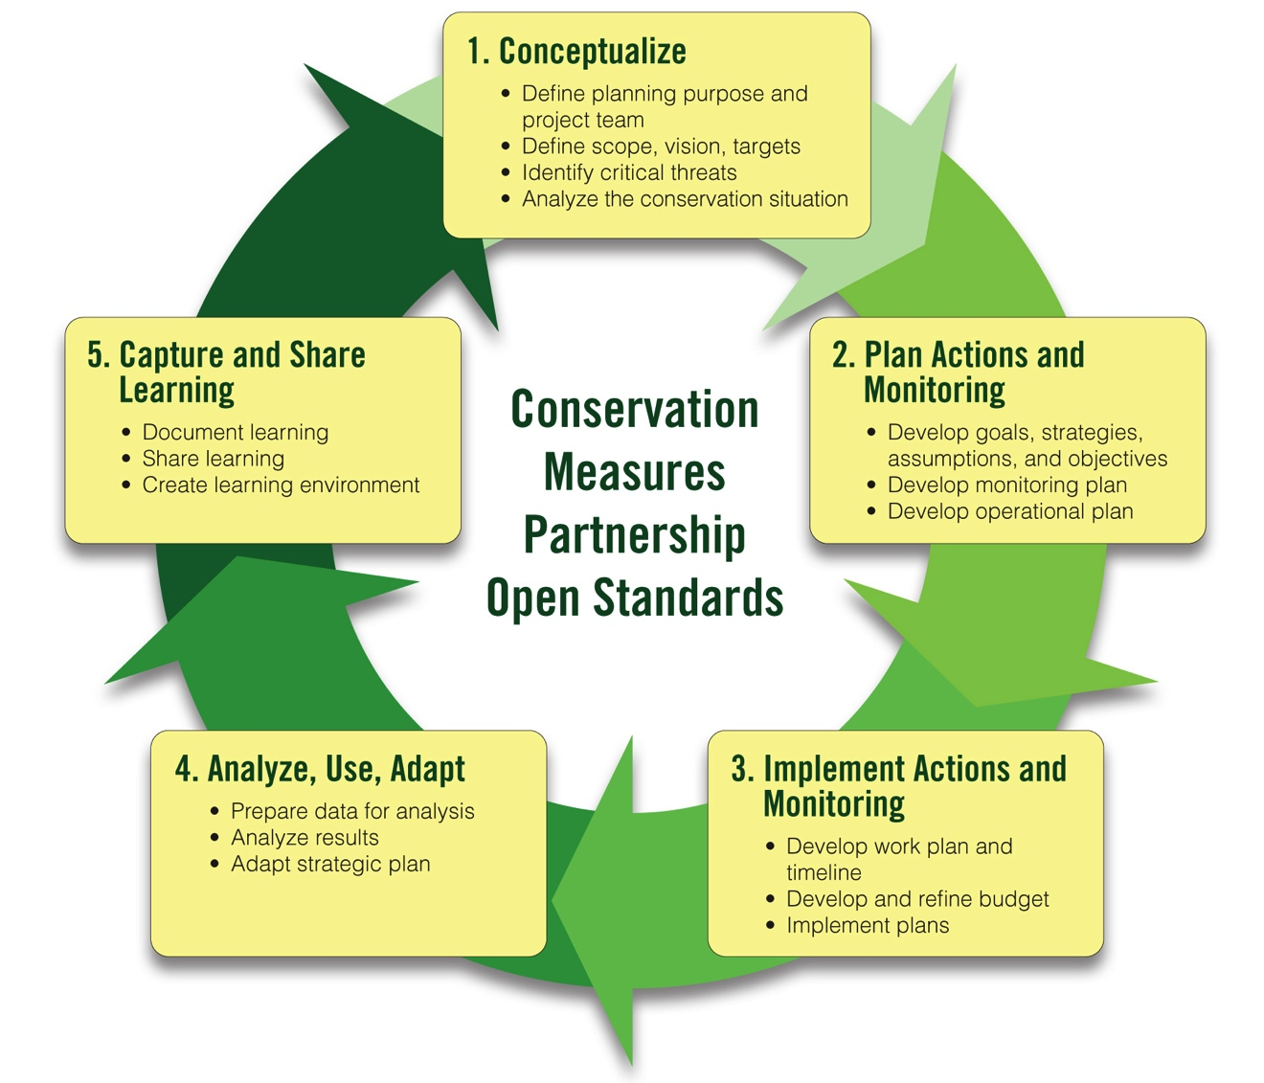
Adaptive Management Workshop Presentations
1A-1B. Team, Scope, Vision
1B. Conservation Targets
1B. Viability Assessment
2A-1. Strategy Selection
2A-2. Results Chains
2A-3. Goals and Objectives
1C. Threat Rating
1D. Conceptual Models
2B. Monitoring Plan

Slide 4
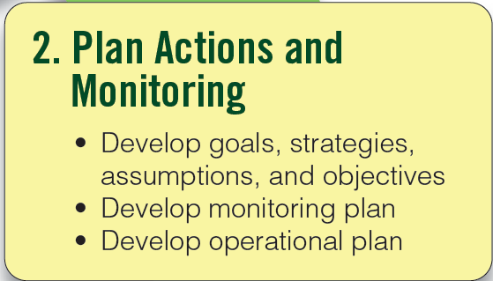
Plan Your Actions & Monitoring
Results Chains
Notes:
4

Slide 5
This Presentation
Results Chains
What is a Results Chain
How to Develop Results Chains
Examples
How Project Teams Have Used Results Chains

Slide 6
What is a Results Chain?
Results Chains
A tool for documenting a team’s “theory of change,” describing how a strategy will lead to conservation success

Slide 7
What is a Results Chain?
Results Chains
A diagram of a series of “if…then” causal statements that:
Defines how a project team thinks a strategy will contribute to reducing a threat or restoring a target
Focuses on the achievement of results – not the execution of activities
Is composed of assumptions that can be tested

Slide 8
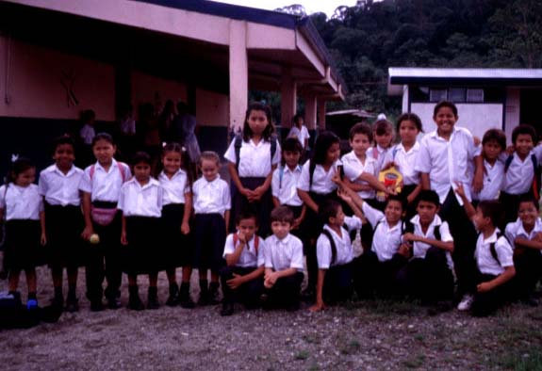
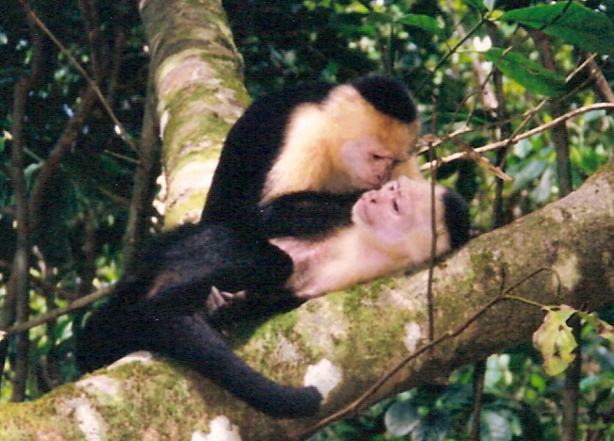
Results Chains
Results Chains
Implicit Assumptions:
Notes:
We have a lot of implicit assumptions. Environmental education will lead to conservation of monkeys and forests. We need to be explicit in stating our assumptions.

Slide 9
What is a Results Chain?
Results Chains
The Basic Components of a Results Chain:

Slide 10
What is a Results Chain?
Results Chains
The Basic Components of a Results Chain:

Slide 11
What is a Results Chain?
Results Chains
The Basic Components of a Results Chain:
Strategic action implemented
Contributing factor addressed or opportunity
achieved
Direct
Threat
Objective
Achieved
Impact of actions achieved/ Viability maintained

Slide 12
Why Results Chains?
Results Chains
Document assumptions
Define how activities will contribute to achieving results
Formulate measures of success
Notes:
Lets us “peek inside” our thinking about how a project strategy or activity is going to actually work to contribute to reducing a threat and conserving a target
Provides a series of hypotheses that can be tested
Creates a foundation for establishing strategy effectiveness measures to determine if the strategy is working or not.
There are several important aspects of results chains that have been developed over the years to
- help construct them in a way that establish sound strategy effectiveness measures
– also help to improve probability that the strategy will be successful.
FIRST – results chains diagrams are best constructed as a series of “if-then” statements. These infer causality…
SECOND – They define how we think a strategy or activity will reduce a threat and conserve a target.
THIRD – They focus on achieving results…not just a listing of activities.
And FOURTH – They are composed of hypotheses that can be tested…

Slide 13
Situation Analysis vs. Results Chains
Results Chains
Situation Analyses:
Shows the situation today → helps us to illuminate points of intervention and identify strategies
Results Chains:
Starts with selected strategies → and helps to illuminate the assumptions leading to the desired results
Notes:
There has been some confusion about the difference between our conceptual models – or situation diagrams – and Results Chains.
In short, situations diagrams show the situation today, and why the strategy is important and relevant.
Results Chains add in measurable objectives and indicators…and these show the desired future conditions that result from the strategy.

Slide 14
Achieving Success
Results Chains
Notes:
Para lograr el éxito, necesitamos: (1) una cadena precisa, y (2) buena ejecución del proyecto.
Si la cadena tiene supuestos falsos, entonces el proyecto no va a ser exitosa, aunque esté bien ejecutado.
Si la cadena es precisa pero la ejecución es pobre, entonces tampoco tendríamos éxito.
Y finalmente existe el caso del FRACASO TOTAL, en lo cual hay supuestos falsos y mala ejecución.

Slide 15
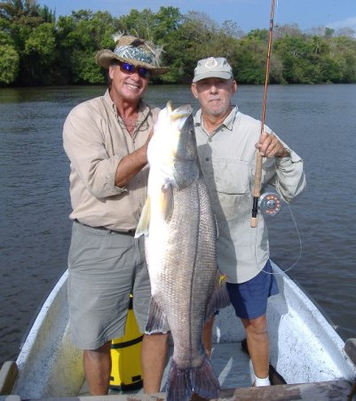
What Happens When We Make False Assumptions?
Results Chains
Training Fly Fishing Guides in Bocas del Toro, Panama
Notes:
Years ago, the PROARCA/Costas project in Central America helped to create a new marine park in southern Belize called the Port Honduras Marine Reserve. The use of gillnets was prohibited in the new marine reserve and, to provide an economic alternative for the fishermen, TNC and its local partner, TIDE, trained fishermen to be flyfishing guides. This initiative was a huge success, because the fishermen could earn about $150 per day as flyfishing guides – using their gillnets it would take them at least 2-3 weeks to earn this much. Because flyfishing in southern Belize is catch-and-release, this initiative provided great environmental and ecological benefits. It was one of those rare “win/win” situations.
Because it was so successful, program staff wanted to replicate the initiative in Panama. They got gear donated by Orvis and organized a training workshop for about 10 fishermen. Their assumptions about the impact of the training are defined in the results chain on the next page.

Slide 16
Underlying Project Assumptions
Results Chains
The project team assumed:
If we train local fishermen as fly fishing guides and we give them fly fishing gear, then they will have the skills and gear to be guides
If they have the skills and gear, then they will work as fly fishing guides
If they are able to work as fly fishing guides, then they will increase their income
If they have increased income, they will not need to fish so much and there will be less unsustainable fishing practices
If there are less unsustainable fishing practices, then the coral reef ecosystem will be more conserved.
X
Notes:
A few months after the workshop, the Director of the PROARCA/Costas project was in Bocas del Toro, Panama and decided to check to see what impact the course had had. He found that none of the fishermen were working as flyfishing guides, but the man who drove the boat during the training workshop was working as a flyfishing guide. What happened? Why didn’t this effort work as it had worked in Belize?

Slide 17
Underlying Project Assumptions
Results Chains
What else did the fishermen need to become fly fishing guides?
Clients – tourists and tourism operators needed to know about the fly fishing guides
English speaking skills
Etc.
X
Notes:
Why didn’t this effort work as it had worked in Belize? There was no marketing aspect to the strategy – so the fishermen didn’t get clients. Also, most of them didn’t speak English, an essential skill for a flyfishing guide hoping to work for North American clients.

Slide 18
This Presentation
Results Chains
What is a Results Chain
How to Develop Results Chains
Examples
How Project Teams Have Used Results Chains

Slide 19
One Way to Develop a Results Chain
Results Chains
Construct an initial results chain
Complete the links in the results chain
Verify that your results chain meets criteria of a good results chain
Add activities to show how your specific actions (activities) will contribute to achieving your results
Notes:
INCLUDE STEPS 4 AND 5 – ADDING OBJECTIVES AND INDICATORS?

Slide 20
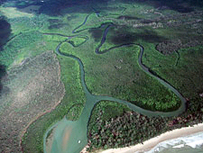
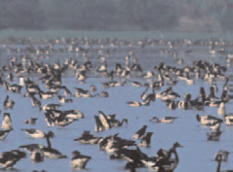
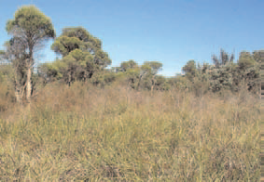
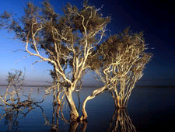
Our Example – Swan Coastal Plain Wetlands
Results Chains
Adapted from WWF Australia’s WeltlandsWatch Project
Notes:
Throughout our presentations, we use example outputs from the Wetland Watch project from WWF Australia that we have modified slightly to reflect the structure and products of the CMP Open Standards. The intent is to give a real-world example of how the Standards have been applied.

Slide 21
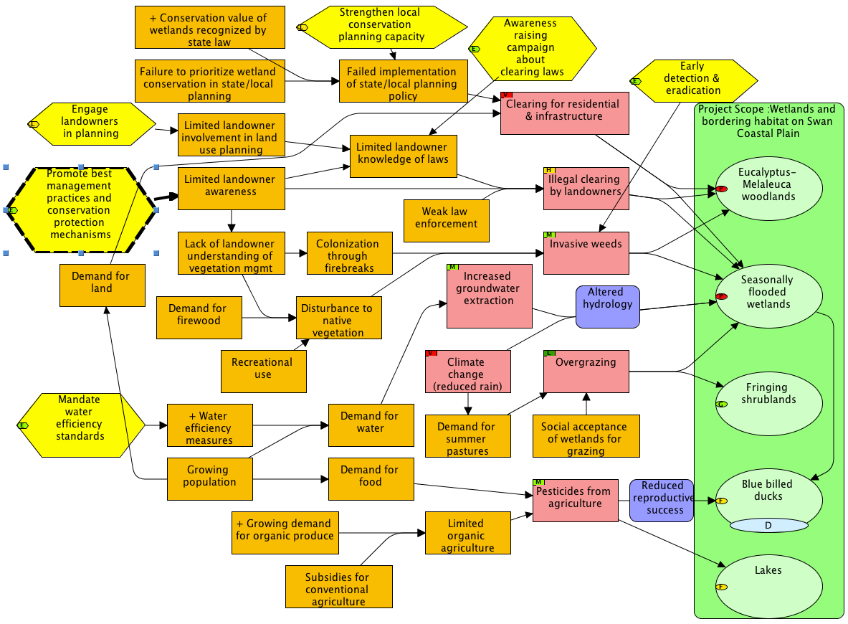
A Chain From the Model Allows You to…
Results Chains

Slide 22
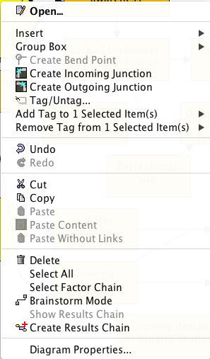
A Chain From the Model Allows You to…
Results Chains
In Miradi, select the direct threat, right-click & select “Create Results Chain”

Slide 23
1. Construct an Initial Results Chain
Results Chains
Notes:
Take a chain from the situation diagram and turn it into the results chain; the top is what Miradi gives you to work with. You then need to reword the results boxes.

Slide 24
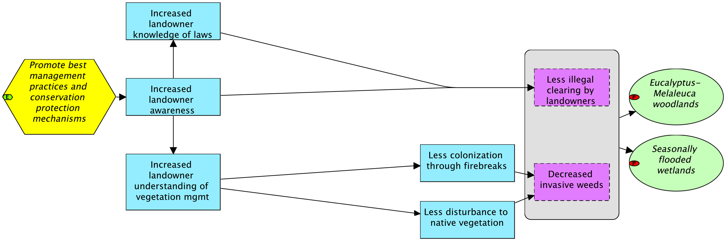
2. Complete the Links in the Results Chain
Results Chains
Spread out initial results:
Notes:
Your initial chain will have some big leaps in logic. Spread out the chain to make space to include intermediate results.

Slide 25
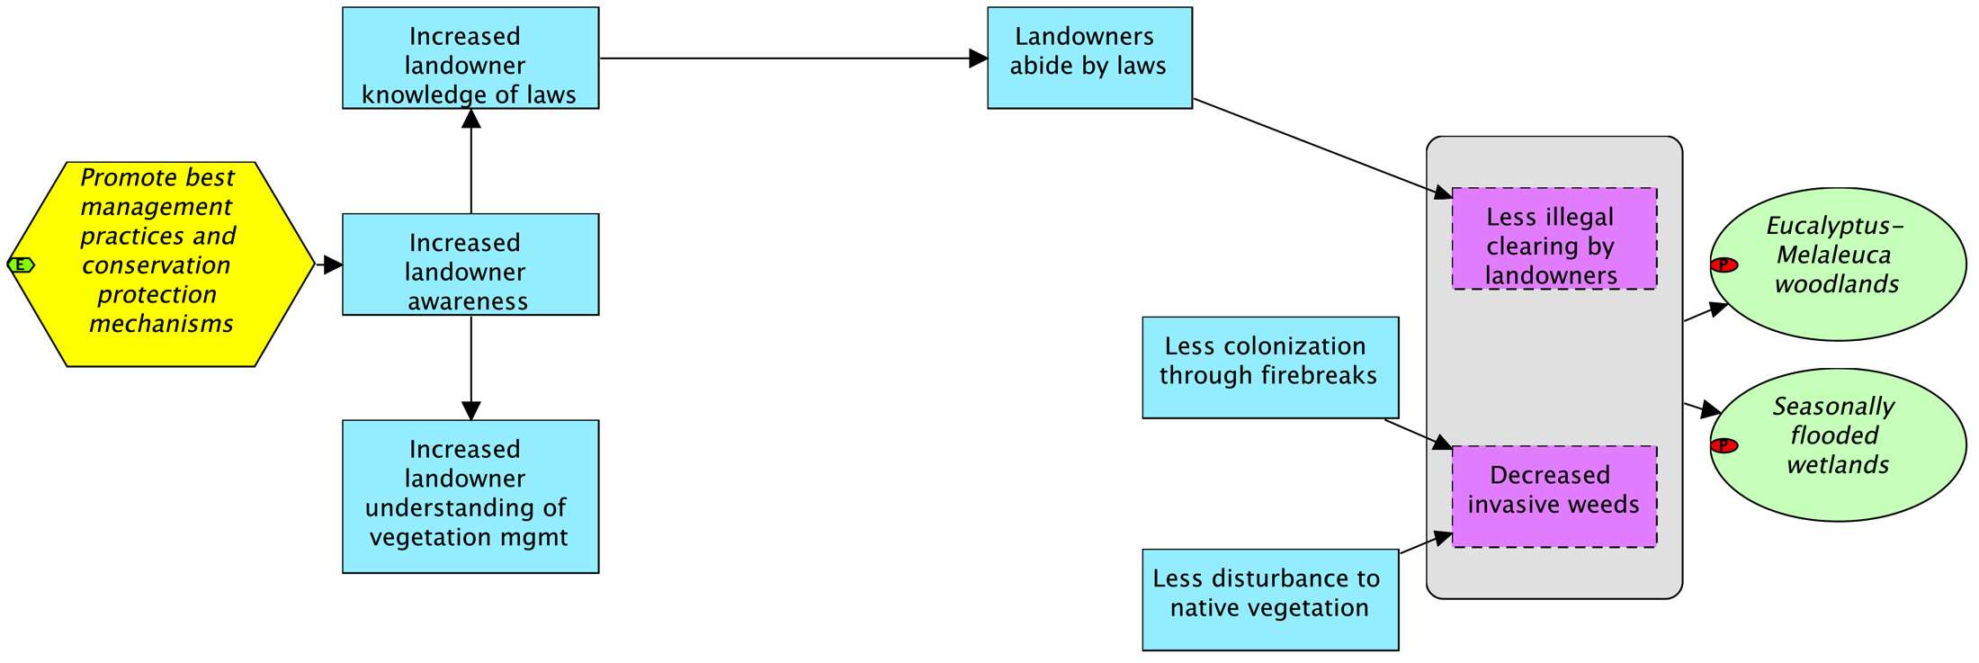
2. Complete the Links in the Results Chain
Results Chains
Notes:
Additional boxes are needed to complete the chain.

Slide 26
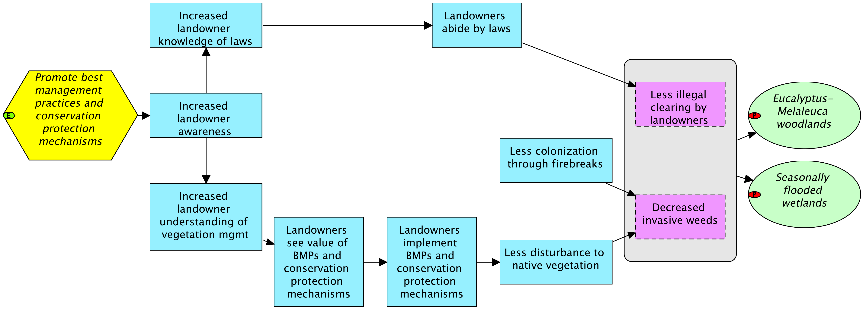
2. Complete the Links in the Results Chain
Results Chains
Notes:
These new boxes are needed to complete the chain.

Slide 27
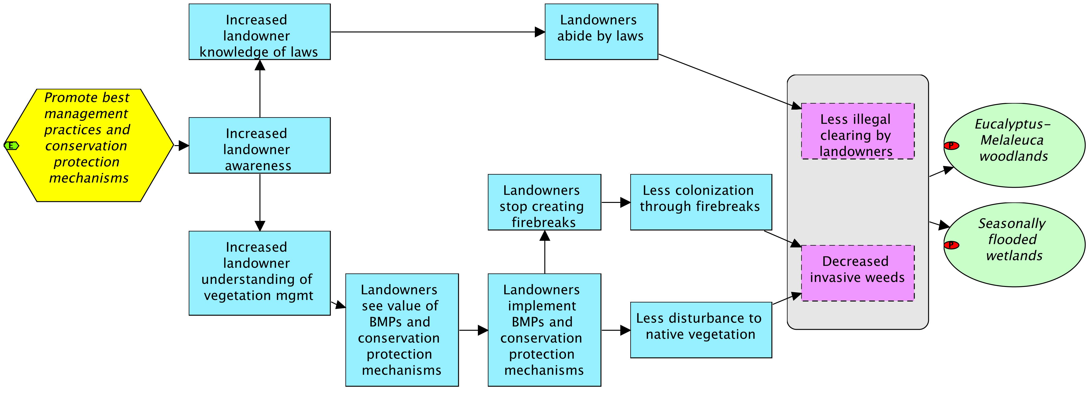
2. Complete the Links in the Results Chain
Results Chains
Notes:
These new boxes are needed to complete the chain.

Slide 28
3. Review the Criteria for Good Results Chains
Results Chains
Results oriented: Boxes contain desired results (e.g., reduction of hunting), and not activities (e.g., conduct a study).
Connected in a “causal” manner: There are clear connections of “if…then” between each pair of successive boxes.

Slide 29
3. Review the Criteria for Good Results Chains
Results Chains
Demonstrates change: Each box describes how you hope the relevant factor will change (e.g., improve, increase, or decrease).

Slide 30
3. Review the Criteria for Good Results Chains
Results Chains
Relatively complete: There are sufficient boxes to construct logical connections but not so many that the chain becomes overly complex.
Simple: There is only one result per box.

Slide 31
4. Add Activities
Results Chains
Activity: A specific action or set of tasks undertaken by project staff and/or partners to reach one or more objectives.
Define activities to accomplish your strategy and add them onto the results chain

Slide 32
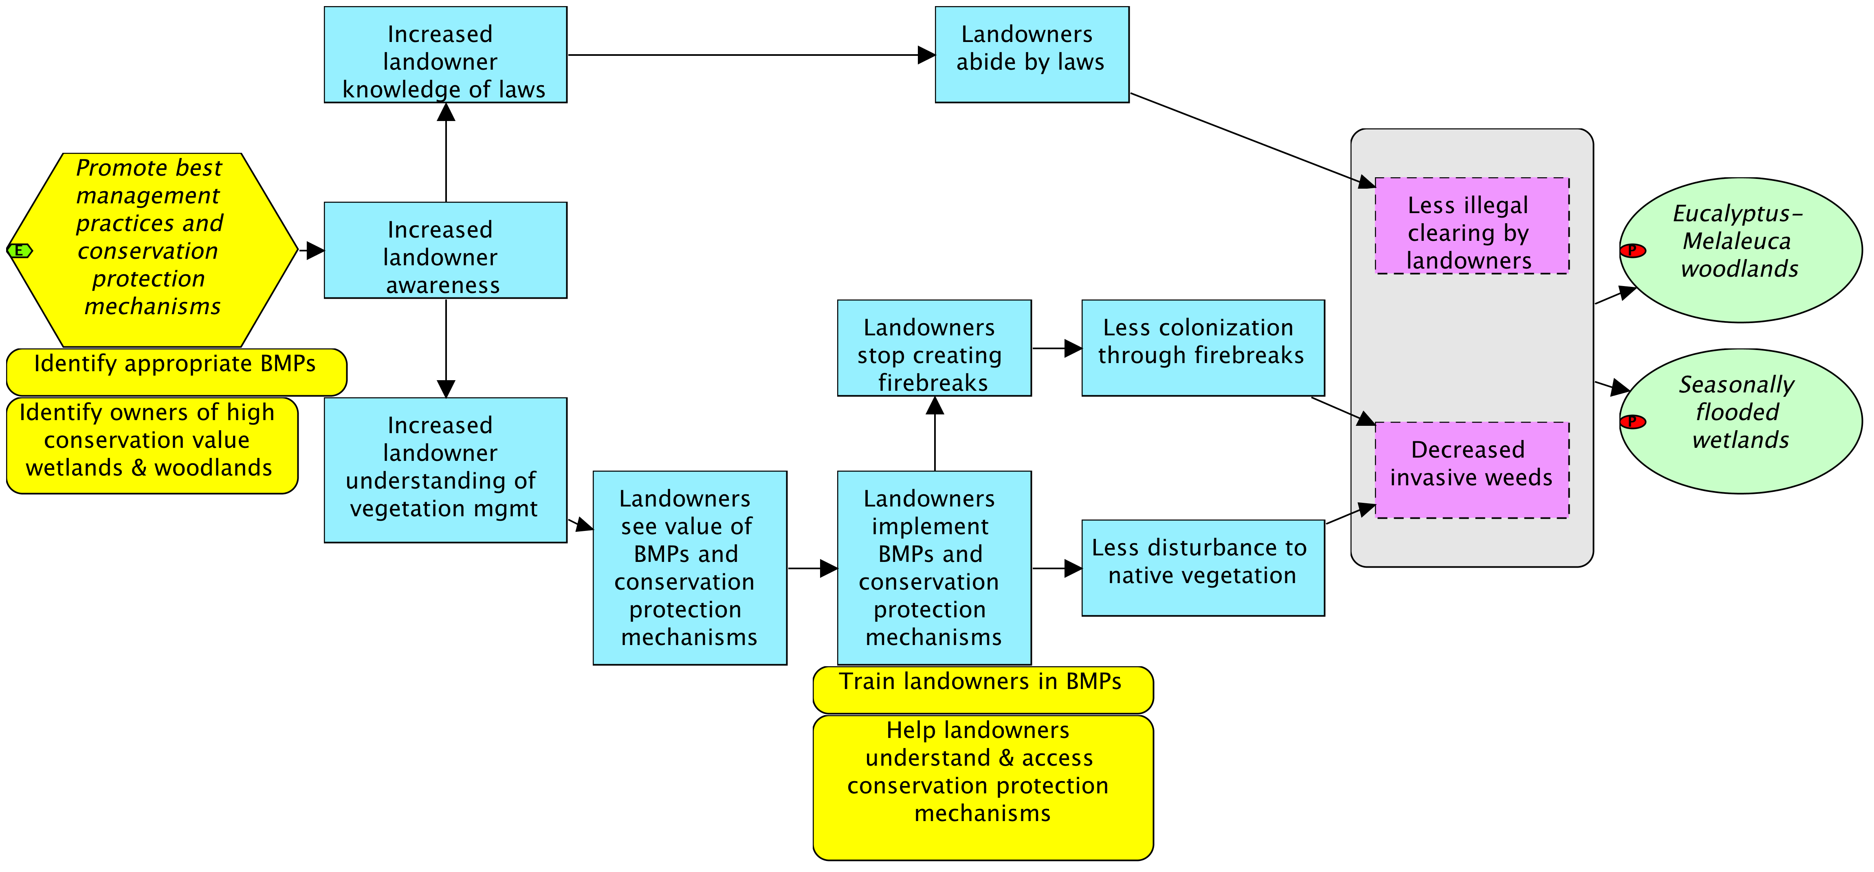
4. Add Activities
Results Chains
Notes:
Showing Activities may or may not be needed or desired, especially when lots of activities within a project.

Slide 33
Activities in Miradi
Results Chains
Select this to show main activities on the results chain
If you have a lot of activities, don’t clutter the results chain with all of them. Keep some hidden.

Slide 34
How to Develop a Results Chain
Construct an Initial Results Chain Based on Your Conceptual Model
Complete the Links in the Results Chain
Verify that Your Results Chain Meets Criteria of a Good Results Chain
Add activities to show how your specific actions (activities) will contribute to achieving your results
Notes:
INCLUDE STEPS 4 AND 5 – ADDING OBJECTIVES AND INDICATORS?

Slide 35
Other Ways to Develop a Results Chain
Results Chains
Steps:
Place strategy, target and threat reduction result
Build the chain, either:
Right to left, defining what needs to be done to reduce the threat
Left to right, defining desired results of the strategy
Brainstorming results and then linking them (as in this example)

Slide 36
Other Ways to Develop a Results Chain
Results Chains

Slide 37
Other Ways to Develop a Results Chain
Results Chains

Slide 38
Other Ways to Develop a Results Chain
Results Chains

Slide 39
What is a Results Chain?
A diagram of a series of “if…then” statements (“causal”) that:
Defines how a project team thinks a strategy will contribute to reducing a threat and restoring a target
Focuses on the achievement of results – not the execution of activities
Is composed of assumptions that can be tested

Slide 40
What is NOT a Results Chain?
Results Chains
It is not an implementation flow diagram…
Results chains focus on
the achievement of results not the implementation of activities

Slide 41
Your Turn: Which of the Following is NOT a Results Chain?
Results Chains
Notes:
Now, it’s your turn to determine which of these three chains does not meet the criteria for good results chains. Please look at these chains and then select one of the following responses.
CORRECT ANSWER: Chain A is not a results chain. It mixes implementation steps with results. For the most part, it shows a series of activities the team will do. These activities, or implementation steps, include: identify key decision makers, educate decision makers, and research and develop regulations. The chain does include a few boxes that are more results-oriented. These include: decision makers pass laws, no wildlife trade, and jaguar populations increased.

Slide 42
This Presentation
Results Chains
What is a Results Chain
How to Develop Results Chains
Examples
How Project Teams Have Used Results Chains

Slide 43
Example: Strategy to Reduce Impact of Mining
Results Chains
Adapted from WWF Eastern African Coastal Forest Ecoregion
Notes:
Another example that might be relevant or you want to show another example.

Slide 44
Example: Strategy to Reduce Impact of Mining
Results Chains
Adapted from WWF Eastern African Coastal Forest Ecoregion

Slide 45
Example: Strategy to Reduce Impact of Mining
Results Chains
Adapted from WWF Eastern African Coastal Forest Ecoregion

Slide 46
Your Turn: Add the Missing Result
Results Chains
Notes:
Now it’s your turn again. Look at the following results chain and think about what result is missing in the box marked by a question mark.

Slide 47
Your Turn: Add the Missing Result
Notes:
Now it’s your turn again. Look at the following results chain and think about what result is missing in the box marked by a question mark. Type your response in the box and click submit when you are done to see if your answer is correct.

Slide 48
Your Turn: Create a Results Chain Using the Following Results
Results Chains
Citizens eradicate invasive plants
Healthy native wetland vegetation
Citizens have skills to eradicate invasive plants
Train citizens to eradicate invasive plants
Citizens knowledgeable of local invasive plants
Invasive plants decreased

Slide 49
Your Turn: Create a Results Chain Using the Following Results
Results Chains
Citizens eradicate invasive plants
Healthy native wetland vegetation
Citizens have skills to eradicate invasive plants
Citizens knowledgeable of local invasive plants
Invasive plants decreased
Notes:
The correct answer is “Train citizens to eradicate invasive plants.” Remember, a strategy is an action your project team will take.
Now, take a look at the chain and try to determine what result should go in the box labeled, “Result 1b.” Remember to use the if-then logic to help you determine the correct response.
PAUSE: 15 SEC

Slide 50
Your Turn: Create a Results Chain Using the Following Results
Results Chains
Citizens eradicate invasive plants
Healthy native wetland vegetation
Invasive plants decreased
Notes:
The correct answer is “Citizens have skills to eradicate invasive plants.” If you read your chain in an if-then fashion, you can see that this is a logical result flowing from the strategy. Let’s give it a try: “If our team implements a strategy to train citizens to eradicate invasive plants, then citizens will have the skills to eradicate invasive plants.” This makes clear and logical sense.
Now, take a look at the chain and try to determine what result should go in the box labeled, “Result 2.” Remember to use if-then logic to help you determine the correct response.

Slide 51
Your Turn: Create a Results Chain Using the Following Results
Results Chains
Healthy native wetland vegetation
Invasive plants decreased
Notes:
The correct answer is: “Citizens eradicate invasive plants.” Reading the results chain: If we train citizens to eradicate invasive plants, then citizens will be knowledgeable of local invasive plants and they will have the skills to eradicate invasive plants. If citizens are knowledgeable of local invasive plants and they have the skills to eradicate invasive plants, then they will eradicate those plants.]
Again, take a look at the chain now and try to determine what result should go in the purple box labeled, “Direct Threat Result 3” and consequently, what should go in the last “box” (or oval) labeled, “Target Impact (Result 4).”
PAUSE (10 SEC)

Slide 52
Your Turn: Create a Results Chain Using the Following Results
Results Chains
Notes:
The correct answer is that “invasive plants decreased” should go in the purple box, because it describes the threat you will reduce, and “Healthy native wetland vegetation” should go in the oval, as your conservation target.
Your complete results chain would look like this.
You may want to take a moment to read the results chain from left to right and make sure that it meets all of the criteria – that all the boxes are results, not implementation steps, they are simple (one result per box), and the if-then causal logic holds well.
PAUSE (15 SEC) TO LET PEOPLE READ THE CHAIN.

Slide 53
This Presentation
Results Chains
What is a Results Chain
How to Develop Results Chains
Examples
How Project Teams Have Used Results Chains

Slide 54
How Teams Have Used Results Chains
Results Chains
To discuss and refine their theories of change
To be realistic about the time required to achieve results
To recognize when NOT to implement a strategy

Slide 55
Refine Theories of Change
Results Chains
Adapted from WWF Southwest Amazon Ecoregion (SWA)
Notes:
Building a results chain helped the Bolivian SWA team to clarify how they believed that increasing the income of brazil nut harvesters would contribute to reducing forest encroachment and increasing forest conservation. It helped the team talk about how to influence the outcomes of the project to increase the probability that it would contribute to conservation.
The team agreed that they needed to understand better who was responsible for most of the current forest encroachment, as well as what the brazil nut harvesters do the other 8-9 months of the year. They decided that the forest management plans needed to address the use of all forest resources (not just Brazil nuts) and they discussed the possibility of involving the harvesters in other sustainable resource use activities during those other 8-9 months of the year. They also developed a strategy to strengthen law enforcement (including regulations that prohibit clearing the forest in the reserve).
SO WHAT ACTIONS DID THE PROJECT TAKE ABOUT THIS IN THE END?

Slide 56
Refine Theories of Change
Results Chains
Adapted from WWF Southwest Amazon Ecoregion (SWA)
Notes:
Building a results chain helped the Bolivian SWA team to clarify how they believed that increasing the income of brazil nut harvesters would contribute to reducing forest encroachment and increasing forest conservation. It helped the team talk about how to influence the outcomes of the project to increase the probability that it would contribute to conservation.
The team agreed that they needed to understand better who was responsible for most of the current forest encroachment, as well as what the brazil nut harvesters do the other 8-9 months of the year. They decided that the forest management plans needed to address the use of all forest resources (not just Brazil nuts) and they discussed the possibility of involving the harvesters in other sustainable resource use activities during those other 8-9 months of the year. They also developed a strategy to strengthen law enforcement (including regulations that prohibit clearing the forest in the reserve).
SO WHAT ACTIONS DID THE PROJECT TAKE ABOUT THIS IN THE END?

Slide 57
Refine Theories of Change
Results Chains
Adapted from WWF Southwest Amazon Ecoregion (SWA)
Notes:
Building a results chain helped the Bolivian SWA team to clarify how they believed that increasing the income of brazil nut harvesters would contribute to reducing forest encroachment and increasing forest conservation. It helped the team talk about how to influence the outcomes of the project to increase the probability that it would contribute to conservation.
The team agreed that they needed to understand better who was responsible for most of the current forest encroachment, as well as what the brazil nut harvesters do the other 8-9 months of the year. They decided that the forest management plans needed to address the use of all forest resources (not just Brazil nuts) and they discussed the possibility of involving the harvesters in other sustainable resource use activities during those other 8-9 months of the year. They also developed a strategy to strengthen law enforcement (including regulations that prohibit clearing the forest in the reserve).
SO WHAT ACTIONS DID THE PROJECT TAKE ABOUT THIS IN THE END?

Slide 58
Refine Theories of Change
Results Chains
Adapted from WWF Southwest Amazon Ecoregion (SWA)
Notes:
Building a results chain helped the Bolivian SWA team to clarify how they believed that increasing the income of brazil nut harvesters would contribute to reducing forest encroachment and increasing forest conservation. It helped the team talk about how to influence the outcomes of the project to increase the probability that it would contribute to conservation.
The team agreed that they needed to understand better who was responsible for most of the current forest encroachment, as well as what the brazil nut harvesters do the other 8-9 months of the year. They decided that the forest management plans needed to address the use of all forest resources (not just Brazil nuts) and they discussed the possibility of involving the harvesters in other sustainable resource use activities during those other 8-9 months of the year. They also developed a strategy to strengthen law enforcement (including regulations that prohibit clearing the forest in the reserve).
SO WHAT ACTIONS DID THE PROJECT TAKE ABOUT THIS IN THE END?

Slide 59
Refine Theories of Change
Results Chains
Adapted from WWF Southwest Amazon Ecoregion (SWA)
Notes:
What are the longer term consequences and likely outcomes with increased income. Could there be unintended consequences that are counter to the conservation goals.

Slide 60
Be Realistic About Time Required to Achieve Results
Results Chains
Adapted from WWF Southwest Amazon Ecoregion (SWA)
Notes:
Add on the time the team thinks it will take it to achieve each of the results. Really important when working with donors to show how long it may take to really reduce a threat. And helps you turn the results chain into an implementation or work plan.

Slide 61
Recognizing When NOT To Implement a Strategy
Results Chains
Should we invest in sustainable agriculture?
Adapted from Eastern African Coastal Forests Ecoregion (EACFE)
Notes:
Part of refining your theory of change is determining when a strategy is not likely to lead to your desired results.
Some teams have used results chains to decide that it ISN’T worthwhile to invest in a strategy. For example, the E African Coastal Forests ecoregional team determined that conversion of forest to agricultural land was a very high threat [this is why the threat has a red dot on it]. They discussed different possible strategies for addressing agricultural encroachment. One was sustainable agriculture.
After spending several hours building a more detailed version of a sustainable agriculture chain [this is a simplified version], they determined that many organizations have been investing in sustainable agriculture in E Africa for the past several decades and there isn’t any evidence to show that increased yields, more permanent crops, or increased income will lead to less conversion of forest to agriculture. They decided not to implement this strategy, because they don’t believe it would be effective.
SO WHAT DID THE PROJECT DO INSTEAD OF THE SUSTAINABLE AGRICULTURE? I DON’T KNOW – YOU’LL HAVE TO ASK DAVID HOYLE. THEY HAD A FOLLOW-UP PLANNING WORKSHOP THAT FOS WASN’T INVOLVED IN. AT THAT WORKSHOP, THEY WERE GOING TO DISCUSS OTHER POSSIBLE STRATEGIES FOR ADDRESSING THIS THREAT.
I DON’T THINK IT REALLY MATTERS WHAT STRATEGY THEY DECIDED TO IMPLEMENT TO ADDRESS THIS THREAT. THE POINT WE’RE TRYING TO MAKE HERE IS THAT CONSERVATION PRACTITIONERS NEED TO THINK ABOUT THE LIKELIHOOD THAT THEIR STRATEGIES WILL OR WILL NOT BE EFFECTIVE, AND NOT INVEST IN STRATEGIES THAT AREN’T LIKELY TO CONTRIBUTE TO CONSERVATION. THE RESULTS CHAIN IS A TOOL THAT ALLOWS TEAMS TO LAY OUT THEIR ASSUMPTIONS EXPLICITLY. JUST PUTTING THOSE ASSUMPTIONS DOWN ON PAPER (I.E., “IF WE INCREASE FARMERS’ YIELDS, THEN THEY WILL NOT CLEAR MORE FOREST”) HELPS TEAMS IDENTIFY WEAK LINKS AND DECIDE WHEN IT IS NOT WORTHWHILE TO INVEST IN A STRATEY.
Isn’t it better to invest a few hours discussing assumptions and theories of change and deciding that a specific strategy is unlikely to be effective, rather than investing several years and many thousand dollars implementing projects that are unlikely to contribute to conservation?

Slide 62
Key Points
Results Chains
Results oriented, but activities can help the flow
The “If-then” logic must stand up
Make your assumptions & the actor’s incentives explicit
Alternative pathways are OK
Peer review is critical

Slide 63
Breakout Instructions
Results Chains
Assemble a Results Chain
Begin to build a results chain for one of your selected strategies, in Miradi. Select a strategy and choose “create results chain.” Copy these factors (strategy, intermediate factors, direct threat and target) and continue your work there.
Build the intermediate part of the chain. You can
build from the right to the left, defining what intermediate results are needed diminish the threat, and what is needed so that can happen, etc.
build from the left to the right, defining the desired short-term results of the actions, then the medium-term results, until arriving at the reduction of the threat.
Brainstorm results and then connect them
Ensure that the chain meets the criteria of a good results chain.
Transfer the results chain to Miradi.
Build a results chain for a second strategy, if time permits

Slide 64
Suggestions for Breakout (option 2)
Results Chains
Give yourself plenty of space – open areas encourage thinking
Start with ~6 sheets of flipchart paper – landscape
Working from the left to the right……
Ask what the immediate results or outcomes of the strategic actions should be?
What intermediate outcomes you expect these actions to produce?
What additional outcomes are necessary to reduce your threat?
Use lots of colors of Post-Its
Pencil in connections when you think you understand
Walk away and come back
Make a legend

