Slide 1
Target Health
Viability
Notes:
*Note: This presentation can be shortened to focus on the following pages: 1, 2, 4, 6, 9, 11, 18, 19, 21, 22, 23, 26, 27, 29, 33, 34
Talking about the health of the Targets is one of the most important steps in the HCP process.
It gives us a lot of important information and is worth spending time on.
If you don’t have much time, then there are some shortcuts you can take – but it good if you don’t leave this step out even if you are in a hurry.

Slide 2
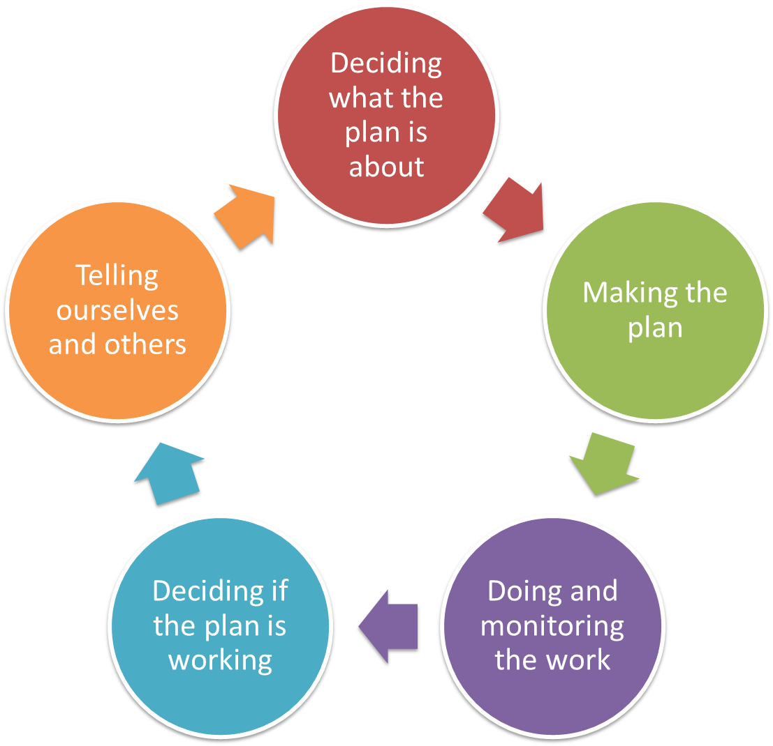
Pre-planning
Dream & Area
Targets & Health
Problems & Causes
Situation Analysis
In the Conservation Standards “Health” refers to “Viability”
Notes:
The Health step is really closely linked to the Target step in the HCP.
But it is an important bit of work that should be done as a specific step.

Slide 3
Deciding what the Plan is all about
Target Health
Overview
What is health?
Steps to decide the health of a Targets - Example
Steps to decide the health of a Targets - Detail
General guidance
Alternative approaches
Notes:
What do we mean by Health?
Something is healthy if it can come back from being sick.
If I am healthy and I get a cold, I will get better – we say that I am healthy.
But if I get a cold and get sicker then I am not healthy.
It is the same for our targets.
We talk about health as a way of thinking about resilience.

Slide 4
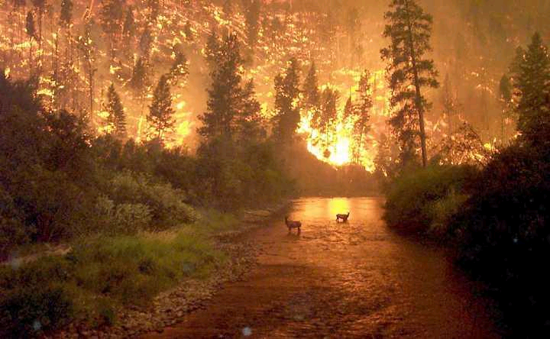
Deciding what the Plan is all about
Target Health
Health (Viability) and Attributes
The ability of a target to withstand or recover from disturbances or survive in hard times and continue to exist is its health
If it is healthy it is resilient
  recover from disturbances
  survive in hard times
  continue to exist
Notes:
What do we mean by Health?
Something is healthy if it can come back from being sick.
If I am healthy and I get a cold, I will get better – we say that I am healthy.
But if I get a cold and get sicker then I am not healthy.
It is the same for our targets.
We talk about health as a way of thinking about resilience.

Slide 5
Deciding what the Plan is all about
Target Health
The important things that make targets healthy
Why do this step?
  To be able to say what makes the targets healthy, how we will measure that, and if they are getting better or worse
  Work here will make the next steps easier and more focused
    Overall Health tells you what to work on first
    Attributes help you work out threats
    Indicators tell you what to measure and monitor
Notes:
This is an important step and gives us a lot of information for the rest of the process.
It also make sure our Targets really are Targets.

Slide 6
Deciding what the Plan is all about
Target Health
Why assess health?
Helps to clearly define targets
Foundation for establishing what the health is now of a target and setting what we want the health to be
Helps to identify threats to each target and understand exactly how these threats hurt the target
Assists in developing good goals and strategies
Guides the design of monitoring protocol and measures of success
Helps identify critical knowledge gaps about the system
Notes:
This list sets out all the reasons why we do the health step.
It is worth focusing on this list for a moment or two and noting that it helps with some of our decisions in the future.

Slide 7
Deciding what the Plan is all about
Target Health
Health (Viability) and Attributes
Its attributes are the things we use to talk about the health of the target
Attributes are the main things used to ‘diagnose’ that health e.g. like a doctor would check your circulatory system to gain insight into your health
Notes:
To look at health we look at two things – attributes
And indicators
If you are just doing this quickly you can skip attributes and just focus on indicators – attributes just help you to think a bit more clearly about what indicators will be important

Slide 8
Deciding what the Plan is all about
Target Health
Attributes and Indicators
Indicators are the things that can be
measured to tell us if our attributes are viable
    E.g. pulse, blood pressure
‘Things we measure’
Indicators tell us:
  Signs of good health
  Signs of bad health
Notes:
Indicators are an important thing to identify because they tell us what we might measure or talk about to decide if our targets are getting healthier.

Slide 9
Deciding what the Plan is all about
Target Health
Who/how?
Planner / facilitator
People who can speak for country / have traditional responsibility for places
People who know the landscape well, its features and how it works
Scientists and specialists
Usually repetitive and iterative
Better to use small groups/individuals
Notes:
This step takes a bit of thinking and time and is best done in small groups of 4-6 people. If you are doing this as part of a larger workshop, then break it into smaller groups and have the groups work separately.
To do this well you need a mix of skills and knowledge – this list is a good indicator.
It is important to have someone be the facilitator otherwise the process can get really bogged down.

Slide 10
Deciding what the Plan is all about
Target Health
Overview
What is health?
Steps to decide the health of a Targets - Example
Steps to decide the health of a Targets - Detail
General guidance
Alternative approaches
Notes:
What do we mean by Health?
Something is healthy if it can come back from being sick.
If I am healthy and I get a cold, I will get better – we say that I am healthy.
But if I get a cold and get sicker then I am not healthy.
It is the same for our targets.
We talk about health as a way of thinking about resilience.

Slide 11
Deciding what the Plan is all about
Target Health
Health analysis has four steps
Step 1: Select Attributes
Step 2: Identify indicators for the Attributes
Step 3: Rate the indicators (good, fair, etc)
Step 4: Assign current status
Notes:
These are the steps, and you follow these for each Target
You will usually select 3-4 key attributes
Then usually 1 or 2 indicators for each of those
It is important to keep focusing on the key things otherwise you can end up with a lot of detail you don’t need.

Slide 12
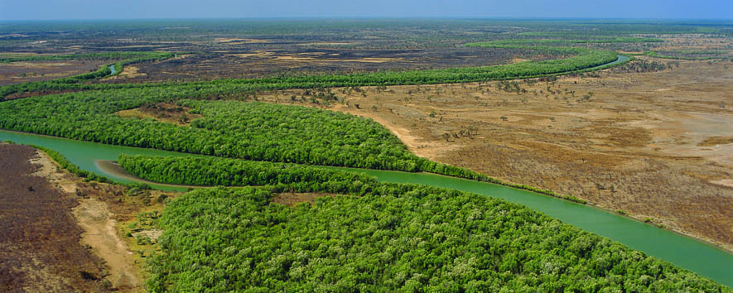
Deciding what the Plan is all about
Target Health
1. Define Attributes
Target | Category | Attribute
River | Connectivity | Riparian Vegetation
Notes:
These next 7 slides just show those steps really quickly so you can get an idea, and then we will talk about each on in detail.
So, first define an Attribute

Slide 13
Deciding what the Plan is all about
Target Health
2. Identify Indicator(s) for Attributes
Target | Category | Attribute | Indicator
River | Connectivity | Riparian Vegetation | % Km of continuous vegetation
Notes:
Then decide on an Indicator for that attribute
Keep telling the story – eg if we see a certain percentage of continuous riparian vegetation then we know the river is healthy

Slide 14
Deciding what the Plan is all about
Target Health
3. Rating Scale
Develop Rating Scale for Indicator
on “Acceptable Range of Variation”
 |  |  |  | Indicator Ratings
Target | Category | Attribute | Indicator | Poor | Fair | Good | Very Good
River | Connectivity | Riparian Vegetation | % Km of continuous vegetation

Slide 15
Deciding what the Plan is all about
Target Health
3. Rating Scale
Poor:
Restoration increasingly difficult; May result in extirpation
Fair:
Outside acceptable range of variation; Requires intervention to get to good
Good:
Within acceptable range of variation; Some intervention required to maintain
Very Good: Ecologically desirable status; Requires little intervention to maintain
 |  |  |  | Indicator Ratings
Target | Category | Attribute | Indicator | Poor | Fair | Good | Very Good
River | Connectivity | Riparian Vegetation | % Km of continuous vegetation |  | 70-80 % | 80-90%
Threshold line
Notes:
Then decide on ratings for the indicator
Keep telling the story – eg if we see 80-90% of continuous riparian vegetation then we know the river is in good health

Slide 16
Deciding what the Plan is all about
Target Health
3. Rating Scale
Poor:
Restoration increasingly difficult; May result in extirpation
Fair:
Outside acceptable range of variation; Requires intervention to get to good
Good:
Within acceptable range of variation; Some intervention required to maintain
Very Good: Ecologically desirable status; Requires little intervention to maintain
 |  |  |  | Indicator Ratings
Target | Category | Attribute | Indicator | Poor | Fair | Good | Very Good
River | Connectivity | Riparian Vegetation | % Km of continuous vegetation | <70% | 70-80 % | 80-90% | >90%
Threshold line
Notes:
Then decide on all the ratings for the indicator (if you need to)

Slide 17
Deciding what the Plan is all about
Target Health
4. Current & Future Health
Poor:
Restoration increasingly difficult; May result in extirpation
Fair:
Outside acceptable range of variation; Requires intervention to get to good
Good:
Within acceptable range of variation; Some intervention required to maintain
Very Good: Ecologically desirable status; Requires little intervention to maintain
 |  |  |  | Indicator Ratings
Target | Category | Attribute | Indicator | Poor | Fair | Good | Very Good
River | Connectivity | Riparian Vegetation | % Km of continuous vegetation | <70% | 70-80 % | 80-90% | >90%
Current Health |  |  |  |  | 75%
Desired Future Health |  |  |  |  |  | 85%
Notes:
Then decide on current and future status (health)
Keep telling the story – eg we currently see 75% of the riparian vegetaion is there which means the river is fair, and we want to see 85% continuous riparian vegetation then we know the river will be in good health

Slide 18
Deciding what the Plan is all about
Target Health
Good Health = Minimum attributes to Reflect Target needs
 |  |  |  | Indicator Ratings
Target | Category | Attribute | Indicator | Poor | Fair | Good | Very Good
River | Connectivity | Riparian Vegetation | % Km of continuous vegetation | <70% | 70-80 % | 80-90% | >90%
River | Size | Volume of water in mid dry season | Water level compared to long-term average | > 3m of average | Within 2m of average | Within 1m of average | Average
River | Condition | Water quality | Drinkable | Can’t drink | Drink if had to | Ok to drink | Good to drink
Notes:
If we do this for all the attributes this gives you a full picture of how we understand health.
The overall health rating is each of the Attributes added together
eg Riparian Vegetation AND Volume of water AND water quality all need to be healthy for the River to be healthy

Slide 19
Deciding what the Plan is all about
Target Health
Cultural Knowledge Target
 |  |  |  | Indicator Ratings
Target | Category | Attribute | Indicator | Poor | Fair | Good | Very Good
Cultural Knowledge | Culture | Transmission (passing on) of cultural knowledge | Elder Satisfaction | Un-satisfied | Satisfied | Very Satisfied | NA
Cultural Knowledge | Culture | Use of cultural knowledge for managing country | Elder Satisfaction | Un-satisfied | Satisfied | Very Satisfied | NA
Notes:
This is the same table but now showing some attributes and indicators for the Cultural Knowledge Target.
Here we are looking at qualitative indicators as qualitative indicators are not appropriate for this context.
We have also adopted only three levels of the rating guide as sufficient.

Slide 20
Deciding what the Plan is all about
Target Health
Overview
What is health?
Steps to decide the health of a Targets - Example
Steps to decide the health of a Targets - Detail
General guidance
Alternative approaches
Notes:
What do we mean by Health?
Something is healthy if it can come back from being sick.
If I am healthy and I get a cold, I will get better – we say that I am healthy.
But if I get a cold and get sicker then I am not healthy.
It is the same for our targets.
We talk about health as a way of thinking about resilience.

Slide 21
Deciding what the Plan is all about
Target Health
Step One – Select Attributes
Characteristics of the target
that if eliminated or significantly altered, would see the target being unhealthy or would shift it into something quite different.
Notes:
Now we go back and talk about the Steps in more detail.
Back to step 1 – what is an Attribute = characteristic that is critical for health
Needs to be critical – not just any old thing.
Think about people – we have many attributes that tell us something about us, but not all are critical for health eg length of fingernails is not as critical as blood pressure
So we want the 3-4 critical ones

Slide 22
Deciding what the Plan is all about
Target Health
Ways to think about Attributes
Size
  Area or abundance
Condition
  Composition (e.g. native vs. introduced)
  Structure (e.g. age)
Context
  Processes (e.g. fire)
  Connectivity (e.g. access to habitats/resources)
Culture
  Traditional knowledge and meaning
Notes:
Don’t “worry” about these categories or obsess about whether something belongs in one category or another.
We just use these to prompt and organize our ideas.
But it is important to note that there is a cultural element to all Targets – even those that might just be about the natural world

Slide 23
Deciding what the Plan is all about
Target Health
Tips for Selecting Attributes
Pick things that are critical for long-term health…
  eg if degraded, would seriously jeopardize the target’s ability to be healthy for 100+ years?
When in doubt, pick things that can be or are likely to be affected by human activities
Look for a few really key attributes
    NOT lots of desirable or descriptive characteristics
    NB these will need to be measured
Notes:
Focusing on the critical ones is key – we want the short list of the MOST important ones
It can help to brainstorm first and then lump and then decide – like we did for Targets

Slide 24
Target: River
Deciding what the Plan is all about
Target Health
Example Attributes
Attribute: Riparian Vegetation
Notes:
In this example, our Target is a River (an important one on country)
And our Attribute is the Riparian (riverside) vegetation – it is important for protecting the banks and shading the water

Slide 25
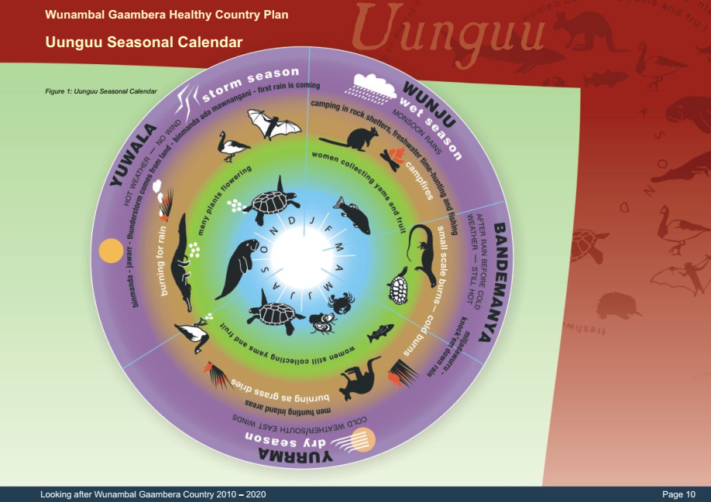
Target: Cultural Knowledge (TEK)
Deciding what the Plan is all about
Target Health
Example Attributes
Calendar from Wunambal Gaambera Healthy Country Plan 2010 © Wunambal Gaambera Aboriginal Corporation
Attribute: Transmission / Sharing of TEK
Notes:
In this example, our Target is Cultural Knowledge
And our Attribute is the Transmission of that knowledge– it is important that TEK is passed on to use in looking after country

Slide 26
Deciding what the Plan is all about
Target Health
Step Two - Select Indicators
Indicators are measurable parts of the Attribute that inform us of its status or “health”
Key Attribute: Circulatory system
Indicator: Blood pressure
Indicators are what you measure
Notes:
After we have identified Attributes we then need to decide how we will measure them – which is what we use indicators for
Again we can use the example of the human body.
In this case there could be a number of things to indicate the Circulatory system – length of blood vessels, volume of blood, average diameter of blood vessels etc
But we have chosen something relatively simple and easy to measure – that is a good guide to how we should do it for our planning as well.

Slide 27
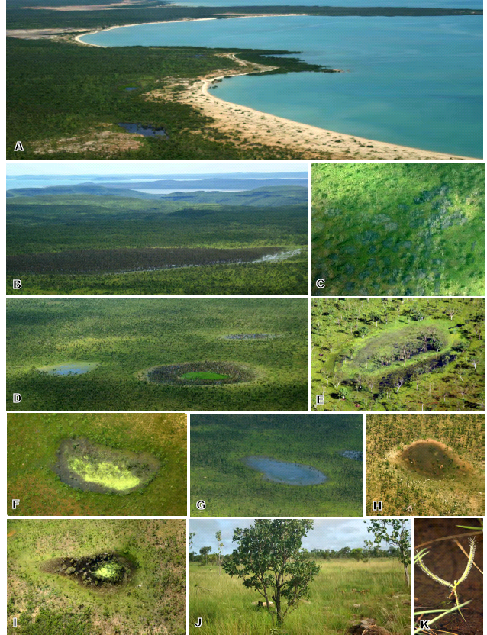
Deciding what the Plan is all about
Target Health
Look for indicators that ...
Use indicators that community members (landowners and managers) will and have used for millennia
Fat on the tail of kangaroo
How kangaroo/meat tastes
Knowledge of stories
Notes:
Indicators need to be important and meaningful for the people who have to make decisions about health
In this example these indicators are telling us about the fire regime: good fire = good habitat = healthy and tasty animals

Slide 28
Deciding what the Plan is all about
Target Health
Look for indicators that ...
  Strongly relate to the health of the attribute
  Are efficient & affordable to measure
  Where you can reasonably define what “Good” is
  Desirable indicators ...
    Might provide an early warning to serious threats
    Might assess two or more attributes
        e.g. Presence of young cypress in a floodplain forest as an indicator for both water regime & reproduction of important species
Notes:
Finding good indicators can be hard.
At this stage we keep some of these ideas in our mind as we select indicators to talk about, but don’t get too caught up in them just yet as we won’t decide which ones we need to measure until a bit later in the process
But it is still good to think about these ideas now

Slide 29
Making the Plan
Target Health
A good indicator
A good indicator should meet the following criteria:
Measurable: you can record something & analyze it.
Precise: Defined the same way by all people.
Consistent: Consistent over time so that it always provides comparable measurements.
Sensitive: Changes in response to actual changes in what you are measuring.
Sustainable: able to be used with the
resources you have
Notes:
This is a more ‘scientific’ list – but these are still important principles to keep in mind.
Finding good indicators can be hard.
At this stage we keep some of these ideas in our mind as we select indicators to talk about, but don’t get too caught up in them just yet as we won’t decide which ones we need to measure until a bit later in the process
But it is still good to think about these ideas now

Slide 30
Target: River
Deciding what the Plan is all about
Target Health
Example Indicators
Attribute: Riparian Vegetation
Indicator: % Km of continuous vegetation
Notes:
For this attribute we are going to use the number of kilometers of continuous vegetation as a portion of the total length
The more continuous the vegetation over a longer length the better

Slide 31
Deciding what the Plan is all about
Target Health
Example Indicators
Target: Cultural Knowledge (TEK)
Calendar from Wunambal Gaambera Healthy Country Plan 2010 © Wunambal Gaambera Aboriginal Corporation
Attribute: Transmission / Sharing of TEK
Indicator: Elder satisfaction
Notes:
For this attribute we are going to use the satisfaction of elders that knowledge (sometimes referred to as TEK – Traditional Ecological Knowledge) is being transferred
It is really only the elders who can determine if this is happening in an appropriate way
The more satisfied the better

Slide 32
Deciding what the Plan is all about
Target Health
Step Three - “Ranking” Target Health
Very Good:
Most desirable status; Requires little intervention for maintenance
Good:
Indicator within acceptable range of variation; Some intervention required for maintenance
Fair:
Outside acceptable range of variation; Requires human intervention
Poor:
Restoration very difficult; May result in extinction
Notes:
Once we have said what we think the indicator is we then set up a simple rating system, so that as we talk about the measurements coming for the indicators we know if that measurement is showing us that things are good or not.

Slide 33
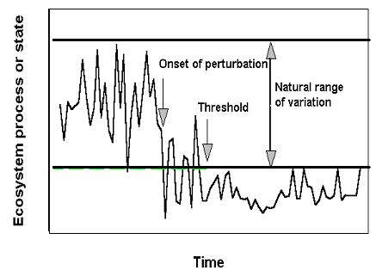
Deciding what the Plan is all about
Target Health
Step Three - “Ranking” Target Health
Develop Rating Scale for Indicator
on “Acceptable Range of Variation”
Notes:
It is important to remember that everything varies over time, and that is normal – a river can be dry and still healthy.
We call this ‘acceptable variation’. Something can vary and be healthy.
We only get concerned if the variation is more than we expect eg a river is dry in the wet season or wet in the dry season

Slide 34
Deciding what the Plan is all about
Target Health
Example Ranking and Status
Target: River
Attribute: Riparian vegetation
Indicator: % Km of continuous vegetation.
Very Good: >90%
Good: 80-90%
Fair: 70-80 %
Poor: <70%
Current status
Notes:
We have set up the rating here because we know that >90% would be a natural and ideal state (floods and fire would have broken things up in the past for example)

Slide 35
Deciding what the Plan is all about
Target Health
Example Ranking and status
Target: Cultural Knowledge (TEK)
Attribute: Transmission / Sharing of TEK
Indicator: Elder satisfaction
Very Good: NA
Good: Very Satisfied
Fair: Satisfied
Poor: Unsatisfied
Current status
Notes:
Here. There is not need to have Good and Very Good – so we are just going for a three level scale

Slide 36
Deciding what the Plan is all about
Target Health
The important things that make targets healthy
Wunambal Gaambera example
Notes:
When we have done the rating for all the Targets and all the attributes this can give us an overall health picture of the targets
This also starts to tell us where we might work – trying to fix the Poor, then the Fair, and get them to Good.
This things that are already Good we can leave and just focus on stopping threats (next step)

Slide 37
Deciding what the Plan is all about
Target Health
Overview
What is health?
Steps to decide the health of a Targets - Example
Steps to decide the health of a Targets - Detail
General guidance
Alternative approaches
Notes:
What do we mean by Health?
Something is healthy if it can come back from being sick.
If I am healthy and I get a cold, I will get better – we say that I am healthy.
But if I get a cold and get sicker then I am not healthy.
It is the same for our targets.
We talk about health as a way of thinking about resilience.

Slide 38
Deciding what the Plan is all about
Target Health
Flexible level of detail
Target | Attribute | Indicator | Poor | Fair | Good | Very Good
River | Riparian vegetation | Connectedness |  | Some not connected
River | Riparian vegetation | Connectedness |  | At least 5km connected | More than 5km connected
River | Riparian vegetation | % Km of continuous vegetation | <70% | 70-80 % | 80-90% | >90%
1
2
3
The project team could have used any one of these
- and changed over time
Notes:
Depending on the stage of the project and the knowledge of the people involved you might have a different level of detail for your indicators.
As long as you record it (write it down) then any of these might be ok to start, and even to continue if they tell you enough to make your management decisions.
But usually over time as we learn more we get more precise.

Slide 39
Deciding what the Plan is all about
Target Health
Incomplete is ok
How important is it to fill out all ratings where current & desired status is Very Good?
Probably not important!
  Unless River area is threatened by large-scale destruction.
  In this case, determining the Fair rating might guide efforts to determine how much to save
  And so that might be enough
Notes:
Just a reminder that you don’t need to complete everything before you move on.
Record what you know, make some decisions, and move kn.
You will come back to it in the review stage.

Slide 40
Deciding what the Plan is all about
Target Health
General Guidance
View main purpose as capturing the current state of knowledge
Don’t worry about information gaps
Don’t focus on filling out all indicator ratings
Can return during later planning stages to add more detail (if necessary)
Accept uncertainty!

Slide 41
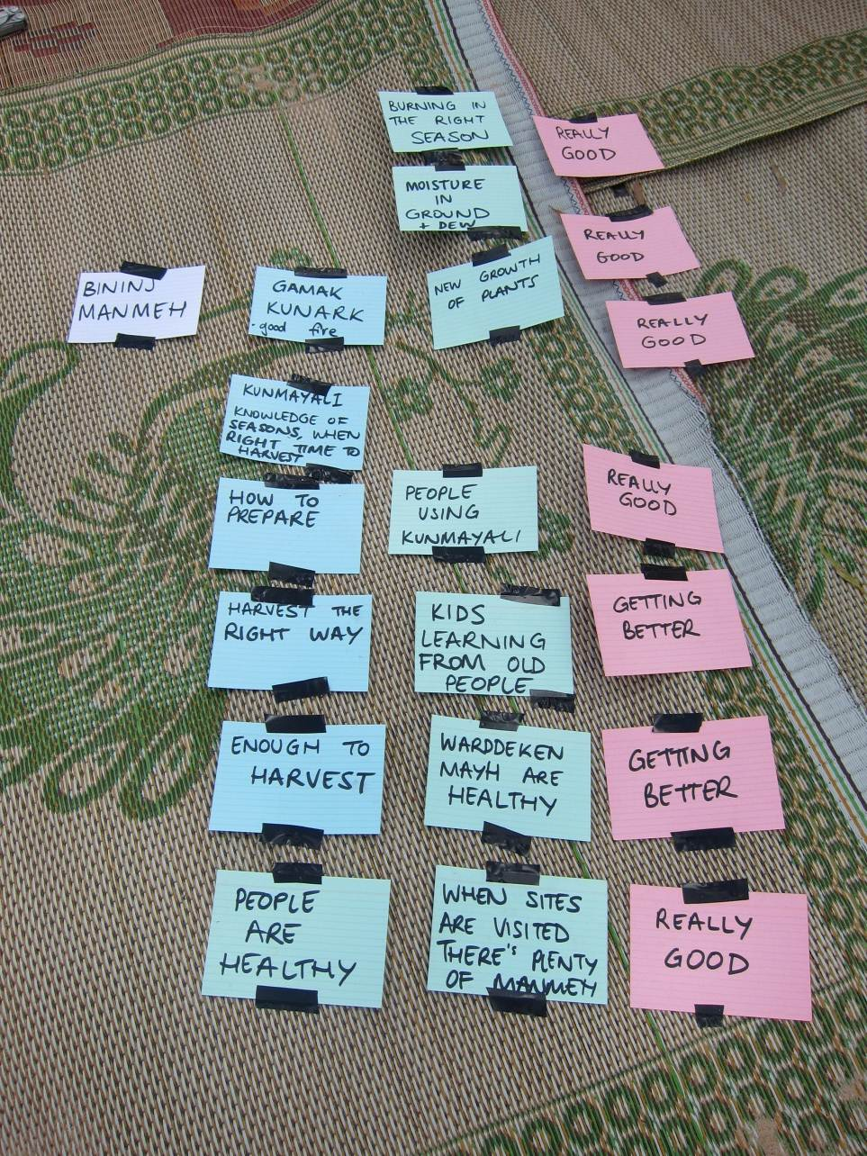
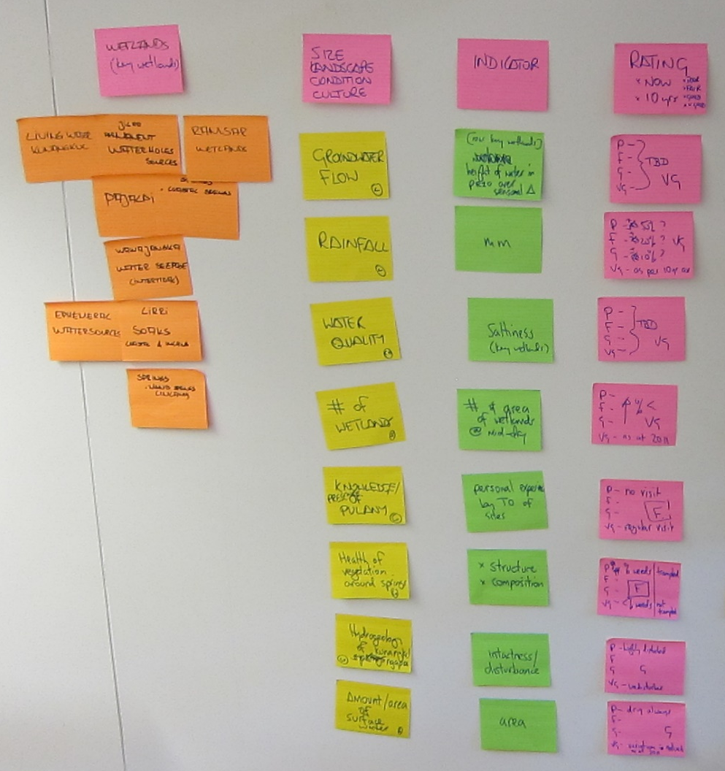
Deciding what the Plan is all about
Target Health
Example 1
Notes:
These are just examples of doing this process in practice – outside or inside, and using different language that was familiar to the people doing the work.
But the purpose is the same.
Note that in the example on the LHS the community have used ratings such as ‘Getting Better’ to indicate ‘Fair’. Although ‘Getting better’ is technically a trend and not a rating, the discussion that lead to the selection of ‘Getting better’ made it clear what it meant, and it translated back into Miradi as Fair.
If you are going to use ‘novel’ descriptions it is important they relate back to the standard definitions

Slide 42
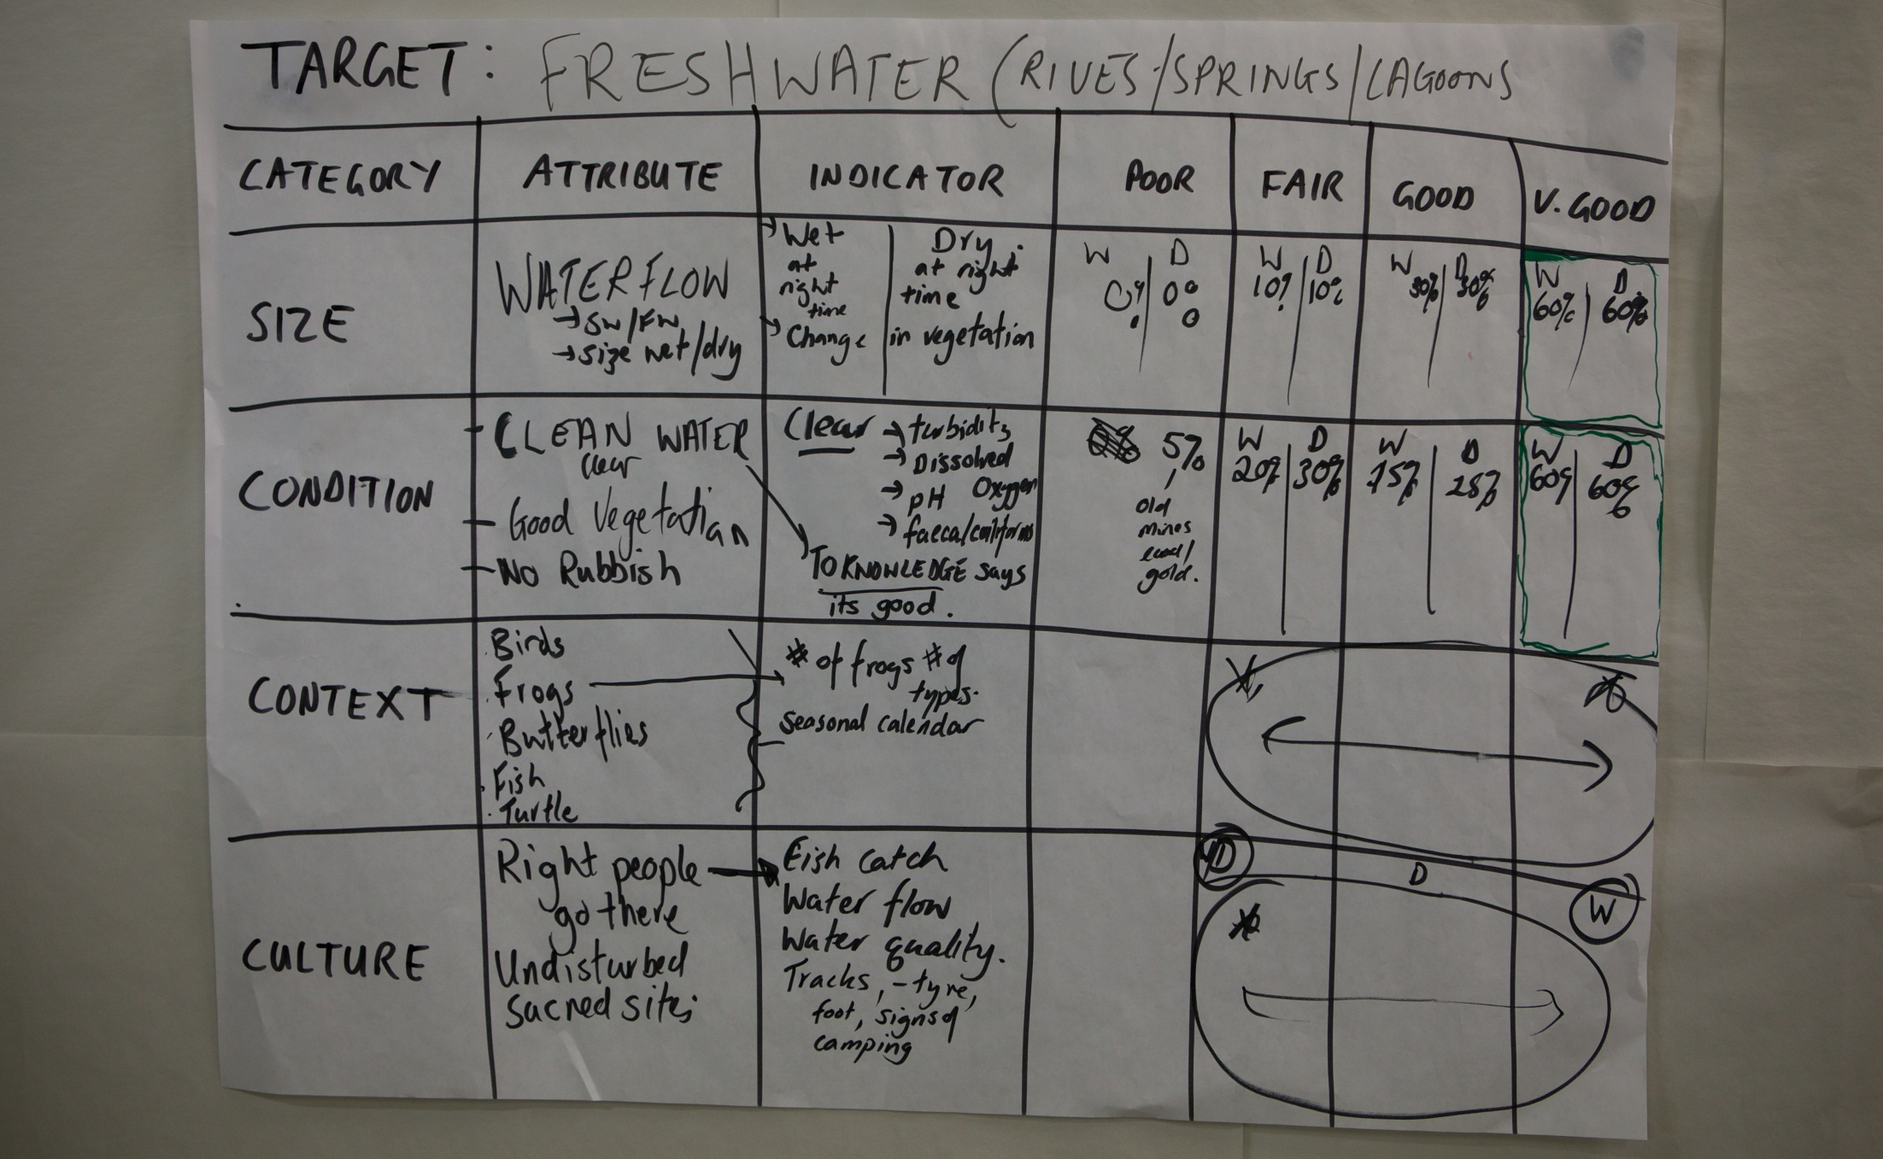
Deciding what the Plan is all about
Target Health
Example 2
Notes:
Another example of a workshop output that shows a table how it might look.

Slide 43
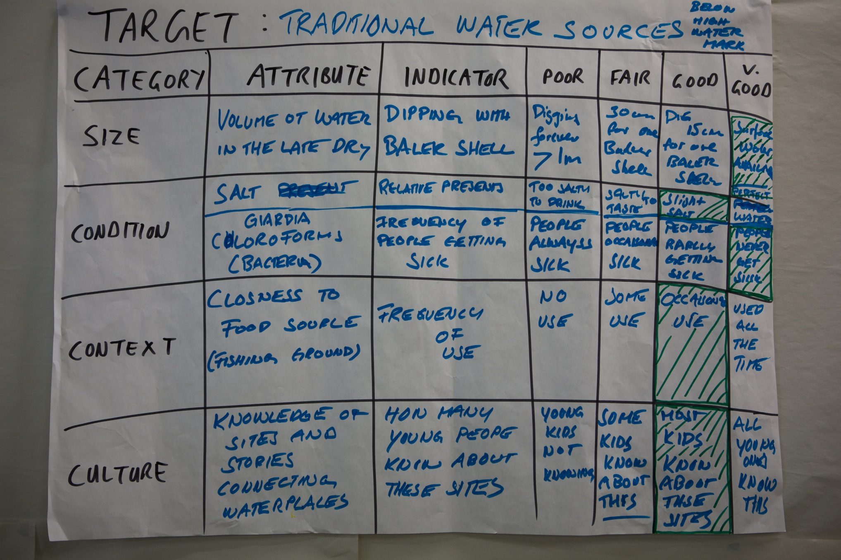
Deciding what the Plan is all about
Target Health
Example 3
Notes:
Another example of a workshop output that shows a table how it might look.

Slide 44
Deciding what the Plan is all about
Target Health
Hints
Work into viability slowly -- it’s complex
Proceed one target at a time – develop 1-3 KEAs & their associated indicators
Consider using small groups - or even a science subgroup - to tackle individual targets and then regroup to review
Encourage free thinking and general discussion about viability in the workshop. Capture the big ideas and observations and don’t worry about getting details right.
Notes:
These are just some hints to keep in mind as you get working on this step.

Slide 45
Deciding what the Plan is all about
Target Health
Overview
What is health?
Steps to decide the health of a Targets - Example
Steps to decide the health of a Targets - Detail
General guidance
Alternative approaches
Notes:
What do we mean by Health?
Something is healthy if it can come back from being sick.
If I am healthy and I get a cold, I will get better – we say that I am healthy.
But if I get a cold and get sicker then I am not healthy.
It is the same for our targets.
We talk about health as a way of thinking about resilience.

Slide 46
Deciding what the Plan is all about
Target Health
Approach # 2 – PCP Method
This is a simplified approach to talking about the health of a target
For each Target draw a diagram like this one, showing time on the bottom axis, and ranking on the side
Have the team start by nominating current condition, then 10 years ago, and then in 10 years if nothing is done
River
Very Good
Good
Fair
Poor
 |  |  | What is v good
 |  |  | What is good
 |  |  | What is fair
 |  |  | What is poor
10 years ago | Now | In 10 years
Notes:
Some folks find the tables a bit confusing and not easy to understand
This approach works well too, where people understand graphs
If you do this step for each of the targets it can create a useful visual impression of health.

Slide 47



Deciding what the Plan is all about
Target Health
Hints
Use visual aids to help define current and future condition
Desired future condition
Very Good
Good
Fair
Current condition (and trend)
Poor
Past
NOW
Future
Notes:
A similar approach using more symbols than words

Slide 48


Deciding what the Plan is all about
Target Health
Additional resources
Notes:
As always, resources to support you if you would like additional support.

Slide 49
Deciding what the Plan is all about
Target Health
Workshop activity
‘Brainstorm’ possible attributes using sticky notes
Organise into ‘like’ groups – these are your attributes
Copy into table
Then for each attribute
  Talk about how people know they are healthy (indicators)
  Talk about how healthy they are now and what the trend is (ranking)
Copy into Table
Look at the Sheet and consider:
  Questions that can help us in this part
  Considerations for planning on country
  Products generated in this step

Slide 50

Attribution
Product of the Conservation Coaches Network, 2019
These presentations were adopted of materials from members of the Conservation Coaches Network.
CCNet strongly recommends that this presentation is given by experts familiar with the adaptive management process presented by the Conservation Measures Partnership’s Open Standards for the Practice of Conservation / Community of Practice – Indigenous CS projects and CS projects on Indigenous Land and Waters.
You are free to share this presentation and adapt it for your use. Please attribute the work to CCNet. If you significantly alter, transform, or build upon this work, it may be appropriate to remove the HCP logo.

