Slide 1
THE OPEN STANDARDS FOR THE PRACTICE OF CONSERVATION
Planning, implementing, monitoring, and learning
from projects and programs at all scales
PHOTO: DIANE DETOEUF, WILDLIFE CONSERVATION SOCIETY
Notes:
Title Slide for Conservation Standards 4.0 Powerpoint presentation developed December 2020.
Photography Notes: Diane Detoeuf, Wildlife Conservation Society

Slide 2
ATTRIBUTION & USE
This slide deck is part of a series of presentations originally published in 2021 and corresponds with the 2020 release of Open Standards for the Practice of Conservation version 4.0. It replaces the 2014 edition of these presentations (identifiable by their bright green headers) which corresponded with 2013’s Open Standards for the Practice of Conservation version 3.0. The Conservation Measure Partnership (CMP) Presentations Working Group will continue to improve these presentations with pertinent new information and corresponding updates. This presentation was last updated: January 2021.
The slides in this presentation were developed by the CMP Presentations Working Group led by John Morrison with the assistance of Marika Suval, Daniel Sprod, and Andrew Bridges. Presentations were reviewed and vetted by the CMP Guidance Committee including: Marcia Brown, Caroline Stem, Catherine Payne, Felix Cybulla, Marie-Andree Carriere, Terri Schulz, and Will Beale.
The photographs contained in this presentation are copyrighted and all rights are owned by the respective photographers as identified on the slides and in the presenters’ notes. As such, each photograph is protected by United States and International copyright laws and may not be used or distributed for any other purpose beyond this presentation without the express written consent of the photographer.
We strongly recommend that this presentation be given by experts (trained conservation coaches; see Coaches Conservation Network for additional information) familiar with the adaptive management process presented herein.
Use of this Material: This work (excepting photography, see above) is licensed for use under a Creative Commons Attribution-ShareAlike 4.0 International License. Under this license, you may take the Conservation Standards and adapt or modify them as you see fit, provided you a) reference the original Conservation Standards (but not in any way that suggests that CMP endorses this derived work), and b) issue the derived work under a similar Creative Commons license or equivalent. You can also formally contribute your modifications to CMP, which will consider incorporating them in a future official version of the Conservation Standards. This process ensures that the Standards evolve through the input of a wide variety of practitioners, are adaptable to individual organizations’ needs, and yet provide a carefully managed global standard for conservation work.
Notes:
THIS SLIDE IS INTENDED TO BE HIDDEN.
Each slide in this and associated Conservation Standards presentations will have extensive notes in the format:
Learning Objective(s)
Presenter’s Notes
Photography Notes (if relevant)
General Notes about the Presentations
There are generally more slides than is practical to present – providing options for the presenter. We strongly suggest that you not try to show and explain every slide but be judicious in selecting what to present. Less is more.
This slide set is a remake of an earlier slide set, and the aim was to use more great photography and less text than the previous slide set. In order to balance the reduced text, we have made great efforts to enhance the notes section of each slide. The end result is that the presentation should be more engaging but will take a bit more preparation on the part of the presenter.
We are always open to feedback, so if you would like to comment on the presentations please email: john.morrison@wwfus.org

Slide 3
GENERAL PRINCIPLES
Collaborate
Involve stakeholders
Use the evidence base
Practice adaptive management
Document
Foster learning environment
PHOTO: JOHN MORRISON, WWF
Notes:
Learning Objective: This slide introduces the general principles of the Conservation Standards
Presenter’s Notes:
Collaborate with partners – One conservation organization will probably not have sufficient expertise or internal resources to do all the necessary work of a given project - you should identify and collaborate with key partners to implement your project by having individuals from partner organizations serve on your project team and/or by developing formal or informal relationships with these organizations. The Conservation Standards explicitly provide a common, transparent framework that enables effective information sharing and collaboration across a wide-range of partners.
Involve stakeholders – It is similarly important to define and, at every step, involve the appropriate stakeholders for your project’s context. Stakeholders are individuals, groups, or institutions that have an interest in, will be affected by, can provide evidence for, and/or may influence your project’s activities and results. In addition to the immediate members of your project team, stakeholders can include those whose behavior you would like to influence, those from whom you need support, those who might oppose your work, and those who may be affected by your interventions.
Appropriately use to the evidence base and contribute findings – Wherever appropriate, you should make use of all available local and global evidence to answer key questions about your project’s situation and actions. This evidence could range from local indigenous knowledge about the breeding grounds for a specific species to a global systematic review about the effectiveness of a proposed conservation action. As you learn more about your project, you should also contribute your evidence back to the broader community so that others can benefit from your experiences.
Practice adaptive management in the face of uncertainty – Although ideally you want to base your situation analyses and actions on available evidence, in many cases you may have to urgently take action without having complete information. In these cases, it is important to state the assumptions you are making and then systematically (but efficiently) collect and assess the information needed to test them so that you can adapt and learn.
Document your decisions – A key principle of both evidence-based conservation and adaptive management is to appropriately document the rationale and evidence supporting your decisions at each step. Not only does this documentation help you analyze why things worked or did not, but it also provides the basis for others to understand, vet, and provide input on the logic of your choices. Documenting decisions and providing evidence to sustain your assumptions also add transparency and accountability to your work. As a general principle, focus on the least amount of documentation that will help your team appropriately evaluate and learn from your work, as well as share with others.
Foster a learning environment – Another key principle of both evidence-based conservation and adaptive management is to learn from your results so you can improve over time. To this end, it is critical to embrace learning, recognize and admit mistakes, identify successes, and work to understand why some actions succeeded while others did not. A project and an organizational culture that values learning will help foster a safe learning environment. Creating this culture will likely require work and commitment from both lower and higher levels of each partner organization involved in the project.
Photography Notes: John Morrison, Fairbanks, Alaska
References:
(see CMP’s guidance on Defining and Using Evidence in Conservation Practice for more detail)

Slide 4
THIS PRESENTATION
Evidence-based Management & Adaptive Management
Conservation Standards Use
Overview of CS 4.0
Tools & Support
Adaptive management
PHOTO: QUANG NGUYEN, PEXELS
Notes:
Learning Objective: This slide explains the STRUCTURE and the learning objectives of this slide set.
Presenter’s Notes: By the end of this presentation you should be able to:
Understand why evidence-based management is important and when to use adaptive management where there is uncertainty
Have a sense of where the CS are used, and the variety of projects they can be used for
How the Conservation Standards have developed tools and approaches that are a powerful and adaptable framework
Access support, no matter what aspect or depth of understanding you need
For specific audiences, you may wish to also set specific organizational learning objectives
Photography Notes: Photo by Quang Nguyen from Pexels (2131967)

Slide 5
EVIDENCE-BASED & ADAPTIVE
MANAGEMENT
Adaptive management
PHOTO: QUANG NGUYEN, PEXELS
Notes:
Learning Objective: Divider slide introducing the first section of the presentation on Evidence-based and adaptive management, plus a brief introduction to the Conservation Standards
Presenter’s Notes:
The first part of the presentation is about Evidence-based and adaptive management.
Photography Notes: Photo by Quang Nguyen from Pexels (2131967)

Slide 6
EVIDENCE-BASED APPROACH
Seek best available
Used throughout
Confidence
PHOTO: JOHN MORRISON, WWF
Notes:
Learning Objective: This slide introduces the idea of an Evidence based approach
Presenter’s Notes:
“Evidence” in Evidence based conservation is defined as “relevant information used to assess one or more hypotheses related to a question of interest”.
[click]
Mature scientific fields such as medicine, engineering and education use comprehensive evidence-based approaches.
In conservation, sources of evidence can be absent, confusing or contradictory.
Types of evidence can range from high quality and reliable to inferential and anecdotal.
Always seek the best available to support your project.
[click]
Evidence is used throughout the CS, for instance:
• Informing stakeholder determination of appropriate project scope and targets;
Informing viability of targets
• Determining the presence/absence or the status of key factors such as conservation targets, biophysical factors,
direct threats, and contributing factors in a situation analysis;
• Determining the associative or causal relationships between key factors in a situation analysis or “theory of change” including
interactive and confounding factors;
• Setting desired outcomes for key factors such as targets or threat reduction results; and
• Deciding which action or set of actions to invest in to achieve desired outcomes.
[click]
A thorough analysis of evidence may results in differing levels of confidence in the implementation phase, from:
implementing at scale and monitoring only the implementation;
through adaptive management;
through to abandoning strategies initially thought useful.
Photography Notes: John Morrison, Brooks Range, Alaska
References:
Salafsky N, Boshoven J, Burivalova Z, et al. Defining and using evidence in conservation practice. Conservation Science and Practice. 2019;e27. https://doi.org/10.1111/csp2.27

Slide 7
ADAPTIVE MANAGEMENT
Complexity & uncertainty
Doing the right things?
Doing them well?
Achieving an impact?
PHOTO: FELIX CYBULLA, CYBULLA.ORG
Notes:
Learning Objective: Introduction to the concept of adaptive management
Presenter’s Notes:
Adaptive management is critical to help us to manage complexity & uncertainty.
Given the urgency of many environmental problems we need to act now, but we cannot be sure that our activities will lead to the desired results.
Thus we need to be willing to adapt.
CLICK
There are many ways we could try to do things to achieve our required impact. How do we know whether we are doing the right things?
How can we choose between the alternative ways?
How can we test the assumptions in our thinking
In the Conservation Standards, our key tools are a ‘Situation Model’ or analysis and ‘Theory of Change’, (or ‘Results Chain’)
CLICK
How do we know if we are doing them well in our work?
To be confident that we are doing our best, we define measureable outcomes for our actions
The degree to which we are achieving defined outcomes gives us confidence in our actions, long before the final impacts can be measured.
CLICK
And finally, in most conservation projects take a long time to become apparent, so it can be challenging to determine if we are achieveing an impact.
we need a roadmap to see whether we are travelling in the right direction along the way
If we find that our expected ‘signposts’ are not happening, we want to know as soon as possible, so we can
Understand where we are going wrong and
Adjust
This is central concept of adaptive management.
Photography Notes: Photo by Felix Cybulla
Reference: Margoulis et al.
https://www.researchgate.net/publication/257363563_Results_Chains_a_Tool_for_Conservation_Action_Design_Management_and_Evaluation
https://www.ecologyandsociety.org/vol18/iss3/art22/

Slide 8
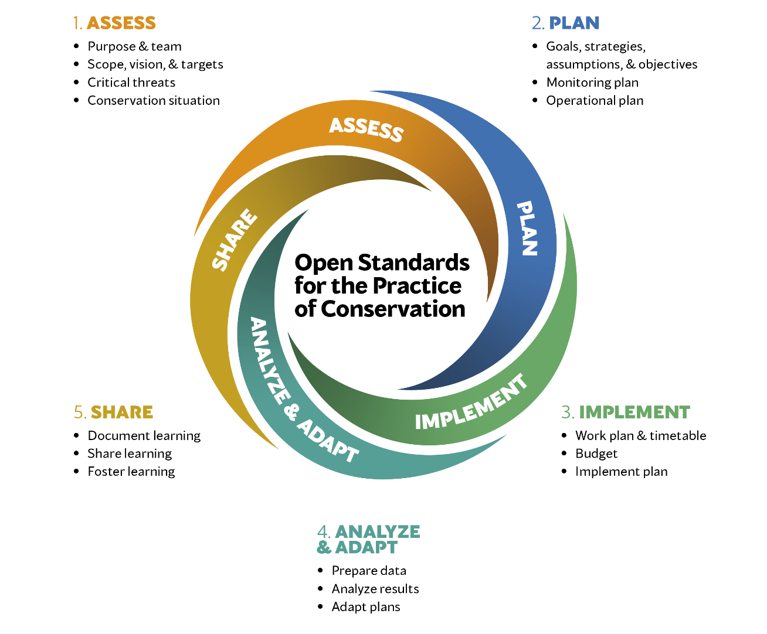
Notes:
Learning Objective: This alternative to the previous slide presents the five broad steps of the Conservation Standards
Presenters Notes:
Assess the conservation situation to prepare for planning
Develop a strategic plan
Implement and monitor the plan
Analyze the experience and monitoring and adapt as needed
Share learning from the experience.
Or with more detail (but note that this is covered in better detail further into the presentation):
The CS have developed a common language or lexicon so people across the globe can share their experience and questions with confidence.
They are open source, and thus can be adapted (and should be adapted) to suit to local circumstances.
They are drawn as a cycle, as the entry point will be different, depending on where the project is up to and furthermore, because planning and management should always adapt as better evidence comes to light.
The first step ASSESS is preparation for planning:
Who is doing the planning and why (purpose and team)
Where does the planning cover (Scope)
What is the vision, or overall outcome sought
Detail the elements or targets that comprise this outcome
How can their health or viability be measured, what is the health now, and what future health is sought
Resolve and rank threats to these targets
Understand who is driving these threats to seek the best points for intervention (conservation situation)
The second step PLAN develops the plan
What is to be achieved - goals
How should this be achieved - strategies
Check the assumptions, logic and critical markers along the way - results chains
From these, develop overall operational and monitoring plans
The third step IMPLEMENT breaks these down into workplans and is the implementation phase
Workplans, timelines and budgets for activities and monitoring
Accessing resources as needed
Doing and monitoring activities
The fourth step ANALYZE and ADAPT covers adaptive management
Prepare and analyze data
Adapt activities, plans and monitoring as needed
The fifth step SHARE comprises
Documenting and internal sharing or reporting
External sharing to build the evidence base
Building a culture of review for constant learning

Slide 9
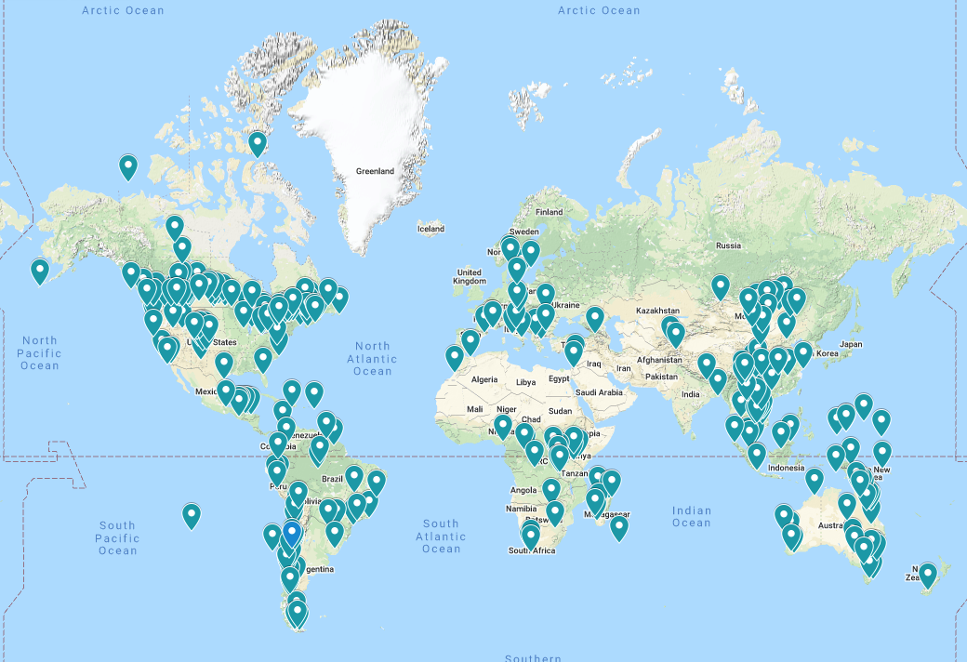
USE OF THE CONSERVATION STANDARDS
Notes:
Learning Objective: Understanding that the Conservation Standards have been used thousands of times all over the planet
Presenter’s Notes:
The Conservation Standards have been used thousands of times by hundreds of practitioners from many organizations. A number of national protected area agencies use the Conservation Standards (e.g., Chile, Madagascar, Mongolia).

Slide 10
WHERE IN THE WORLD?
Notes:
Learning Objective: Divider slide introducing the section of the presentation outlines WHERE the CS are used and WHO uses them for WHAT sort of projects
Presenter’s Notes:
The Conservation Standards have been used thousands of times by hundreds of practitioners from many organizations. A number of national protected area agencies use the Conservation Standards (e.g., Chile, Madagascar, Mongolia).
What kinds of projects are appropriate for using the Conservation Standards ? The Conservation Standards are not the right tool for every situation, and the use of a range of tools complementing the Standards is encouraged (e.g., systematic conservation planning for spatial planning), but every type of conservation project can benefit from using the Conservation Standards , including…

Slide 11
ECOSYSTEMS: REEFS
PHOTO: Francesco Ungaro/Pexels
Notes:
Learning Objective: An example of who uses the Conservation Standards and for what sort of projects – in this case for an ecosystem-based project
Presenter’s Notes:
The CS are used for all sorts of projects, including projects & programs designed to conserve entire ecosystems, like coral reefs.
More detail: In the marine environment to support and resolve reef, species and fisheries conflicts, such as
the Republic of Palau and the Federated States of Micronesia, where the Nature Conservancy works with local communities to protect reefs and fish stocks for livelihoods and future generations
Across many of the world oceans where a variety of international and local organisations including WWF and The Nature Conservancy address declining sea-turtle populations
Photography Notes: Photo by Francesco Ungaro from Pexels

Slide 12
SPECIES: CHIMPANZEES
PHOTO: BRECORD, JANE GOODALL INSTITUTE
PHOTO: FELIX CYBULLA, CYBULLA.ORG
Notes:
Learning Objective: Another example of who uses the Conservation Standards and for what sort of projects – in this case for a species-based project.
Presenter’s Notes:
The Conservation Standards are used for projects designed to conserve species or species groups.
More detail: In the mountains of Tanzania, where the Jane Goodall Institute (JGI) is focusing on saving chimpanzees – our closest evolutionary relatives.
Photography Notes:
Local field assistants at JGI have kept chimpanzee behavioural and other records for over 60 years, building a remarkable repository of data used both for understanding the great apes, but also humans.
Photography Notes: Brecord, Jane Goodall Institute

Slide 13
THEMATIC: WILDLIFE TRAFFICKING
THEMATIC: WILDLIFE TRAFFICKING
PHOTO: TANATHIP RATTANATUM, PEXELS
Notes:
Learning Objective: Another example of who uses the Conservation Standards and for what sort of projects
Presenter’s Notes:
The Conservation Standards are used for thematic projects, such as this wide global partnership called ROUTES (Reducing Opportunities for Unlawful Transport of Endangered Species) that seeks to disrupt wildlife trafficking in airports, seaports and warehouses – for instance Rhino horn, Reptile, Pangolin, Marine Products, Mammals, Ivory tusks and Birds
Photography Notes: Photo by Tanathip Rattanatum from Pexels

Slide 14
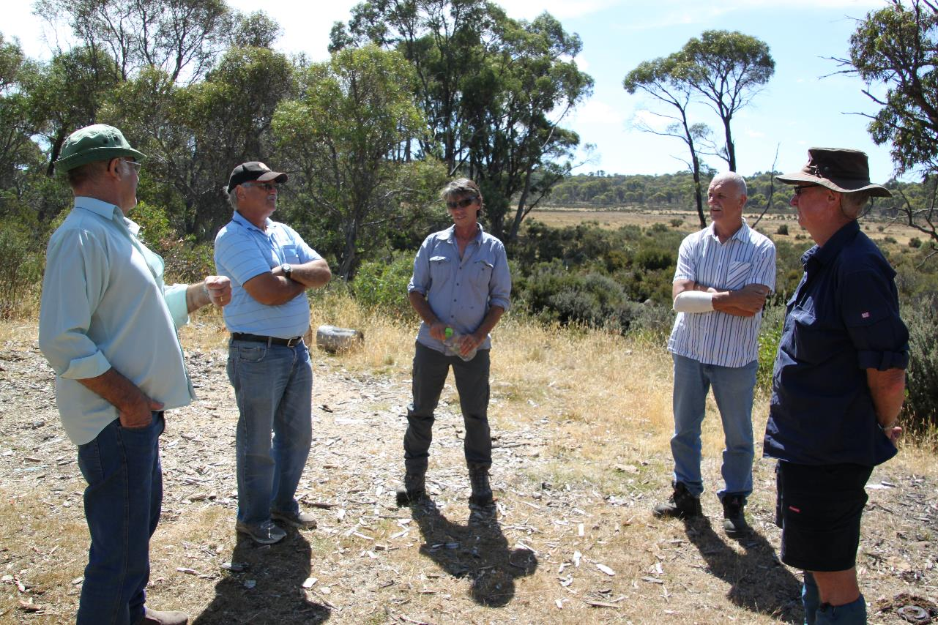
ORGANIZATIONAL: TRUST FOR NATURE
PHOTO: DANIEL SPROD
Notes:
Learning objective: CS can be used to plan and manage the strategies of entire conservation organizations
Presenters notes:
The CS are adaptable to many non-conservation planning and managing organisations, such as the Australian state conservation organisation: Trust for Nature.
Photography Notes: Daniel Sprod - Discussing property acquisition with indigenous partners

Slide 15
COMMODITY PRODUCTION: OIL PALM
PHOTO: JOHN MORRISON, WWF
Notes:
Learning Objective: CS can be used to work on improved commodity production,
Presenter’s Notes:
The Conservation Standards are used for thematic projects, such as those dealing with commodity production (and consumption) of commodities like oil palm, soy, and beef
Photography Notes: John Morrison, harvested palm oil bunches, Sabah, Borneo, Malaysia

Slide 16
HIGH LEVEL POLICY INFLUENCE
Notes:
Learning Objective: CS can be used to work on high level policy issues.
Presenter’s Notes:
The Conservation Standards are used for thematic projects, such as those addressing high level policy instruments like Sustainable Development Goals (SDGs), the Convention on International Trade in Endangered Species (CITES),or the Convention on Biological Diversity (CBD).
Photography Notes:

Slide 17
CLIMATE AND ENERGY POLICY
PHOTO: NARCISA ACIKO, PEXELS
Notes:
Learning Objective: CS can be used to work on climate and energy policy issues.
Presenter’s Notes:
The Conservation Standards are used for thematic projects, such as those dealing with climate change mitigation (and related energy policy), climate adaptation.
Photography Notes: Narcisa Aciko (https://www.pexels.com/photo/photo-of-wind-turbines-lot-1292464/)

Slide 18
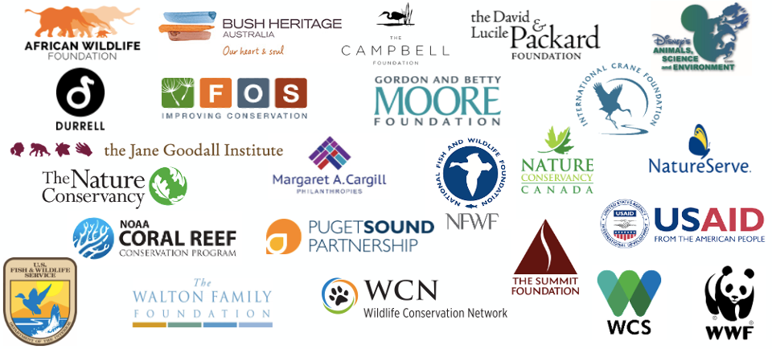
CONSERVATION MEASURES PARTNERSHIP
Notes:
Learning Objective: This slide presents the “current” (June 2020) members of the Conservation Measures Partnership that developed the Conservation Standards based on earlier work in conservation and other fields.
Presenter’s Notes:
The CS were developed by the Conservation Measures Partnership (CMP), originally
Foundations of Success (FOS),
The Nature Conservancy (TNC),
World Wildlife Fund (WWF),
African Wildlife Foundation (AWF),
Wildlife Conservation Society (WCS) and
Conservation International (CI).
and now they are used by a range of organizations, some of which are featured here among the members of the Conservation Measures Partnership. (Note that not all of these organizations use the Conservation Standards exclusively).
Logo notes: Up-to-date CMP member logos are here
[https://drive.google.com/drive/u/0/folders/0B0LmkRENkfPsaXJKMVQ4R3YzdjQ]

Slide 19
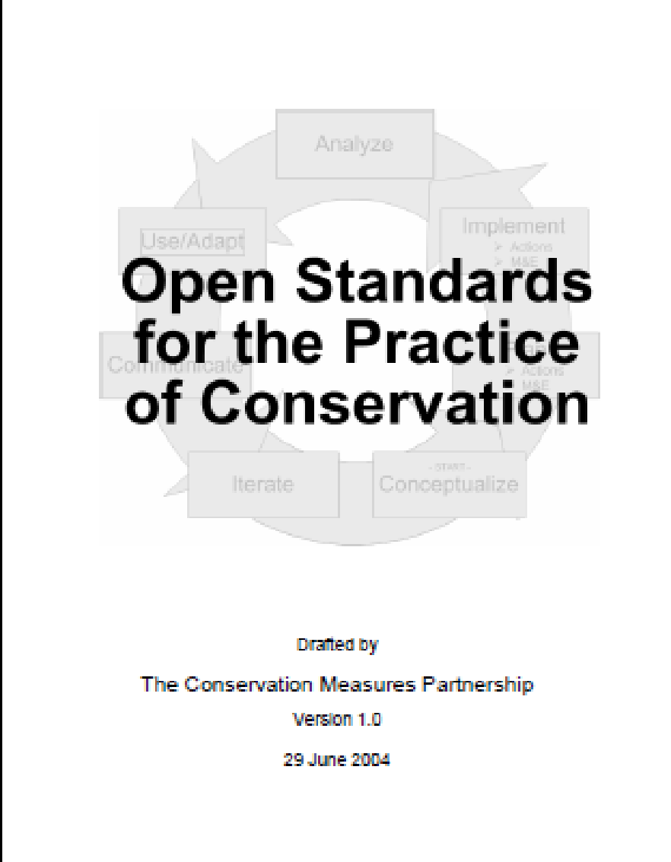
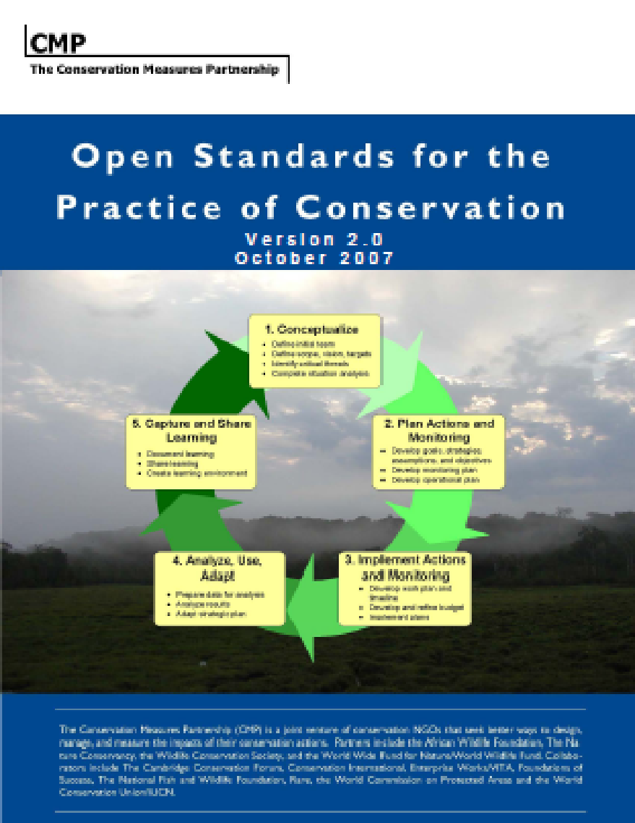
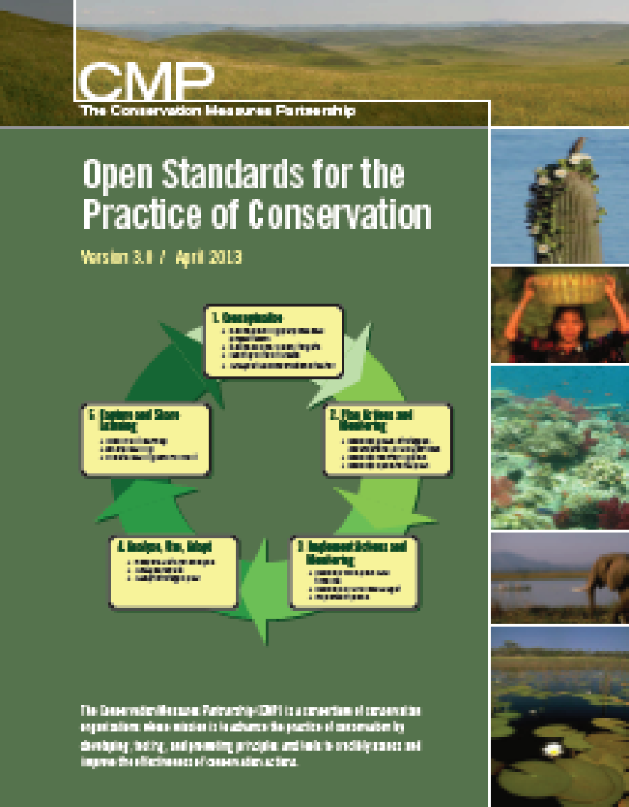
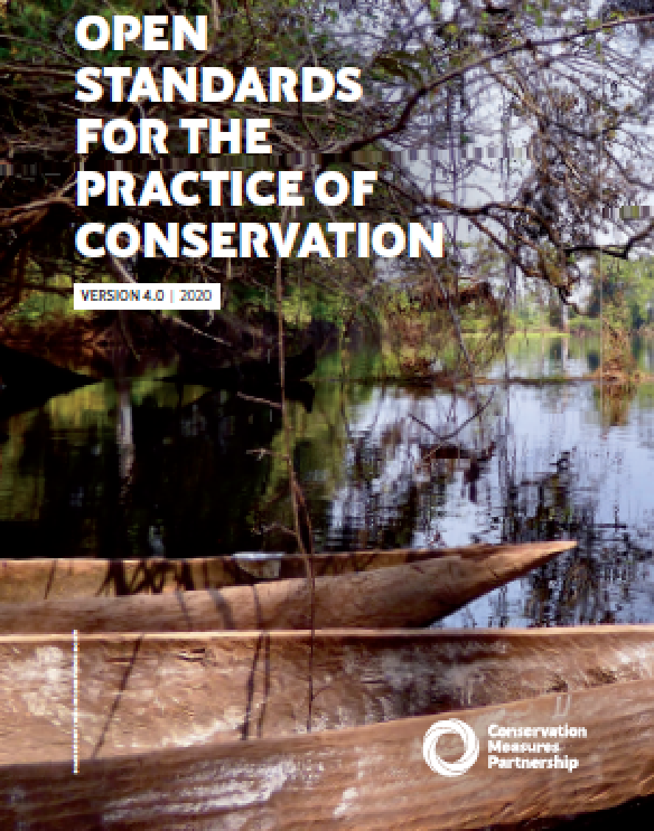
EVOLUTION
Conservation Measures Partnership
established
(CMP)
Open
Standards
formalized
Open Standards 2.0
Open Standards 3.0
Conservation Standards
4.0
?
2002
2004
2007
2009
2013
2020
Conservation Coaches Network (CCNet) Chartered
Coaches Network formed in The Nature Conservancy
Notes:
Learning Objective: Introduce participants to the history of the co-development/evolution of Conservation Standards and the Coaches Conservation Network (CCNet) up to the present.
Presenter’s Notes:
The Open Standards for the Practice of Conservation – or Conservation Standards - are ultimately a product of the collaborative work of the Conservation Measures Partnership.
CLICK
Important foundations include:
a planning framework used by The Nature Conservancy (TNC), eventually called Conservation Action Planning;
a book, Measures of Success, by Salafsky & Margoluis,published in 1998; and
the results of the 2002 Measuring Conservation Impact (MCI) Initiative that reviewed experiences in seven fields – conservation, public health, family planning, international development, social services, education, and business – to determine common concepts of and approaches to good project design, management, and monitoring.
CLICK
The Conservation Measures Partnership (CMP) has roots both in the conservation and donor communities. During the July 2002 annual meeting of the Society for Conservation Biology, members of the USAID-funded Global Conservation Program – in particular WWF-US, WCS and TNC – called together conservation practitioners who shared similar questions and concerns about how they monitor and measure conservation success. Since 2002, CMP membership has grown, and numerous products have emerged.
CLICK
The Conservation Standards were codified in 2004. Individual CMP member organizations contributed their experience in project implementation to refine the Conservation Standards and focus them more specifically on biodiversity conservation.
CLICK
At the same time, TNC realized that in order to assist conservation teams to apply the Conservation Standards effectively, that the services of a trained “coach” was extremely helpful. Thus what was known as the Efroymson Coaches Network was formed, sponsored by a gift from the Efroymson family.
CLICK
The Conservation Standards were updated with the release of Version 2.0 in 2007.
CLICK
The Conservation Coaches Network (CCNet) evolved from TNC’s Efroymson Coaches Network in response to the opportunity to address demand for project team support & influence a growing community of Conservation Standards users in and out of CMP Partners.
CLICK
Version 3.0 of the Conservation Standards were released in 2013, while
CLICK
Version 4.0 was released in 2020.
CLICK
The Conservation Standards will continue to evolve and who knows what innovations will develop over the next few years.

Slide 20
CONSERVATION STANDARDS V4.0
PHOTO: FELIX CYBULLA, CYBULLA.ORG
Notes:
Learning Objective: Divider slide to introduce the next section which provides a quick overview of all the steps of the CS to give an insight into how the framework fits together
Presenter’s Notes:
The next section gives a quick overview of all the steps of the Conservation Standards
Photography Notes: Felix Cybulla, tarsier

Slide 21
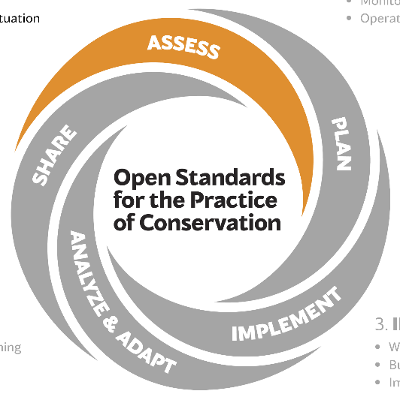
1. ASSESS
Purpose & team
Scope & vision
Targets & Viability
Threats
Conservation situation
Notes:
Learning Objective: Everyone is oriented to where we are in the five steps of the Conservation Standards.
Presenter’s Notes: We are now in Step 1: Assess. The first step in the CS is to Assess the get ready to plan and to start understanding the overall situation:
Get consensus on what the purpose of the project & planning are and who should be on your project team
Understand the literal & conceptual boundaries forming the scope of the project
Get consensus on what the vision the project is trying to achieve
Understand the what the project is focused on and how healthy these things are, i.e., the targets and their viability
Understand the threats to the conservation focus
Understand the conservation situation including the drivers & opportunities related to the threats & synthesize and how to synthesize that information.

Slide 22
SCOPE
Place-based
Target-based
Thematic
PHOTO: MAX, UNSPLASH
Notes:
Learning Objective: This slide introduces the different types of project Scope
Presenter’s Notes:
We generally recognise three types of project Scope:
1. Place-based (e.g., Ecoregion, priority area, or protected area; e.g., Gobi desert, Great Barrier Reef or here on Wunambal Gaambera in NW Australia, where the traditional owners have establish an Indigenous Protected Area)
2. Target-based (e.g., species, species assemblages, or ecosystems; e.g., Gobi bear or Amazonian Brazil nut forest, sea turtles in the Eastern Pacific Ocean). Target-based projects usually also have a or multiple geographies associated with them.
3. Thematic (e.g., project based on particular threats, contributing factors, or strategies; e.g., reducing carbon emissions, or wildlife trafficking (as here), reducing bycatch by promoting alternative fishing gear).
The Scope of a thematic project can be global.
You may cycle through all three of these approaches as you work through the steps for your own project. Deciding exactly where you are working may take a while to decide, as the area may expand and contract as you think about the work you are hoping to pursue.
Photography Notes: Photo by “Max” on Unsplash

Slide 23
SPATIAL INFORMATION
Applicable throughout
GIS… sketch maps
MiradiShare
Notes:
Learning Objectives:
The purpose of this slide is twofold:
Let viewers know that the blue box and icon in this slide will be repeated in the slide series – relating to mapping & GIS considerations
Provide some very basic general considerations for mapping & GIS into the Conservation Standards
Presenter Notes
We will periodically include notes about how to incorporate mapping & GIS into the Conservation Standards framework.
Here are some general considerations for incorporating mapping & GIS in the Conservation Standards:
Maps are applicable throughout and useful in virtually every step of the Conservation Standards
Scope – reference to maps is critical during the scoping phase
Target selection – it is important to understand where your targets are located and the extent to which they overlap
Target viability – knowledge of the distribution of targets is frequently important to understanding target viability
Threat rating – maps can assist with understanding the scope of direct threats
Situation diagram – maps can be very helpful in understanding the contributing factors to direct threats
Strategies – maps will be helpful when discussing where different strategies will be implemented
Maps don’t have to be GIS, fancy or detailed to be useful – sketch maps are extremely useful tools to get an understanding among the group
Mapping is now part of MiradiShare and promises to be an important element of the program in the future
Photography Notes:

Slide 24
VISION
Relatively general
Visionary
Brief
PHOTO: ANDREW BRIDGES
Notes:
Learning objective: This slide provides some details about vision statements
Presenter’s Notes:
The Vision Statement encompasses what success in your project will look like. A good way to think of this is if you looked back after your project was finished, what would you see?
Though this step can sometimes seem trivial, experience shows that the development of a vision statement can bring out differences of opinion among the project team of what the project is about, and when involving stakeholders, ensures that everyone’s voice is heard and incorporated into the vision.
Seek to have the vision be relatively general, so many people can identify with it, visionary!! And brief.
Photography Notes: Andrew Bridges; Yellowstone Nation Park, Montana, USA.

Slide 25
CONSERVATION TARGETS
Ecosystems
Habitats
Species
PHOTO: ANDREW BRIDGES
Notes:
Learning Objective: This slide shows examples of different types of Conservation Targets
Presenter’s Notes:
Conservation Targets can be entire ecosystems, habitats such as this riparian grassland, or individual species or assemblages.
For a target-based project, the targets will generally be obvious (e.g., “tigers” and or “tiger prey” for a tiger-based project).
For a place-based project, “targets” are selected to represent the full array of biodiversity, with the fewest targets. These targets will form the basis for setting goals, selecting actions, and measuring effectiveness. As natural resource managers, we are often asked to “protect this”. In this photo alone, we see a lake system, a pelagic ecosystem, a coastal ecosystem, several Azorean endemic plant communities, and more! How can we represent thousands of plants and animals and a myriad of habitats and ecological processes?
Targets may be subtler for thematic projects.
Large scale targets such as the ecosystem level shown here, will have “nested” targets within. In this case, a wetland flowing plant species, and rare species of trout, are nested within the largescale riverine ecosystem target to reduce complexity for planning purposes.
Photography Notes: Andrew Bridges; (Lagoa do Fogo (Lake/Lagoon of Fire) is a crater lake within the Água de Pau Massif stratovolcano in the center of the island of São Miguel, Azores, Portugal)

Slide 26
HUMAN WELL-BEING TARGETS
Livelihoods
Health
Social cohesion
Security
Governance
PHOTO: QUANG NGUYEN VINH, PEXELS
Notes:
Learning Objective: this slide provides examples of human well-being targets
Presenter’s notes:
Here are some human well-being targets. There are many ways in which ecological conservation can benefit people, some of which include livelihoods, human health, social cohesion, security, and governance. These are actually broad categories of human well-being targets – you can be much more specific than this if you need to, depending on your project.
Photography Notes:
Photo by Quang Nguyen Vinh from Pexels

Slide 27
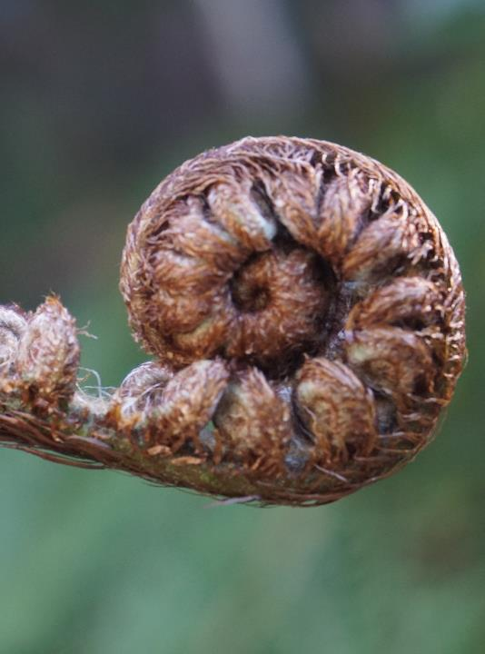
ECOSYSTEM SERVICES
Clean water
Wild foods
Recreation opportunities
Cultural icons
PHOTO: JOHN MORRISON, WWF
Notes:
Learning Objective: this slide provides examples of ecosystem services
Presenter’s notes:
Here are some examples of specific ecosystem services. These are probably easier to understand than the categories developed by the Millenium Ecosystem Assessment:
1. Provisioning Services: any type of benefit to people that can be extracted from nature. Along with food, other types of provisioning services include clean water, timber, wood fuel, natural gas, oils, wild foods, plants that can be made into clothes and other materials, and medicinal benefits.
2. Regulating Services: the benefit provided by ecosystem processes that moderate natural phenomena. Regulating services include pollination, decomposition, water purification, erosion and flood control, and carbon storage and climate regulation.
3. Cultural Services: non-material benefit that contributes to the development and cultural advancement of people, including how ecosystems play a role in local, national, and global cultures; the building of knowledge and the spreading of ideas; creativity born from interactions with nature (music, art, architecture); and recreation opportunities.
4. Supporting Services: underlying natural processes, such as photosynthesis, nutrient cycling, the creation of soils, and the water cycle. These processes allow the Earth to sustain basic life forms, let alone whole ecosystems and people. Without supporting services, provisional, regulating, and cultural icons wouldn't exist.
Photography Notes: John Morrison; New Zealand fern

Slide 28
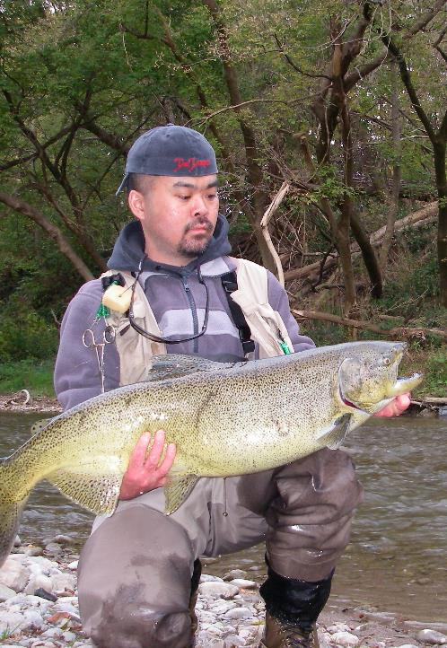
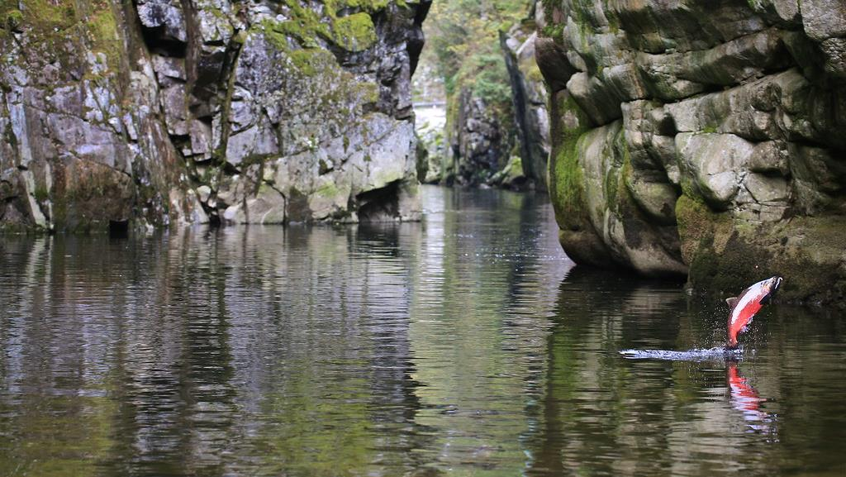
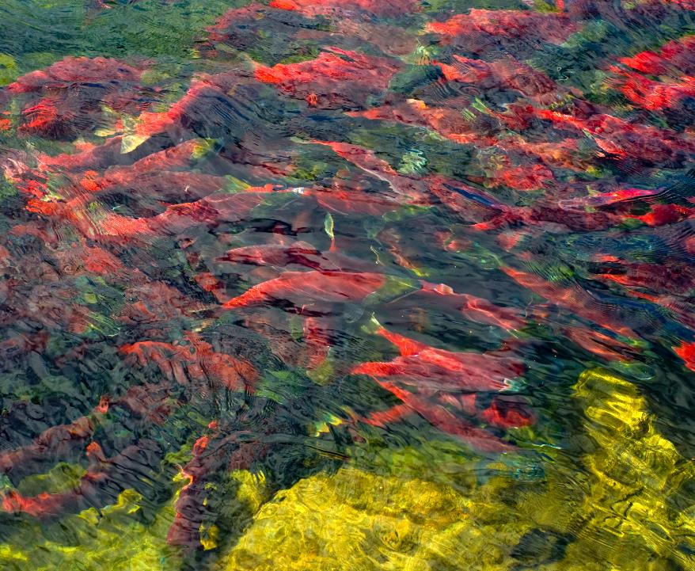
Conservation scope
Human wellbeing scope
(as affected by conservation)
Ecosystem Service
Conservation target
Human wellbeing target
PHOTO: EYESPLASH, FLICKR (CC)
PHOTO: KATRINA LIEBICH, USFWS
PHOTO: CO1867, FLICKR (CC)
Notes:
Learning Objective: This slide uses an example to explain human wellbeing & ecosystem services targets
Presenter’s Notes:
Depending on the project, we often explicitly recognize the ecosystem services that are derived from the conservation targets, and in turn the human well-being targets associated with those ecosystem services.
There are a wide variety of potential human wellbeing targets. A team may wish to consider the audience for their plan, relationship between conservation targets and human wellbeing, and if human wellbeing targets are a primary component of their work.
In this example, protecting an estuarian river target links through the service of providing salmon spawning habitat and corresponding salmon fisheries which links to the human wellbeing targets of salmon to provide livelihoods and food for people.
Photography Notes:
Salmon jumping: Eyesplash Flickr CC
Salmon spawning: Katrina Liebich USFWS CC
Salmon fisherman: Photograph by CO1867 Flickr CC

Slide 29
VIABILITY
Very Good
Good
Fair
Poor
Characteristics
Measures
Current status
Future goals
PHOTO: MAX GOTTS, UNSPLASH
Notes:
Learning Objective: This slide provides more details on the concept of Conservation Target Viability
Presenter’s Notes:
In this step, we determine what ecological characteristics define our target and how we will measure the health of each target.
What characteristics should we evaluate and what measures can we use to evaluate them?
How is each individual target currently doing? What is its current status?
Can we set measurable future goals describing how we hope our targets will fare in the future in response to our conservation actions?
To do this, we will need customized ratings. Optimally, these ratings will be quantitively robust and involve strong evidence, and where information gaps exist, we will document them. We will assign each a standard categorical description from poor to very good, with the differentiation between good and fair being a key point that identifies independent viability of the conservation targets.
Photography Notes: Photo by Max Gotts on Unsplash

Slide 30
THREATS
Degrade target viability
Human activities
Unsustainable harvest
Oil drilling, road construction
Industrial wastewater
Invasive species
Who?
PHOTO: ANASTASIA SHURAEVA, PEXELS
Notes:
Learning Objective: This slide explains and provides examples of direct threats
Presenter’s notes:
Direct threats (sometimes called pressures) are primarily human activities that immediately degrade target viability of a conservation target (e.g., unsustainable fishing, unsustainable hunting, oil
drilling, construction of roads, industrial wastewater, or introduction of exotic invasive species).
Direct threats can also be natural phenomena altered by human activities (e.g., increase in extreme storm events or increased evaporation due to global climate change) or
in rare cases, natural phenomena whose impact is increased by other human activities (e.g., a potential tsunami that threatens the last remaining population of an Asian rhino).
In identifying threats, it is important to specify the who the actors are (e.g. illegal fishers, poachers, specific companies). Your team may want to lump or split some threats depending on whether the actors are the same (e.g., you may split “poaching” into “poaching by organized syndicates” and “poaching by villagers”).
The synonym “pressure” may be helpful in cases where the term “threat” may not be well-received by stakeholders (e.g., ranchers or loggers) whose actions or
professions might be identified as a “threat.” It is also helpful to use adjectives such as “unsustainable” or “illegal” to clarify the nature of the threat (e.g.,
unsustainable ranching). Being explicit about the actors can assist your team with your stakeholder analysis and strategy development.
When discussing threats we are focusing on present and future threats, rather than threats of the past (like the commercial whaling that decimated the world’s great whale populations).
Photography Notes: Anastasia Shuraeva from Pexels

Slide 31
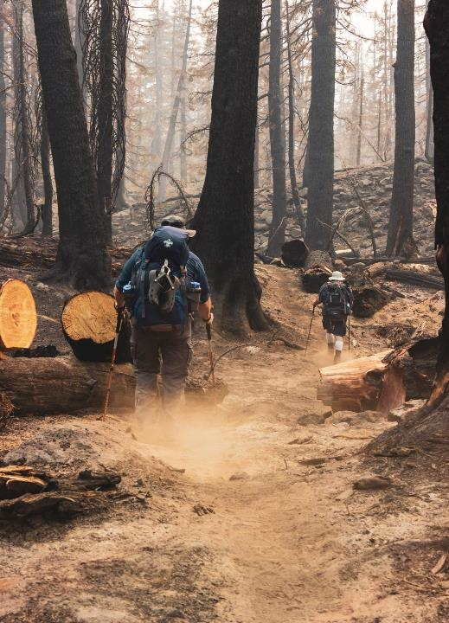
THREAT RATING
Very High
Scope
Severity
Irreversibility
Cumulative
High
Medium
PHOTO: ERIC SANMAN, PEXELS
Low
Notes:
Step 3 - Viability Analysis
15 December 2020
TNC & Foundations of Success
‹#›
Learning Objective: This slide is an introduction to threats and threat rating
Presenter’s Notes:
After we’ve brainstormed the human actions that are harming our conservation targets, we then go through a prioritization process to determine which threats posed the largest risk to our individual targets. We use standard criteria to evaluate the threats.
For a threat such as unplanned human-caused wildfire in a forest, first, we define the scope or area or percent of population it impacts.
Then, we determine the severity with which the fire impacts our target within this area.
Finally, we determine how long it would take our target to recover once the threat is removed. We call this irreversibility.
Together, these factors give us our Threat Rating from low to very high.
For Threats that affect multiple Targets, we can calculate a Cumulative Threat Rating describing how a single Threat can have a broader affect on the larger system we wish to conserve.
Photography Notes: Photo by Eric Sanman from Pexels;

Slide 32
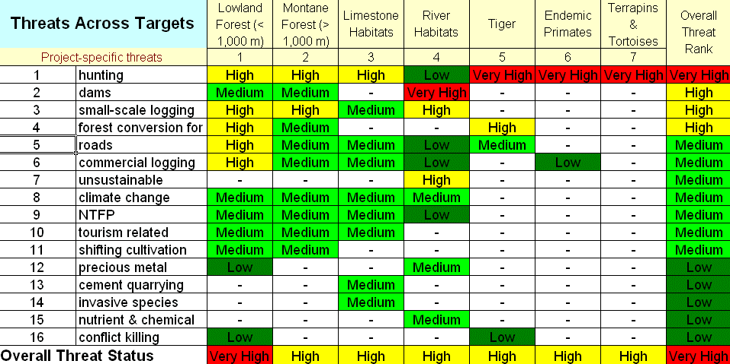
THREAT RATING
Notes:
Learning Objective: This slide shows a full threat rating table to explain the benefits of a full threat rating.
Presenter’s Notes:
This table shows what a full threat rating table looks like for a site – this could be developed using a spreadsheet or as an output of Miradi software.
The conservation targets are arrayed across the top – read them if you have time.
And a long list of threats is found along the left hand side of the table.
Each colored box is the combination of scope, severity, and threat ratings for one combination of threat and conservation target.
Along the right hand side are the combined ratings for each threat – and the treats have already been sorted from highest to lowest. This helps us understand the risk posed by each threat across the site.
At the bottom of each conservation target column are the combined threat ratings for each target – helping us understand which targets are most in danger.
And there is an overall site rating at the lower right hand corner – that would help us understand how threatened this site is compared to other sites.
Some final notes about this table:
This table is not the truth, but a representation of the best understanding of a team of conservation practitioners. This table might have been developed in a day, a week, or over the course of a year – we don’t know – but the team knows what went into it and how certain they are of the outputs.
There may be disagreement among the team about the final ratings and that’s OK – the point is to have a structured discussion about the level of each and all threats across the site so that a more objective understanding can be had.
Finally, a project team would not want to slavishly follow the results of the table and only work on the highest threats without thinking about it. Perhaps it makes sense to address low-hanging fruit like invasive species before they get out of hand…

Slide 33
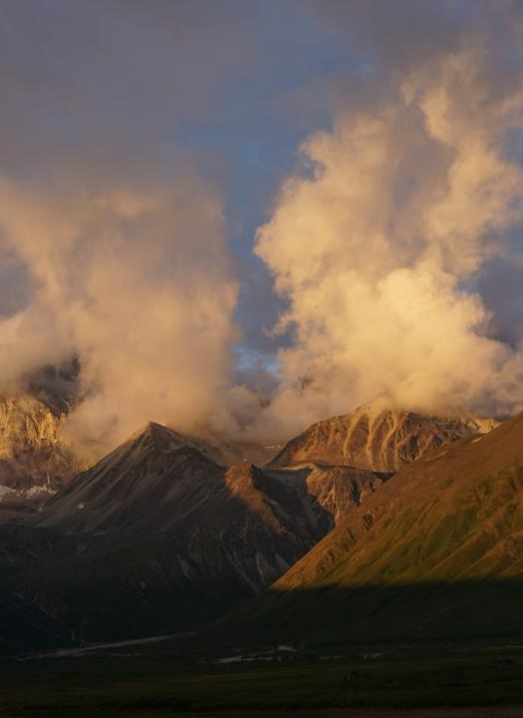
CLIMATE CHANGE
Threat by convention
Basic understanding
Deconstruct
Scenarios
Integrate
PHOTO: JOHN MORRISON, WWF
Notes:
Learning Objectives:
The purpose of this slide is twofold:
Let viewers know that the blue box in this slide will be repeated in the slide series – relating to climate change considerations
Provide some very basic general considerations for incorporating climate change into the Conservation Standards
Presenter Notes
We will periodically include notes about how to incorporate climate change into the Conservation Standards framework.
Here are some general considerations for incorporating climate change into the Conservation Standards:
Climate change itself is not a threat but we treat it as a threat by convention.
The Planning team must first have a basic understanding of Climate Change – otherwise the team may get completely overwhelmed. Some coaches recommend not even including a detailed look at climate change in a team’s first exposure to the Conservation Standards.
Deconstruct Climate Change into its components – one box saying “climate change” will only be so helpful. What the team needs to do is to break down the components of climate change, based on one (or more – see below) generally recognized climate scenario. Example of the components are:
More frequent and severe storms
Sea level rise
Less (or more) average rainfall
Longer periods of drought or extreme heat
Etc.
Modeling is suspect – review multiple models & consider Scenarios and Scenario Planning. It is important to not rely on only one climate (general circulation) model – there are ~20 available models, and if they are providing very different results – that is something to take into account with more than one climate scenario in your planning. If they all generally agree – that is also telling you something – that the future seems clear.
Combine (integrate) conventional & climate threats. The idea is to eventually develop your situation diagram with both the conventional (non-climate) threats and the climate threats – and to see how they are understood to interact – this will provide a more realistic picture of the situation, including the climate factors that you are unlikely to change in the coming decades.
Photography Notes: John Morrison; Brooks Range, Alaska

Slide 34
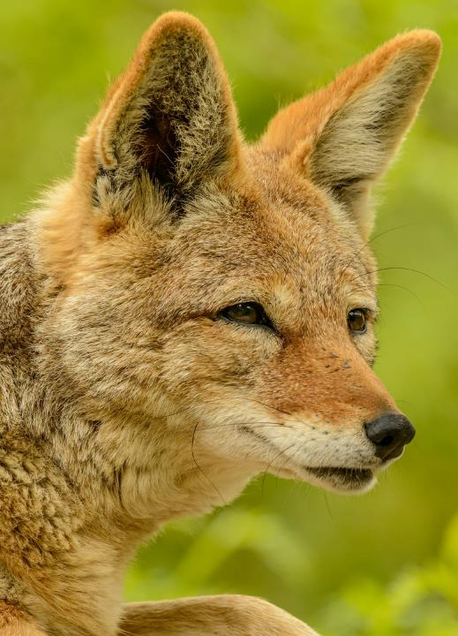
CONSERVATION SITUATION
Indirect threats & opportunities
Stakeholders
Situation model
Ground-truth & revise
PHOTO: PETR GANAJ, PEXELS
Notes:
Learning Objective: This slide explains the steps involved in doing a Situation Assessment
Presenters Notes:
Now that we’ve identified critical (direct) threats, we carry out a situation assessment.
To do that, we review available evidence to identify key drivers of our direct threats, i.e. those factors that affect our conservation targets and lead to their low viability. This process includes:
Identify and analyze indirect threats (also known as root causes or drivers) & opportunities
Assess stakeholders & their primary interests (Who is driving the threats or contributing factors?)
Build an initial situation model, narrative description or other representation of key cause-and-effect relationships among the factors that affect your project context
Ground-truth & revise our model. This is something we do iteratively throughout the life of our project.
Photography Notes: Coyote. Photo by Petr Ganaj from Pexels

Slide 35
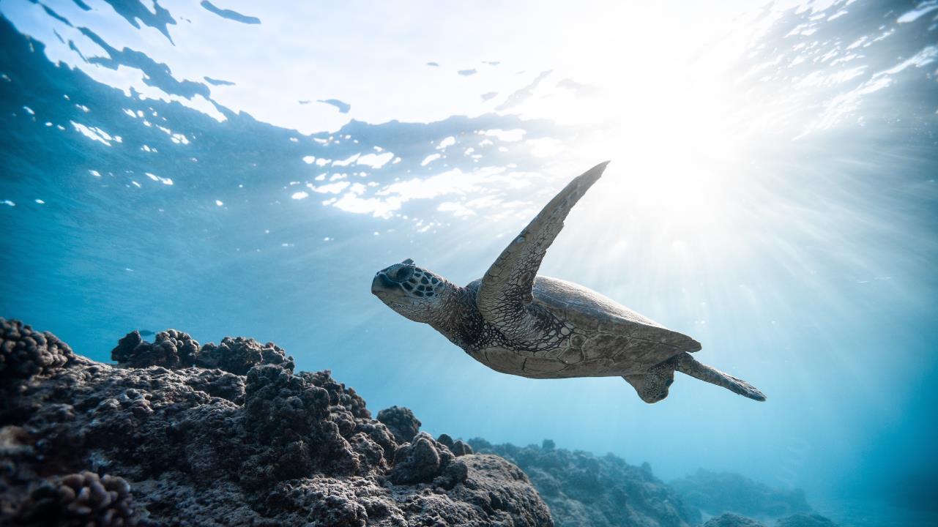
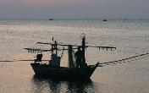
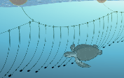
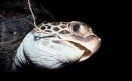
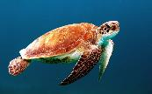
SITUATION MODEL
Eastern Pacific Sea turtles
+OPPORTUNITY
Fishers don’t want to harm turtles
Sea turtle bycatch reduces fishing efficiency
PHOTO: JEREMY BISHOP, PEXELS
Scope
Bycatch of sea turtles in longline fisheries
Target
Traditional fishing methods
Contributing Factor
Contributing Factor
Marine turtles
Contributing Factor
Reluctance to change gear
Fishers using
J hooks
Direct Threat
Notes:
Learning Objective: This slide explains how to construct a Situation Model by laying out an example from the Sea Turtle/Circle Hook project example.
Presenter’s notes:
We can capture the relationships between our targets and the various factors that impact them by constructing a situation model.
Let’s walk through an example; for that we’ll go to the Eastern Pacific and look at a project that aims to reduce turtle bycatch caused by longline fisheries.
CLICK
Scope: Here we have a target-based project - sea turtles in the Eastern Pacific Ocean
CLICK
Identify Conservation Targets: In this example, our conservation target is “Marine turtles.” (Clarify that scope and target in this example are similar.)
CLICK
Identify direct threats: Earlier we asked: What is harming the health of our targets? We mentioned unhealthy fishing practices. But let’s dive deeper (pardon the pun!):
In this example, the direct threat is the turtle bycatch in the Eastern Pacific Ocean's longline fisheries.
CLICK
Next, we analyze the key drivers of the threats (also called indirect threats/contributing factors).
One contributing factor is “Fishers using J hooks,” which is the most common way to catch fish in longline fleets in the Eastern Pacific.
CLICK
Contributing to that, is a reluctance to try new fishing gear.
CLICK
And contributing to that, are the traditional fishing methods handed down through generations – following what they were taught and lacking experience with (and trust in) alternative methods.
There are several other contributing factors, and you’ll see them in a bit in the full situation model. For now, we’re keeping the example simple to focus on the process.
CLICK THROUGH THE CS LABELS THAT DESCRIBE THE STORY JUST TOLD
FINALLY: To further illustrate the process, we’re going to add 2 more contributing factors:
The fact that Sea turtle bycatch reduces fishing efficiency, and
The fact that fishers really don’t want to harm sea turtles.
And, we recognize that these two are possible opportunities, which will come into play when we start brainstorming strategies.
Photography Notes:
Turtle: Photo: Jeremy Bishop from Pexels
Hawksbill turtle hooked on long-line Cocos Island Costa Rica. Photo: Jeff Rotman, WWF
Turtle on longline: Sea Turtle Conservancy
Longline hooks: Isaac Wedin, Flickr
Traditional fishing boat: Photo: Doug Heil from Pixabay

Slide 36
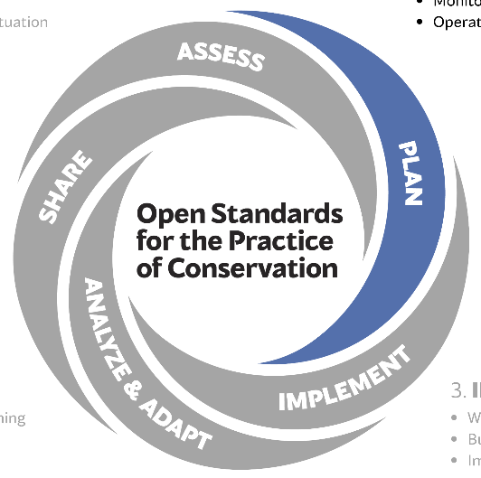
2. PLAN
Goals
Strategies
Theory of Change
Monitoring
Operations
Notes:
Learning Objective: Outline the sub-steps of Step 2: Plan.
Presenters Notes: We are now in Step 2: Plan. We will:
Establish goals for each target, based on our work defining viability
Consider a range of strategies based on our situation analysis and select which strategies to pursue
Develop a “theory of change” for each strategy to clarify exactly how we think they will work
Identify clear objectives and indicators that we can monitor to check progress for each theory of change
Identify broad actions to implement each theory of change
Pull together all the theories of change into an Operations plan so we can assess resources needed and develop proposals for funding and organisational approaches.
At the end of Step 2 we have all the elements of our Plan, which can be written up and shared with others. It includes what we want to achieve, how we will achieve them, global resources required and how we will measure progress along the way to ensure that we are doing the right things, and doing them well.
The next Step – Step 3 – is where we detail budgets, timelines, responsibilities and start implementing the plan and monitoring our progress.

Slide 37
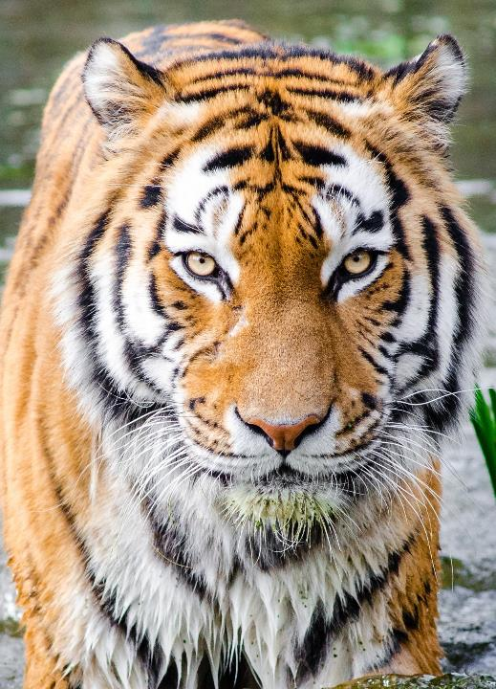
GOALS
Linked to conservation targets
Desired future status
S.M.A.R.T
PHOTO: RICHARD VERBEEK, PEXELS/FLICKR
Notes:
Learning Objective: details about what goals are
Presenter’s Notes:
Goals are linked to conservation targets for the project
They represent the desired future status of those targets over the long term. Essentially, they are formal statements of the ultimate impacts we hope to achieve.
A good goal meets “S.M.A.R.T.” criteria: Specific, Measurable, Achievable, Results-oriented, and Time-limited
Photography Notes: Tiger stalking. Photo: Richard Verbeek from Pexels/Flickr

Slide 38
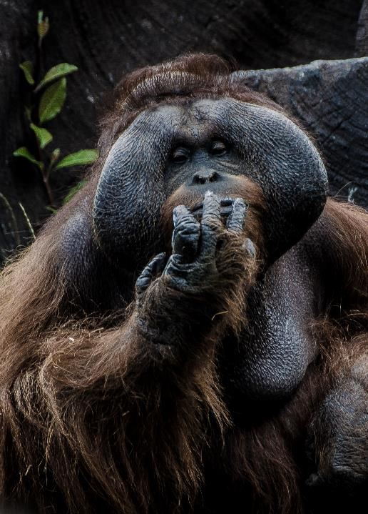
STRATEGIES
Prioritize
Intervention points
Process
Research existing strategies
Generate new strategies
Select optimal strategies
PHOTO: LUCA AMBROSI, UNSPLASH
Notes:
Learning Objective: details about conservation strategies
Presenter’s Notes:
When developing strategies, we prioritize the factors we need to influence to improve the situation we outlined in the situation analysis - these are the key intervention points.
To identify key intervention points, we need to evaluate all factors and, using available evidence, identify which ones are likely to impact the target the most and show good leverage opportunities for achieving project goals.
The act of generating and selecting strategies is generally a three-part process that includes:
Researching existing strategies: How have others attempted to intervene in similar situations? How successful were they?
Generating new strategies: Incorporate findings from situation analysis and strategy research (#1 above) to develop a range of possible solutions
Selecting optimal strategies based on available evidence.
The processes of determining and prioritizing key intervention points and generating and selecting strategies are very interrelated, and an iterative approach will prove valuable to decision-making. For example, one we complete the Theory of Change (results chains) for priority strategies, we may find that some strategies just won’t hold up and at that point, we may abandon them. This is a good thing, we we always want to avoid wasting our precious funding!
Photography Notes: Orangutan photo by Luca Ambrosi from Unsplash (46CIdzukUz4)

Slide 39
SITUATION MODEL 🡪 THEORY OF CHANGE
Test and promote circle hooks to reduce bycatch
INTERVENTION POINT
Strategy
PHOTO: JEREMY BISHOP, PEXELS
Traditional fishing methods
Contributing Factor
Contributing Factor
Bycatch of sea turtles in longline fisheries
Target
Contributing Factor
Reluctance to change gear
Fishers using
J hooks
Direct Threat
Marine turtles
Goal
Notes:
Learning Objective: How to develop a Results Chain from a Situation Model
Presenter’s notes:
To have an impact, we need to build a chain of results from the strategy to the target. This is our Theory of Change.
Photography Notes:
Background Turtle: Photo: Jeremy Bishop from Pexels
Target Turtle: Photo by Wexor Tmg on Unsplash
Hawksbill turtle hooked on long-line Cocos Island Costa Rica. Photo: Jeff Rotman, WWF
Turtle on longline: Sea Turtle Conservancy
Longline hooks: Isaac Wedin, Flickr
Traditional fishing boat: Photo: Doug Heil from Pixabay

Slide 40
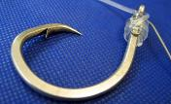
SITUATION MODEL 🡪 THEORY OF CHANGE
?
?
?
Strategy
Result
Result
Result
Target
Threat reduction objective
Goal
PHOTO: JEREMY BISHOP, PEXELS
Contributing Factor
Contributing Factor
Target
Strategy
Direct Threat
Marine turtles
Notes:
Learning Objective: Identify the elements of a results chain or theory of change
Presenter’s notes: Looking at our sea turtle example:
CLICK
On one side we have the Goal, preceded by a threat reduction objective
CLICK
And on the other, our chosen strategy ("Test and promote circle hooks to reduce bycatch” - image)
Question: (...to get from our strategy to an improvement in our target, what intermediate results could we possibly include here? (Just take a guess.)
Once we've determined our intermediate results, we will set objectives for the most important (impactful) ones. But more about that in a bit, when we walk through the process using our turtle example.
Photography Notes:
Background Turtle: photo by Jeremy Bishop from Pexels
Target Turtle: Photo by Wexor Tmg on Unsplash

Slide 41
By July 2008, equal or better target catch and reduced turtle catch using circular hooks.
By January 2009, > 60% fishers using circular hooks.
I
I
Share experimental results
Test and promote circle hooks to reduce bycatch
Effectiveness of circle hooks demonstrated
Fishers recognize advantages of circle hooks
Fishers accept and use circle hooks
Bycatch mortality in hook lines reduced
Marine turtles
Goal
Objective
Objective
Threat reduction objective
Collaborate with academia & fishing authorities
Evaluate circle hooks in longline fleet
Fishers can get circle hooks for free
By 2025, 10% increase from 2005 levels of turtles.
I
Develop protocol to test circle hooks
PHOTO: JEREMY BISHOP, PEXELS
Provide a hook exchange program
By January 2012, turtle capture rates below 50% of 2005 rates .
I
Notes:
Learning Objective: This slide shows how a theory of change includes broad activities, objectives, and indicators
Presenter’s Notes: We build our results chain by testing a series of “If… then… “ questions:
If we do …. then the result is …
If the results is … then we can achieve the next result…
And using our turtle example, a simplified results chain would be
If we “test and promote circle hooks” then we can
CLICK
Demonstrate the effectiveness of circle hooks
If we can demonstrate the effectiveness of circle hooks, then
CLICK
Fishers will recognise the advantages of circle hooks.
If fishers recognise the advantages of circle hooks, then
CLICK
They will accept and use circle hooks.
If they accept and use circle hooks, then
CLICK
Bycatch mortality in hook lines will be reduced
If Bycatch mortality in hook lines is reduced, then
CLICK
Turtle populations will increase
These intermediate results, being assumptions and uncertain, have objectives and indicators associated with them to make sure that we can test our theory, well before seeing any increase in turtle abundance.
CLICK
The first of the objectives tests the outcome of hook use on individual boats: “By July 2008, equal or better target catch and reduced turtle catch using circular hooks.”
CLICK
The second is that the outcome of the proportion of fishers using the hooks: “By January 2009, more than 60% of the fishers are using circular hooks”.
CLICK
If these two objectives are achieved, we want to see the outcome of fewer turtle deaths: (a threat reduction objective): “By January 2012, turtle capture rates below 50% of 2005 rates.”
CLICK
And finally , our positive IMPACT on turtle population –stated by the measurable goal:
By 2025, there is a 10% increase in the abundance of leatherback and green turtles compared to 2005 levels
CLICK
Progress towards each Objective need to be monitored by Indicators, each of which will need a monitoring method.
CLICK
And finally, broad activities were identified to
Collaborate with academia and fishing authorities,
Develop protocol to test the circle hooks and
Evaluate their efficacy in the artisanal longliner fleet, plus
various other activities once our early objectives have been met
Photography Notes: Turtle photo by Jeremy Bishop, Pexels

Slide 42
OPERATIONS
Monitoring
Activities
Assess resources
Risk
Exit
PHOTO: ROGER BRADSHAW, UNSPLASH
Notes:
Learning Objective: The Theory of Change for each strategy is pulled together into to set the overall Operations, Management or Strategic Plan
Presenter’s Notes:
From the ToC:
Monitoring activities are defined and costed
Broad implementation activities are defined and costed
Assess human, financial, & other resources and develop further strategies as needed to address any shortfalls in funding and capacity
Assess major project risks and determine mitigation activities
If appropriate, develop an exit strategy - how the project can wind up and hand ongoing operations over to project partners
Depending on the scale and complexity of the project, a formal Monitoring, Evaluation and Learning plan may be needed:
Define audiences, their information needs & preferred communication modes
Define Indicators & methods
Finalize Monitoring, Evaluation, & Learning Plan
Develop an Operational Plan
Assess risk and determine mitigation actions
Estimate project lifespan & exit strategy
Photography notes: Owl: Photo by Roger Bradshaw, Unsplash

Slide 43
UNDERSTANDING RISK
Clarify risk
Other tools
Results chains
Environmental & Social Safeguards
PHOTO: JONATHAN BOWERS, UNSPLASH
Notes:
Learning Objectives
The purpose of this slide is twofold:
Let viewers know that the blue box in this slide will be repeated in the slide series – relating to risk considerations
Provide some very basic general considerations for understanding risk via the Conservation Standards
Presenter Notes
We will periodically include notes about how to use the Conservation Standards framework to understand and address risk.
Here are some general considerations for understanding risk using the Conservation Standards:
Risk is a broad term, and many people use the term to mean different things – it is important to clarify risk and the definition with the group that you are working with so that communication is clear. Some people consider direct threats or their drivers to be risks (though that is not how we are using the term). There are risks associated with poor project design theory, poor project design, poor project implementation, and risks that strategies will fail for a host of unforeseen, reasons (political, financial, social).
Risk assessment and risk management is a large and thriving field unto itself. If the project you are working with seems to be high risk for some reason, consider reaching out for assistance - there are other tools that can be used in conjunction with the Conservation Standards if needed.
A great tool to understand risk is your results chains – they lay out the activities and results that your project is hoping for – use your results chains to systematically assess various risks to project success.
The need to have and implement Environmental & Social Safeguards is an emerging movement in conservation. It began with large multilateral institutions like the Global Environment Facility and the Global Climate Fund and then into bilateral aid agencies like USAID and GIZ. It will likely flow through to many if not most conservation organizations.
Photography Notes: Photo by Jonathan Bowers on Unsplash

Slide 44
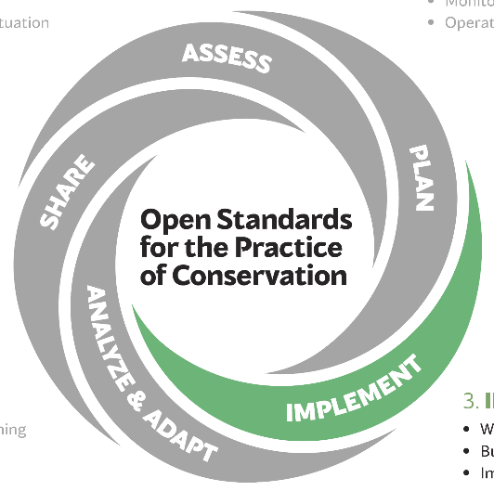
3. IMPLEMENT
Work plan, budget
Implement
Monitor
Report
Notes:
Learning Objectives: This slide briefly explains what Step 3: Implement is all about.
Presenter Notes
The third Step in the CS is to Implement the plan and Monitor progress. In Step 2, we developed the overall Management, Strategic or Operational PLAN
From this, we can develop work plans, budget and timelines to start the implementation
Proceed to implement the plan – typically the longest time period of any project – often occupying years, or even decades
And throughout, monitor the results of our activities
And ensure there is a functional reporting structure for monitoring and tracking progress
This is preparation for Step 4, where we analyze results to work out whether we need to adapt our actions or plans

Slide 45
WORKPLANS
Short-term detail
Budgets
Responsibilities
Timelines
Notes:
Learning Objective: This slide briefly explains what Step 3: Implement is all about
Presenter’s Notes:
Activities identified in the theories of change are the basis for workplans
These resolve the detail of who will be doing what and when – both implementation and monitoring activities
Depending on the scale of the project, they may be quarterly or yearly for at least the first year
These will also yield detailed budgets, responsibilities and timelines.

Slide 46
By July 2008, equal or better target catch and reduced turtle catch using circular hooks.
THEORY OF CHANGE to WORKPLAN
I
Test and promote circle hooks to reduce bycatch
Effectiveness of circle hooks demonstrated
Fishers recognize advantages of circle hooks
Fishers accept and use circle hooks
Bycatch mortality in hook lines reduced
Marine turtles
Goal
Objective
Objective
Threat reduction objective
Collaborate with academia & fishing authorities
Evaluate circle hooks in longline fleet
Fishers can get circle hooks for free
Develop protocol to test circle hooks
PHOTO: JEREMY BISHOP, PEXELS
Notes:
Learning Objective: This slide shows how a theory of change includes activities, objectives, and indicators
Presenter’s Notes:
Our case study’s strategy is to test and promote circle hooks to reduce bycatch of turtles.
CLICK
Broad activities were identified to
Collaborate with academia and fishing authorities,
Develop protocol to test the circle hooks
CLICK
Then we needed to
Evaluate their efficacy in the artisanal longliner fleet,
With the objective of “By July 2008, equal or better target catch and reduced turtle catch using circular hooks”
Using defined indicators to assess progress
Photography Notes: Turtle photo by Jeremy Bishop, Pexels

Slide 47
MS
Action | Who | Cost / Source | When | Output
Identify academics
Develop agreement
Secure funding
Action | Who | Cost / Source | When | Output
Identify academics | project manager | 10 days | 04/06 | Broad agreement
Develop agreement | project manager | 5 days | 06/06 | Signed agreement
Secure funding | project manager | $15,000 WWF | 12/06 | Grant secured
Test and promote circle hooks to reduce bycatch
Collaborate with academia & fishing authorities
PHOTO: JEREMY BISHOP, PEXELS
Notes:
Learning Objective: This slide series shows in table form how a broad strategy can be turned into a workplan with activities and timelines.
Presenter’s Notes
For the first activity
CLICK
Who will be doing the collaborating? – project manager? project officer? And with which academics?
If there are existing personnel, this may be obvious, but still a work plan is needed to allocate time and resources to achieve these tasks
Who are the academics? Will they require funding to conduct the research? Where will this come from?
This provides the basis for a detailed budget as well
Similarly, development of the testing protocol and evaluation of the circle hook efficacy will need to be broken down into tasks.
Photography Notes: Turtle photo by Jeremy Bishop, Pexels

Slide 48
Monitoring | Who | Frequency | Cost / Source | Comments
Fishing days | fisher | # boats | nil, fisher | Collate trips and locations
Number & type of turtles, hook type, location | observer | per trip | $60/day, 100 days | Develop standard data collection form with academics
Catch rate, spp & weights | fisher | per trip |  | Ability to compare hook efficiency
Evaluate circle hooks in Eastern Pacific
PHOTO: JEREMY BISHOP, PEXELS
By July 2008, equal or better target catch and reduced turtle catch using circular hooks.
I
Notes:
Learning Objective: This slide series shows in table form how monitoring is broken down into tasks
Presenter’s Notes:
Moving further along the results chain, the turtle project needed to evaluate the efficacy of circle hooks
CLICK
This had an objective and indicators to understand how well the project was progressing.
CLICK
This protocol to test circle hook efficacy needs to take into account the needs of statistical analysis
In this case monitoring is an integral part of the action plan and needs to be very carefully constructed
The general case is that monitoring is part of the tasks needed in the work plan
Monitoring activities will form part of the Theory of Change
A reporting structure will need to be sorted at this stage to ensure that the right data is collected in the right format and frequency
Whilst further work was needed to flesh out the Results Chain to:
Develop detailed work plans
Cost them
Time them
Allocate appropriate expertise and resources,
We can see that the Results Chain provides a very solid starting point for a detailed workplan, including monitoring.
Photography Notes: Turtle photo by Jeremy Bishop, Pexels

Slide 49
Monitoring
Fishing days
Number & type of turtles, hook type, location
Catch rate, spp & weights
Evaluate circle hooks in Eastern Pacific
REPORTING
PHOTO: JEREMY BISHOP, PEXELS
By July 2008, equal or better target catch and reduced turtle catch using circular hooks.
I
Notes:
Learning Objective: This slide series shows in table form how monitoring is broken down into tasks
Presenter’s Notes:
Moving further along the results chain, the turtle project needed to evaluate the efficacy of circle hooks
CLICK
This had an objective and indicators to understand how well the project was progressing.
CLICK
This protocol to test circle hook efficacy needs to take into account the needs of statistical analysis
In this case monitoring is an integral part of the action plan and needs to be very carefully constructed
The general case is that monitoring is part of the tasks needed in the work plan
Monitoring activities will form part of the Theory of Change
A reporting structure will need to be sorted at this stage to ensure that the right data is collected in the right format and frequency
Whilst further work was needed to flesh out the Results Chain to:
Develop detailed work plans
Cost them
Time them
Allocate appropriate expertise and resources,
We can see that the Results Chain provides a very solid starting point for a detailed workplan, including monitoring.
Photography Notes: Turtle photo by Jeremy Bishop, Pexels

Slide 50
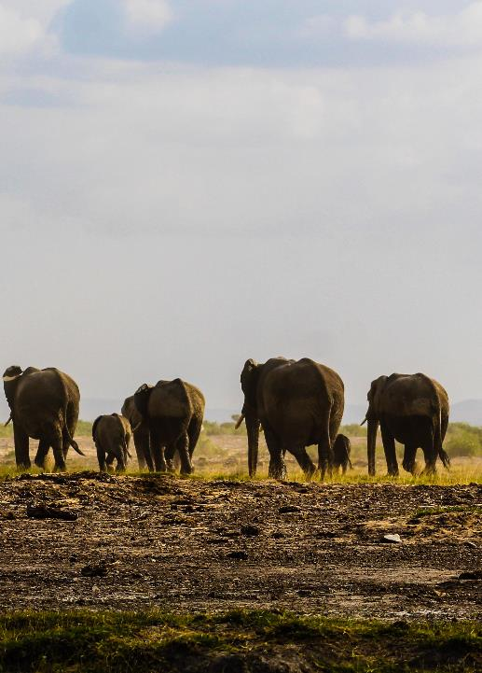
IMPLEMENT
Use the plan
Monitor
Report
PHOTO: ABSALOM ROBINSON, PEXELS
Notes:
Learning Objective: Using the plan
Presenter’s Notes:
Implementation converts the Plan into activity.
After all the work in developing plans, it is surprising that often, actual work deviates from planned work
This is not necessarily a problem, but monitoring is critical to ensure the work is still leading towards the intended outcomes
Similarly, from the outset of implementation, reporting systems need allow for subsequent analysis and any required adaptation
Photography Notes: Photo by Absalom Robinson from Pexels (2622266)

Slide 51
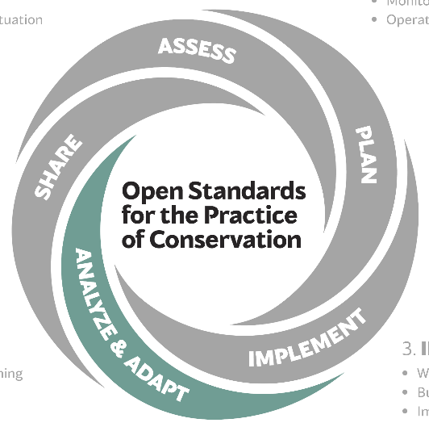
4. ANALYZE & ADAPT
Prepare
Analyze
Adapt
Notes:
Learning Objectives: Everyone is oriented to where we are in the five steps of the Conservation Standards.
Presenter Notes: We are now in Step 4: Analyze & Adapt. Here we look at the results of the monitoring and:
Prepare data for analysis
Analyze results and reflect on what has worked and what has not
Adapt the plan as necessary
All this happens iteratively during the project, not just at the end.

Slide 52
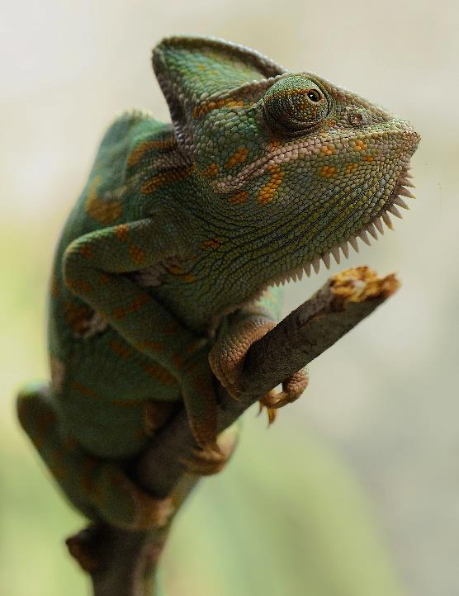
ANALYZE & ADAPT
Analyze data
Implementation: input/output
Effectiveness: outcomes
Status: impacts
Evaluate
How do we adapt?
PHOTO: PIXABAY
Notes:
Learning Objective: This slide explains what is meant by Analyze & Adapt
Presenter’s Notes:
The first level of analysis is about implementation.
This is frequent – maybe even monthly – and helps to understand how efficiently we are doing activities. It will also inform the degree to which we are following the plan. This analysis is about outputs.
[click]
The next level is about the effectiveness of our activities.
This is less frequent – probably several years – because it takes time to assess whether our activities and strategies are having the desired OUTCOMES.
[click]
And finally, we can analysis STATUS data. Are having the intended IMPACTS on the viability or health of our targets.
{click]
Each of these levels of analysis will build the evidence needed to EVALUATE whether we are doing the right things in the right ways.
[click]
Once our understanding is increased, we can then make informed decisions about changing our approaches, where needed.
Photography Notes: Photo: Pixabay

Slide 53
By July 2008, equal or better target catch and reduced turtle catch using circular hooks.
ANALYZING RESULTS
?
By January 2009, > 60% fishers using circular hooks.
?
Test and promote circle hooks to reduce bycatch
Effectiveness of circle hooks demonstrated
Fishers recognize advantages of circle hooks
Fishers accept and use circle hooks
Bycatch mortality in hook lines reduced
Marine turtles
Goal
Objective
Objective
?
?
Threat reduction objective
Fishers can get circle hooks for free
By 2025, 10% increase from 2005 levels of turtles.
PHOTO: JEREMY BISHOP, PEXELS
Collaborate with academia & fishing authorities
By January 2012, turtle capture rates <50% of 2005 rates .
Develop protocol to test circle hooks
Notes:
Learning Objective: This slide explains how the Theory of Change is again used to analyze effectiveness
Presenter’s Notes:
In our case study – we start with the PLAN:
Our target goal is to increase turtle populations, and our strategy is to test and promote circle hooks to reduce turtle bycatch
Our threat reduction objective is to reduce bycatch from longline fishing
Two intermediate objectives are effectiveness of the hooks demonstrated and fishers using hooks
Our actions start with testing, deploying and monitoring the effectiveness of the new hooks, prior to having them adopted by the fishers
As work progresses, we’ve set out indicators for these steps, which we analyze:
Actions – do the circle hooks work? Are they catching as many fish, but not catching turtles?
Strategy - Do the fishers accept them as a viable alternative to J hooks? What proportion of boats are using them?
Threat reduction – are fewer turtles being killed?
Impact on our target – are there more turtles?
Photography Notes: Turtle photo by Jeremy Bishop, Pexels

Slide 54
ADAPTATION
Other strategies?
Other strategies?
Test and promote circle hooks to reduce bycatch
Effectiveness of circle hooks demonstrated
Fishers recognize advantages of circle hooks
Fishers accept and use circle hooks
Bycatch mortality in hook lines reduced
Marine turtles
Goal
Objective
Objective
Threat reduction objective
Understand?
Other threats?
Fishers can get circle hooks for free
PHOTO: JEREMY BISHOP, PEXELS
Collaborate with academia & fishing authorities
Actions OK?
Develop protocol to test circle hooks
Notes:
DUPLICATE
Learning Objective: This slide explains the how we evaluate the results of the analysis to adapt our work as needed
Any need for adaptation comes from how well we have met our objectives.
This happens over time, with the first questions being about our activities.
The first most simple questions are about implementation (input/output)
Did we do the work/actions as set out in the plan? Was it on time and budget?
If not, maybe we were doing the wrong things or doing them poorly and need to adapt
If our work was OK, we subsequently ask questions about effectiveness of the strategy (outcomes)
Did the hooks as well as hoped?
If not, maybe the advantages of circular hooks is less than expected, and we need to look to other strategies
Do the fishers accept hooks as advantageous?
Can they access the hooks easily?
If not, maybe we missed something about how the fishers operate – we need to understand the process better
If that was OK, we subsequently ask questions about our threat reduction (outcomes):
Has the bycatch rate dropped?
Were the fishers using the hooks well?
If not, maybe we missed something about how fishers deploy their lines and we need to address this.
And finally, questions about how well we achieved our Goal (impact)
Was the Goal achievable?
Were factors outside our control impacting on the turtles?
If not, maybe the threat of by-catch was not driving turtle loss, and we need to address other threats.
Photography Notes: Turtle photo by Jeremy Bishop, Pexels

Slide 55
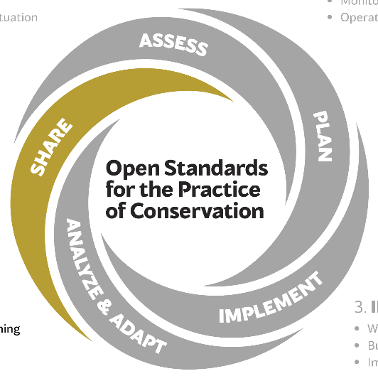
5. SHARE
Document
Share
Foster learning
Notes:
Learning Objectives: Everyone is oriented to where we are in the five steps of the Conservation Standards.
Presenter Notes: We are now in Step 5: Share. Here we:
Document results and knowledge gained to build the evidence base
Share within the team, to funders and interested parties
Foster a performance and learning culture within the project team, across the organization & partners, and among conservation practitioners around the world.

Slide 56
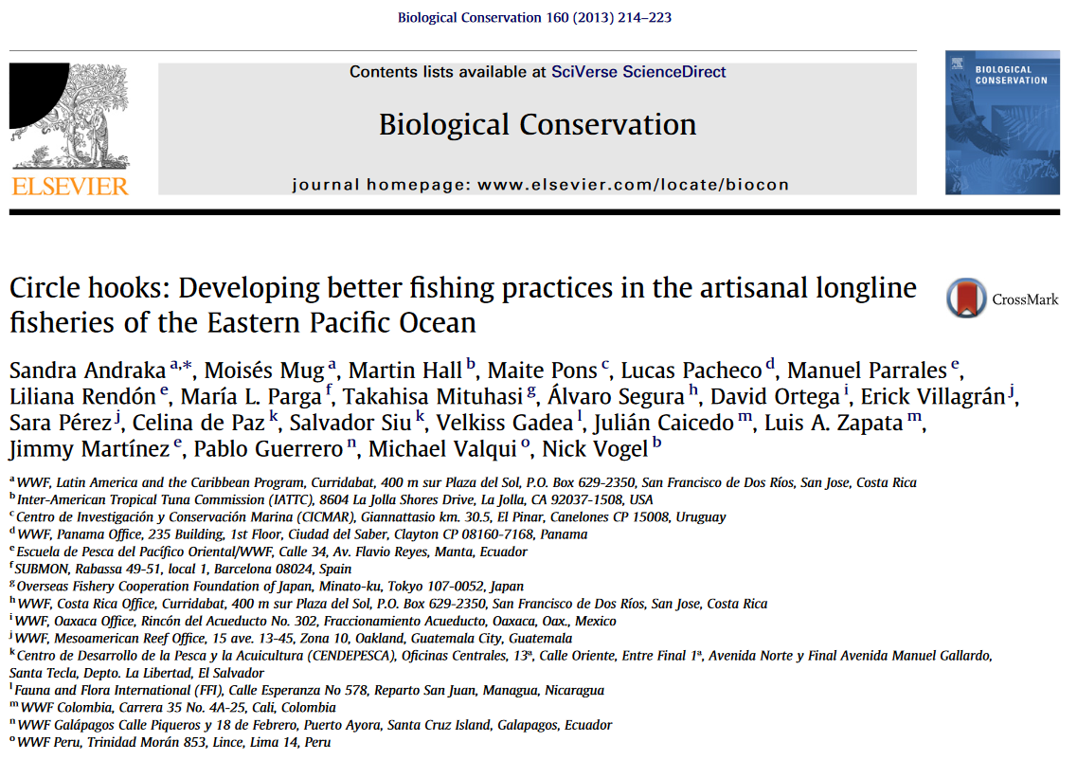
DOCUMENT
Building evidence base
Successes AND failures
Trust
Notes:
Learning Objective: This slide explains why sharing your learning is so important
Presenter’s Notes:
External sharing means building the evidence base for conservation action. Your success and failures can help other people learn and do things better.
Help others learn from your experience:
Successes help people to implement strategies with confidence.
Failures help people to avoid an approach that has proved to be less useful
Telling the story of success and failures helps to build confidence and trust in the sector.
Reference:
Andraka etal (2013) Circle hooks: Developing better fishing practices in the artisanal longline fisheries of the Eastern Pacific Ocean. BIOLOGICAL CONSERVATION, 160 (2013) 214-224. doi:10.1016/j.biocon.2013.01.019
.

Slide 57
SHARE
Formal communication
Range of options
Management recommendations
PHOTO: MATT TURNER
Notes:
Learning Objectives: Understanding of what should be shared with others.
Presenter’s Notes: Targeted formal communication products will help you share your findings with practitioners around the world.
There are a range of options for sharing your findings more broadly, including contributing to evidence libraries, publishing in scientific journals, posting lessons on your website, sharing learning via social media, and telling your stories at workshops and conferences.
When sharing lessons, you should provide:
• Clear management recommendations (based on your analysis) to the right people;
• Necessary details to help support your recommendations and interpret results; and
• Alternatives and contingencies based on the results
Photography Notes: Matt Turner – Laura Rangers

Slide 58
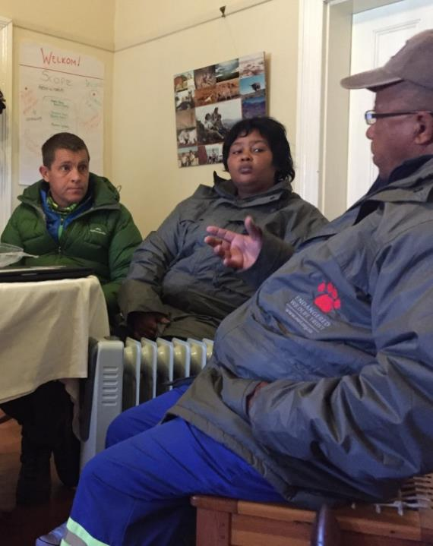
FOSTER LEARNING
Evaluations
Audits
Embrace innovation
Accept failure
PHOTO: MARIKA SUVAL
Notes:
Learning Objective: This slide explains why fostering a learning environment is so important
Presenter’s Notes:
Organisations seeking and providing feedback both internally and externally create better potential to learn and grow.
These may be
evaluations which assess a project against its own stated goals and objectives, or
audits, which assess a project against a set of process standards.
The conservation sector needs to get better at achieving real outcomes. This is what motivates many in the sector, where personal values align well with organisational values.
People are more willing to:
Embrace innovation and try unusual approaches where the organisation fosters learning and
Embrace and accept failure as a cost of innovation.
There is a real thirst for EFFECTIVE environmental action, but the results need to be real and communicated well.
Venture capital, crowd funding and local environmental action all need confidence that their effort translates to results.
Photography Notes: Photo by Marika Suval (EWT Drylands Team discussing aspects of their strategic plan)
Reference:
Stewart (2016) Open Standards Support for the Impact Investing Market – An outline of a significant new funding source, showing how use of the Open Standards can position organisations to access it. Fulbright Scholarship, Melbourne Australia.
.

Slide 59
TOOLS AND SUPPORT
TOOLS AND SUPPORT
PHOTO: PEXELS
Notes:
Learning Objective: Divider slide introducing the next section which outlines what tools and support exists for coaches and practitioners of the CS
Presenter’s Notes: there are a number of resources that Conservation Standards practitioners can use to assist with the process.
Photography Notes: Pexels: Brown Ostrich

Slide 60
RESOURCES
Coaches network
Training & guidance
Miradi software
Teaching network
Standard classifications
PHOTO: JOHN MORRISON, WWF
Notes:
Learning Objective: Participants understand the range of resources available to them for the practice of the Conservation Standards
Presenter’s Notes:
There are a range of resources available to practitioners of the Conservation Standards
There is a network of coaches network of trained and experienced “Conservation Coaches” to teach the Conservation Standards and facilitate CS planning processes.
There are live remote & in-person basic Conservation Standards training & guidance, stored online trainings, and many guidance documents and Powerpoints.
There are desktop and online versions of “Miradi” software, which is a non-profit package and means “project” in Swahili.
There is a teaching network of universities and professors that include the Conservation Standards in their undergraduate and graduate curricula.
There are a couple of standard classifications that may provide additional help to assist an organization in standardizing terminology.
The next few slides go into these resources in a bit more detail…
Photography Notes: John Morrison; Revelation Mountains, Alaska, USA

Slide 61
COACHES NETWORK
PHOTO: FELIX CYBULLA (CYBULLA.ORG)
Notes:
Learning Objective: Participants learn what CCNet is and how it can help them.
Presenter’s Notes:
The Conservation Coaches Network (CCNet) is a global community of trained professional coaches that use the Conservation Standards to strengthen conservation action and results around the world. CCNet trains and supports Conservation Coaches to teach and to lead Conservation Standards-based conservation projects and programs. Coaches help teams through the CS process. Coaches link practitioners with other support services and identify peer projects where project leaders can find additional review and support for similar challenges. Coaches also actively promote the Conservation Standards around the world.
Photography Notes: Felix Cybulla; 2014 Monatura CCNet Coaches Rally in Catalonia, Spain.

Slide 62
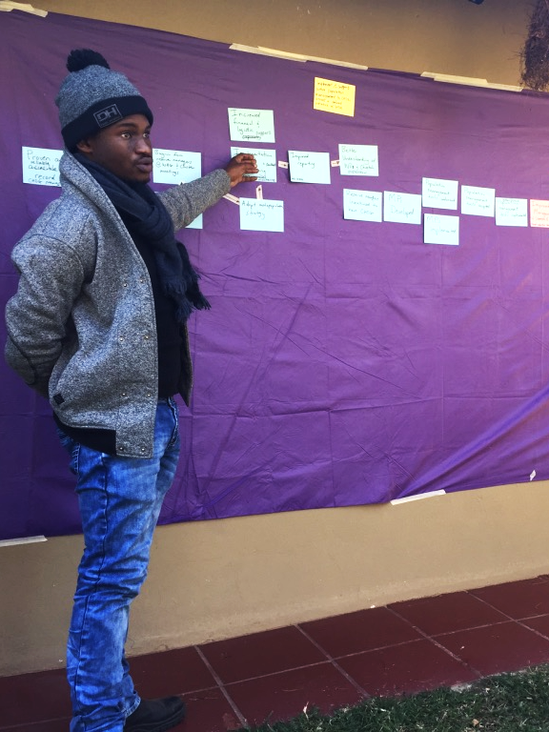
TRAINING
Basic Conservation Standards
Coach training
PHOTO: MARIKA SUVAL
Notes:
Learning Objective: Participants should understand the range of training available to them.
Presenter’s Notes:
Basic Conservation Standards Training can happen in a variety of formats, like this one. It can be as light as a 30-minute presentation or take place over the course of a week during the development of an actual conservation project.
Unfortunately, basic Conservation Standards trainings are not as easy to find as we’d like them to be. Many practitioners have access to them in the medium- to large-size conservation organizations they work for. Other trainings are offered at conservation meetings like Society for Conservation Biology or the Wildlife Society. More opportunities are developing, and we hope that before long there are several opportunities offered to anyone each year.
Coach training - over the last 10 years, CCNet has continuously developed a consistent curriculum and format for training coaches that last the course of a week. The training is for those already experienced with the Conservation Standards, who have the opportunity or the mandate to lead conservation project teams, and who feel ready and the desire to increase their knowledge.
Coaches can be self-taught, but most go through an intensive week-long coach training facilitated by 3 experienced trainers. Participants are assumed to have a fair amount of experience with the Conservation Standards already and be motivated to lead.
Photography Notes: Andrew Bridges; 2016 CCNet Coach Training in Colorado Springs, Colorado, USA.

Slide 63
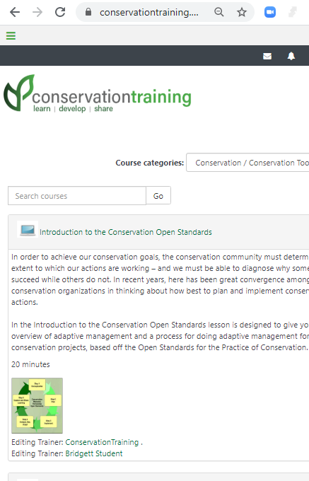
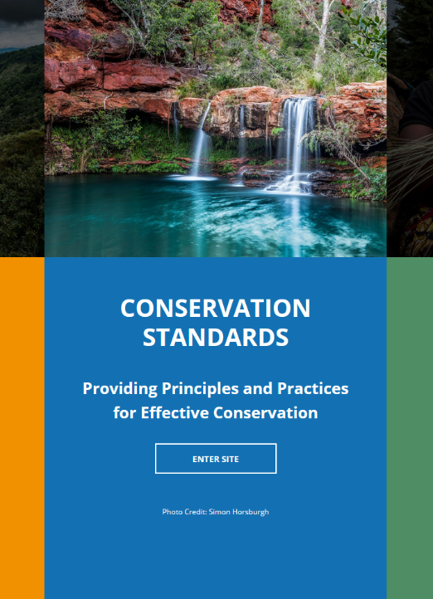
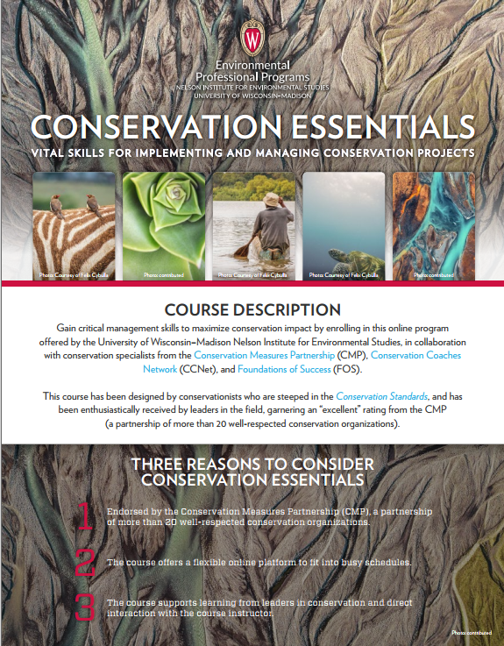
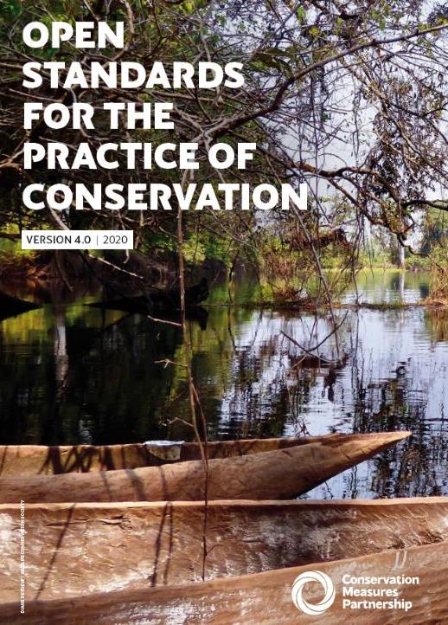
GUIDANCE
Conservation Standards 4.0
Conservation Standards website
Conservationtraining.org course
University of Wisconsin Step 3 course
FOS & WWF websites
Notes:
Learning Objective: Participants should understand the range of guidance materials available to them.
Presenter’s Notes:
The most basic CS resource is the Conservation Standards 4.0 document which explains the process and the reasoning behind all of the steps. That said, it is not intended as a practical how-to guide. For that, other resources will be more helpful.
There are helpful presentations for all of the steps+ on the Conservation Standards website.
Conservationtraining.org has an online course for Steps 1 & 2
The University of Wisconsin Step 3 course is online and carries a significant financial cost for students, but the videos are freely available to stream (and they are working on further steps 4 & 5).
Finally, Foundations of Success (a quasi-NGO) and WWF have extensive CS materials. They can be found on the FOS & WWF websites. WWF materials can be found by searching for the Project & Programme Management Standards.
Photography Notes: Screenshots

Slide 64
MIRADI SOFTWARE
Notes:
Learning Objective: Participants are familiar with the benefits of using Miradi and/or Miradishare – and realize that the software is NOT the Conservation Standards .
Presenter’s Notes:
Miradi - a Swahili word meaning "project" or "goal" - is a user-friendly program that allows nature conservation practitioners to design, manage, monitor, and learn from their projects to more effectively meet their conservation goals, following the process laid out in the Conservation Standards. Note that the software is not the CS itself, but software that can help facilitate the process, store information, and manage a project.
There are both desktop and online (Miradishare) versions. The online version is meant to facilitate easier collaboration and roll ups of parent and child projects.
There is a Miradi YouTube Channel with short 2-8 min tutorial videos on how to best use Miradi Desktop and Miradi Share.
The Miradi software program is a non-profit joint venture between the Conservation Measures Partnership (CMP) and Sitka Technology Group. There is a cost associated with Miradi though there is a 60-day free trial – and that software will keep working (without a license it just won’t get updated).

Slide 65
UNIVERSITY NETWORK
Academic focus
PHOTO: ANDREW BRIDGES
Notes:
Learning Objective: Participants understand what the TAM Network is all about.
Presenter’s Notes:
There is network of people focused on teaching the Conservation Standards with an academic focus, called the Teaching Adaptive Management (TAM) network.
The TAM network serves faculty, staff, students, and coaches who are involved or interested in conservation adaptive management courses at universities or other academic institutions. Through TAM, members share tried-and-tested resources, experiences, and insights for bringing the Conservation Standards to the classroom and integrating adaptive management training into applied conservation curricula. Find out how to start a course, find a course near you or check out their webinar series at the CCNet website.
Academic courses that bring together students and practitioners to apply the CS to real conservation projects has proven time and again to be a win-win collaboration.
Practitioners get:
An opportunity to systematically apply the OS to their work
Useful draft management plans and recommendations
A cadre of prospective staff / interns with AM skills
Students get:
Fluency in Open Standards – looks great on a resume!
An opportunity to gain hands-on experience applying AM skills to real-world projects
Exposure to the realities and challenges of conservation practice
There are already undergraduate and graduate level university courses on the Conservation Standards taught around the world, and the TAM network wants to help you get another course started.
Photography Notes: Andrew Bridges; CCNet coach training in Julian, California, USA 2020.

Slide 66
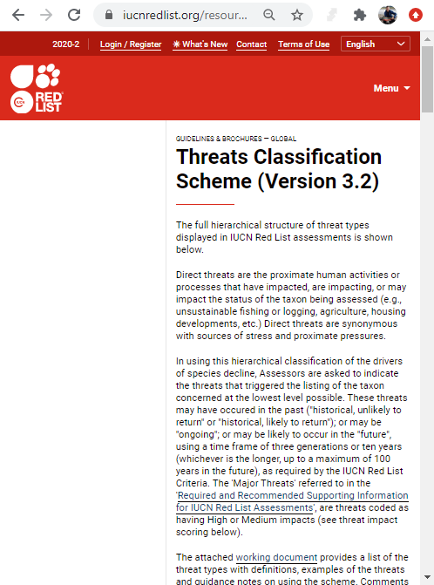
STANDARD CLASSIFICATIONS
CMP & IUCN
Standardized threats
Standardized actions
Notes:
Learning Objectives: To understand what the CMP/IUCN Standard Classifications are and how they might be useful in the context of the Conservation Standards.
Presenter’s Notes:
To allow information about threats and strategies to be analyzed, and to ensure uniformity when describing the habitat in which a taxon occurs, the threats to a taxon, what conservation actions are in place or are needed, and whether or not the taxon is utilized, a set of standard terms (Classification Schemes) have been developed by CMP & IUCN. These include names for standardized threats and standardized actions.
This helps practitioners talk to each other and not past each other.
References:
Conservation Biology. 2008. A Standard Lexicon for Biodiversity Conservation: Unified Classifications of Threats and Actions.

Slide 67
SUMMARY
Evidence-based Management & Adaptive Management
Conservation Standards used
Overview of CS 4.0
Tools & Support
Adaptive management
PHOTO: QUANG NGUYEN, PEXELS
Notes:
Learning Objective: This slide summarizes what has been covered in this slide set.
Presenter’s Notes: So, in this presentation, we have reviewed:
Why evidence-based management is important and when to use adaptive management (where there is uncertainty). Often we use both in our projects.
Where the are Conservation Standards used, and the variety of projects they can be used for
An overview of CS 4.0 as a set of tools and approaches that provide a powerful and adaptable conservation planning framework
Where to find tools & support for all aspect of the Conservation Standards.
Photography Notes: Photo by Quang Nguyen from Pexels (2131967)

